Slide 1
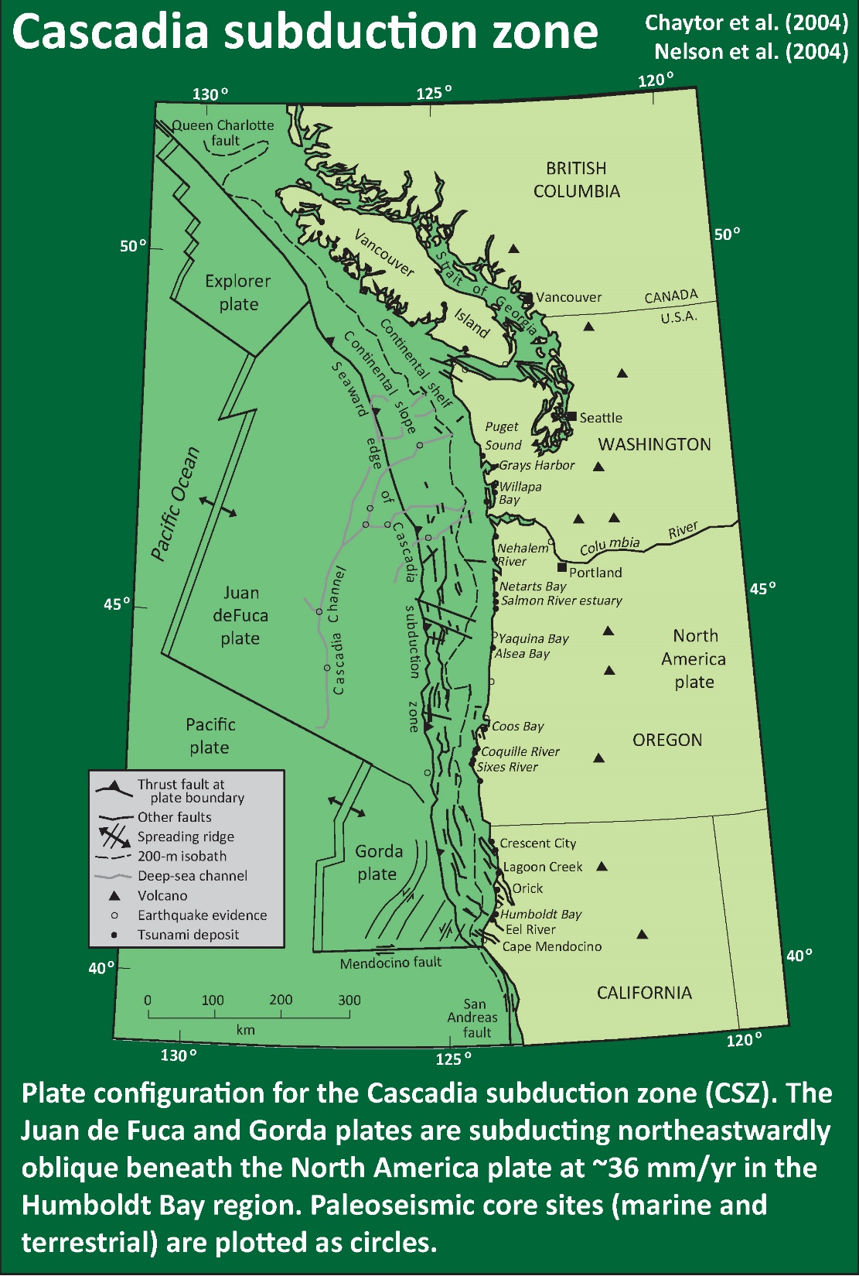
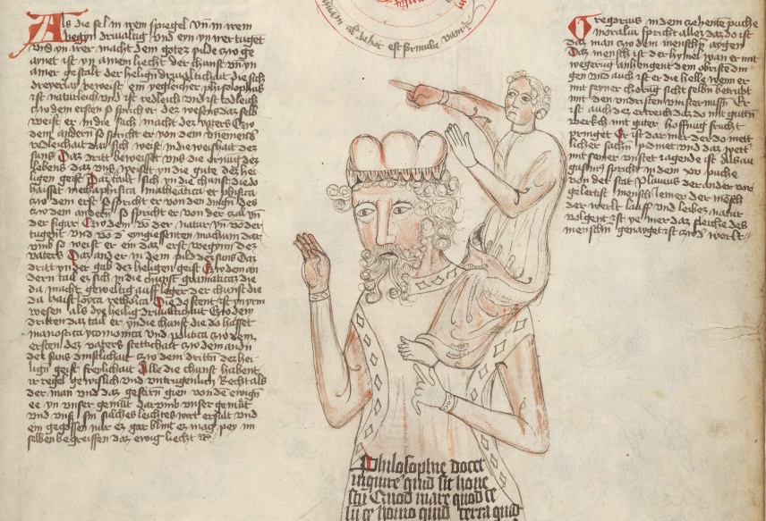
Bradley Lake: There and Back Again, Additional Sedimentary Evidence for Earthquakes
Jason “Jay” R. Patton Jason.Patton@humboldt.edu
Chris Goldfinger gold@ceoas.oregonstate.edu
Bradley
Lake
With material from fellow jerks:
Eileen Hemphill-Haley
Harvey Kelsey
Ann Morey
Alan Nelson
Rob Witter
“standing on the shoulders of giants”

Slide 2
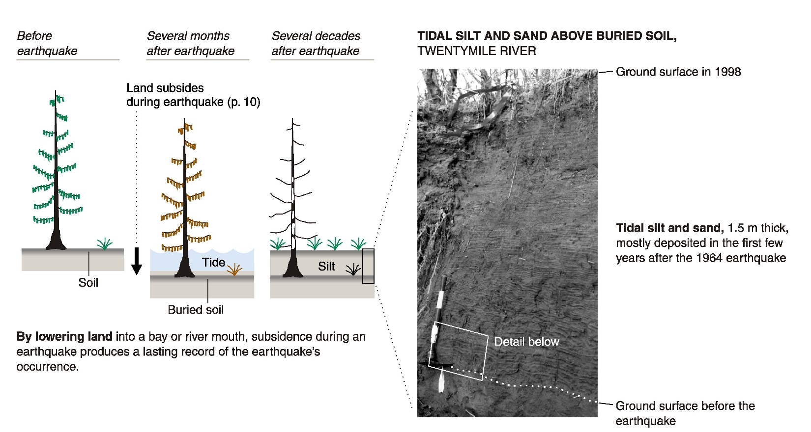
Atwater et al., 2005

Slide 3
past
tsunami
evidence
Atwater et al., 2005

Slide 4
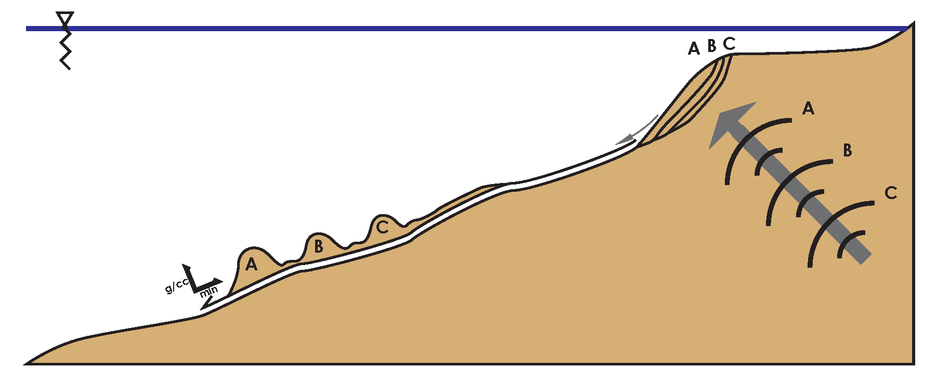
Earthquakes, ground motions, landslides, turbidity currents, and turbidites:
Earthquake creates Ground Motions
Ground Motions trigger Landslides
Landslides transform into Turbidity Currents
Turbidity Currents leave deposits called Turbidites
Submarine
Landslides
Ground Motions
Turbidity Current
Earthquake

Slide 5
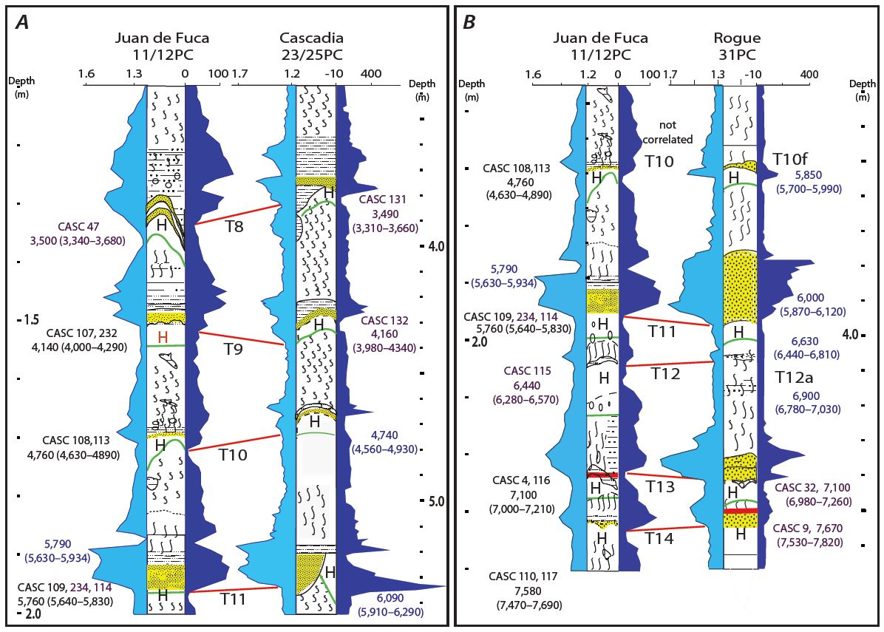
Goldfinger et al., 2012

Slide 6
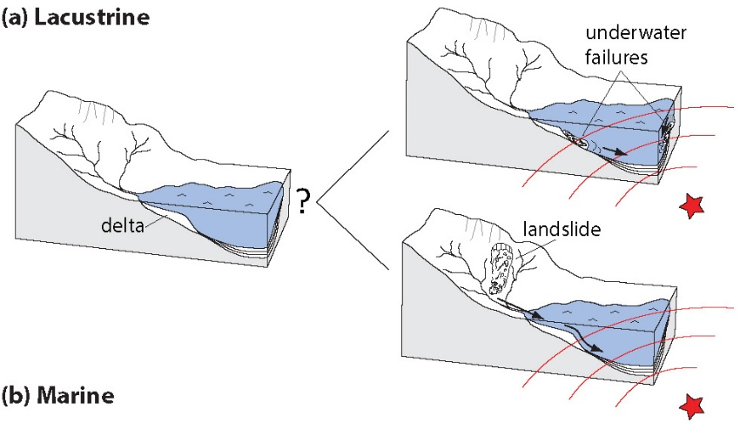
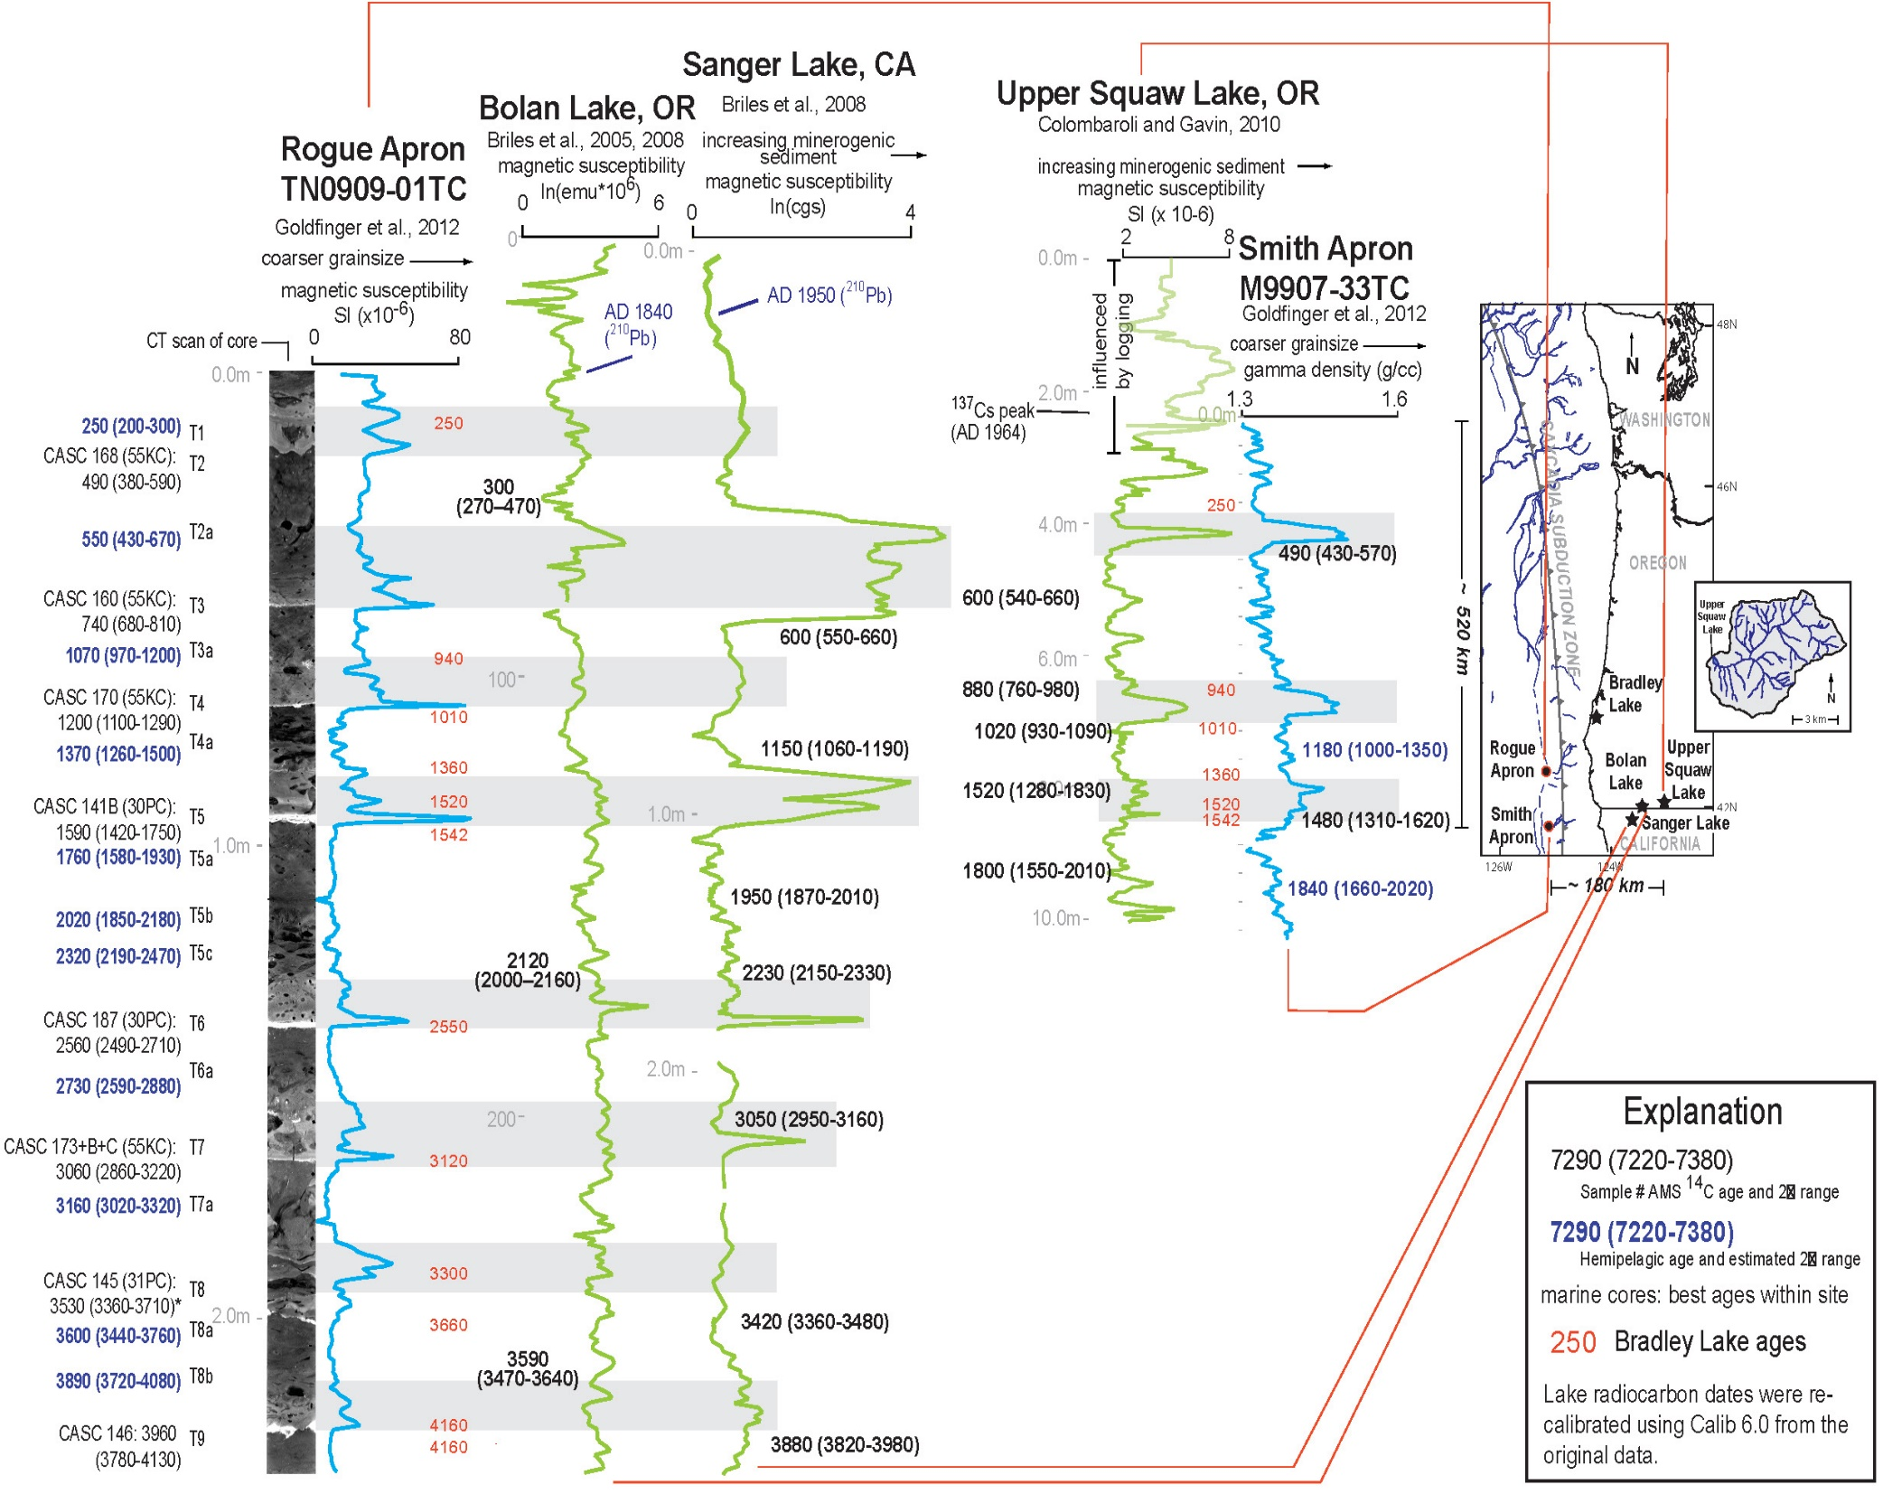
Morey et al., 2013
Schematic showing a comparison between (a) two possible scenarios for mechanisms to explain seismogenic terrigenous layers in lake sediments. Shaking from a subduction zone earthquake will either dislodge material internal to the lake (above) or external to the lake (below).

Slide 7
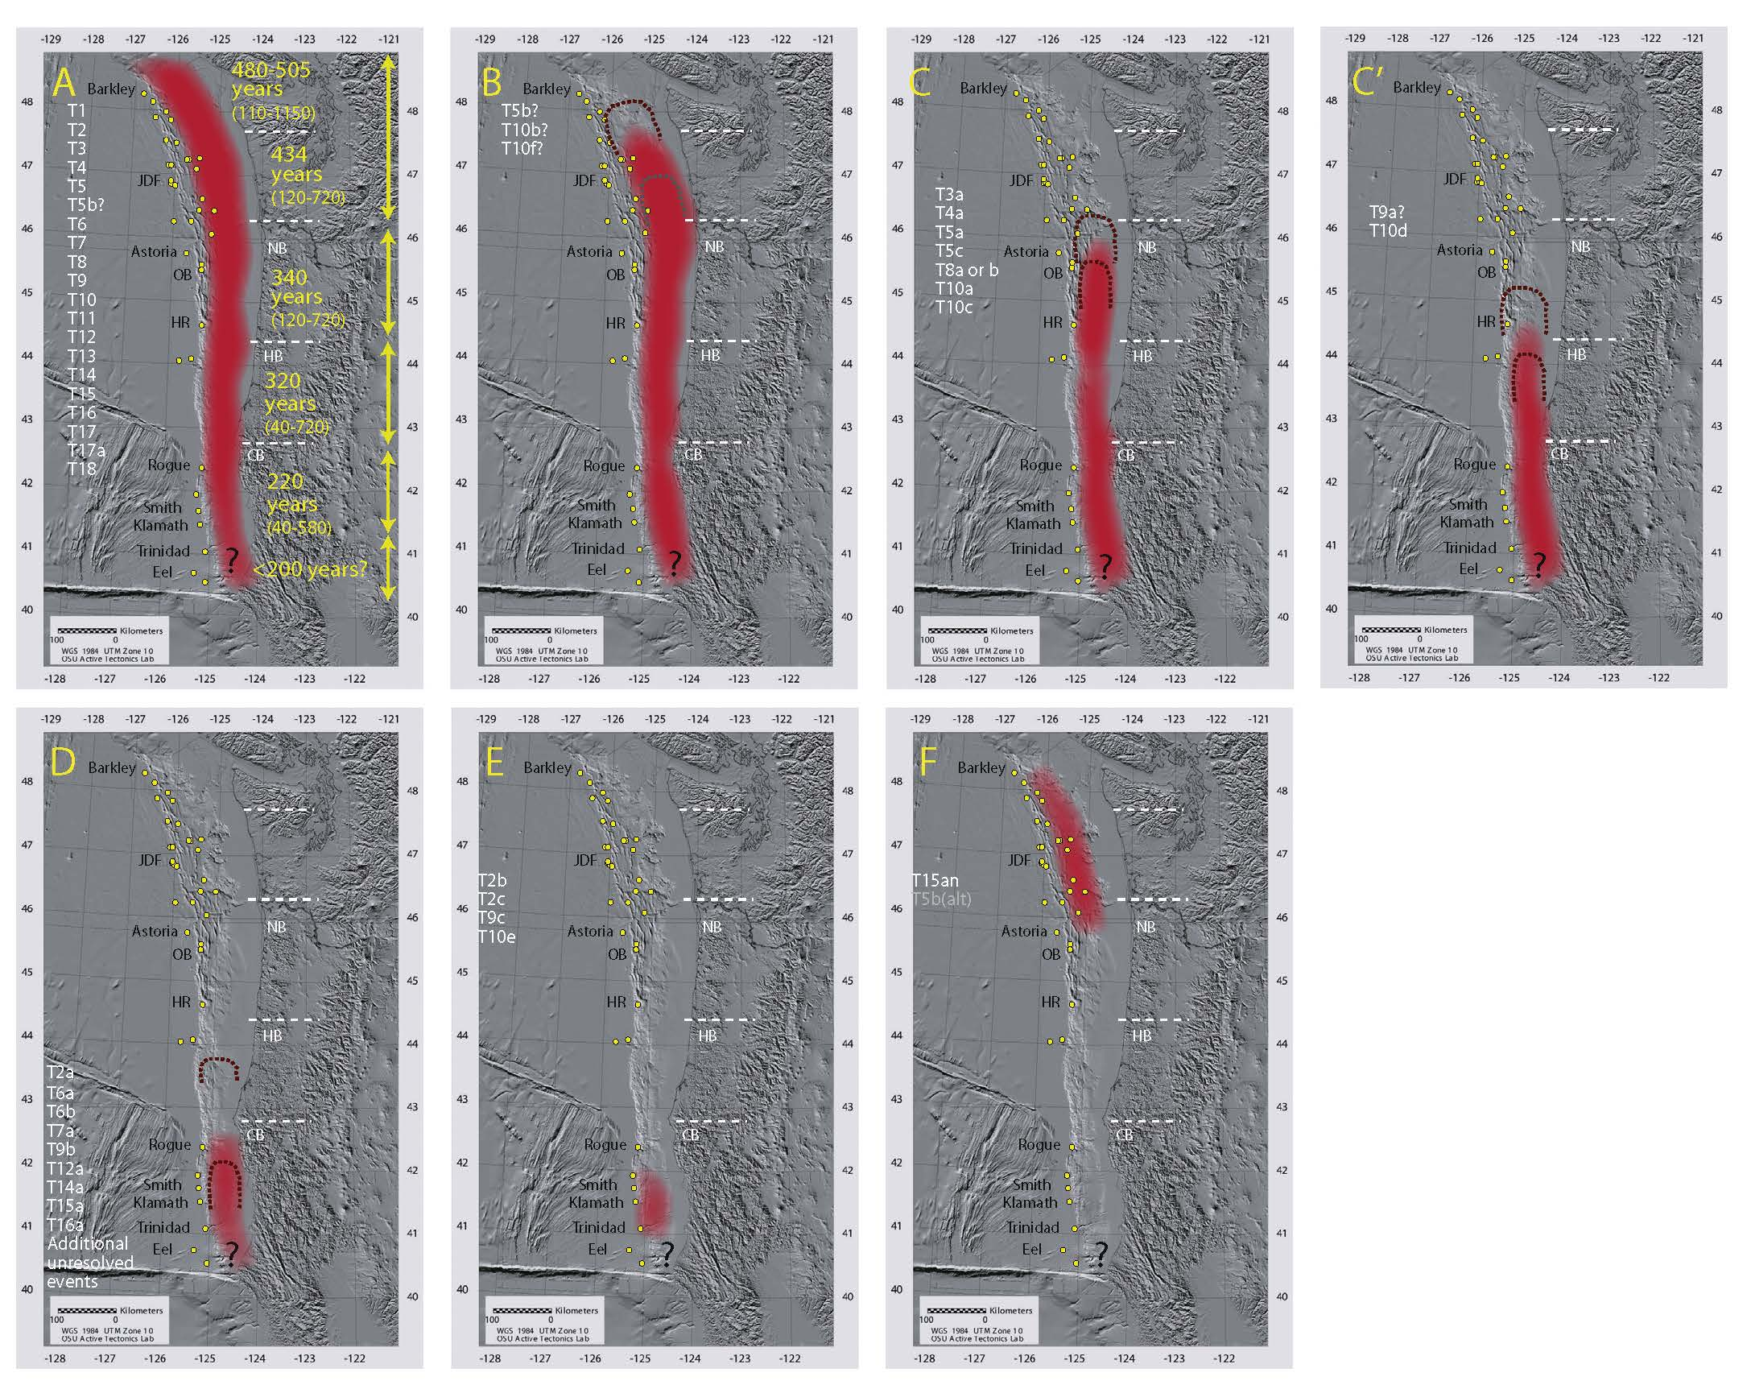
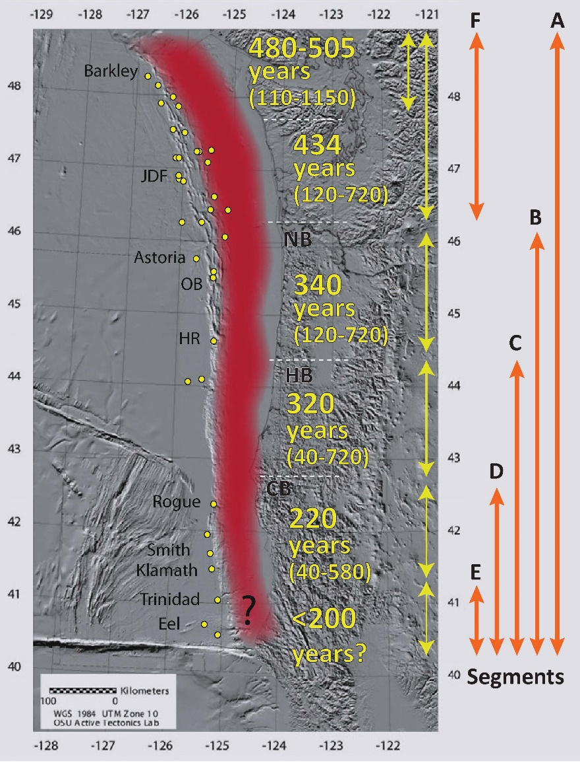
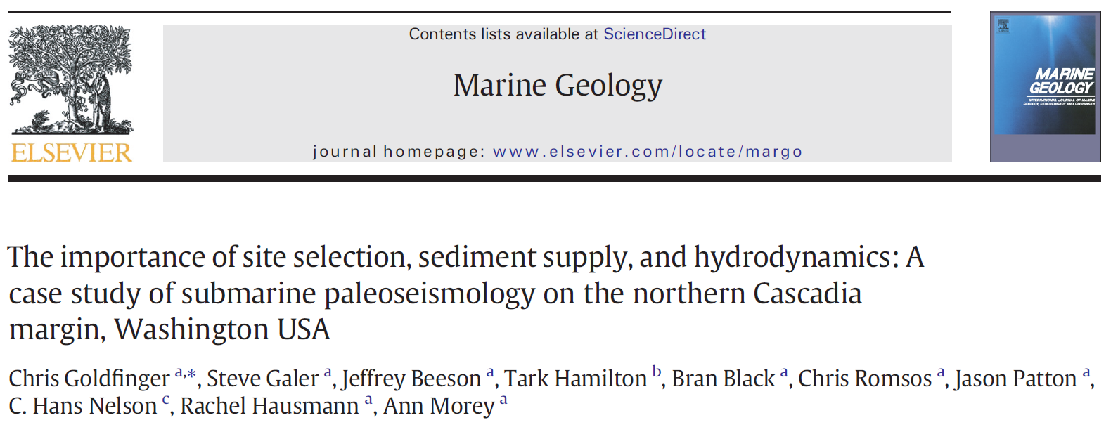
Bradley Lake
Bradley Lake Recurrence
Kelsey et al. (2005) = 420 years
Bradley
Lake
Notes:
Holocene rupture lengths of Cascadia great earthquakes from marine and onshore paleoseismology. Four images showing rupture modes inferred from turbidite stratigraphic/14C correlation, supported by onshore radiocarbon data. Marine core sites controlling rupture-length estimates are shown as yellow dots.
Fig. 18. Segmented rupturemodel, revised fromGoldfinger et al. (2012a, b). Thismodel reflects revision of the northern boundaries of Segments B, C, and D, with addition of a subdivision
to include C′ and addition of segments E and F based on newcore data and tsunamimodeling at Bradley Lake (Priest et al. 2014).Marine core sites controlling rupture-length estimates are
shown as yellowdots. Addition of several small ruptures in northern California are shown in Segment E, and a single northern rupture is identified offWashington in Segment F, both from
Goldfinger et al. (2013a, b). Preferred latitudinal limits shown with red shading. Estimatedminimumandmaximumlatitudinal rupture limits shown with dashed lines.Widths of up and
downdip limits approximate. Paleoseismic segmentation shown also is compatible with latitudinal boundaries of episodic tremor and slip (ETS) events proposed for the downdip
subduction interface (Brudzinski and Allen, 2007) and shown by white dashed lines. NB = Nehalem Bank, HB = Heceta Bank, CB = Coquille Bank; OB = Oceanus Basin, HR =
Hydrate Ridge, other locations as noted in text. See Supplementary Table S11 for segment limit criteria. (For interpretation of the references to color in this figure legend, the reader is
referred to the web version of this article.)

Slide 8
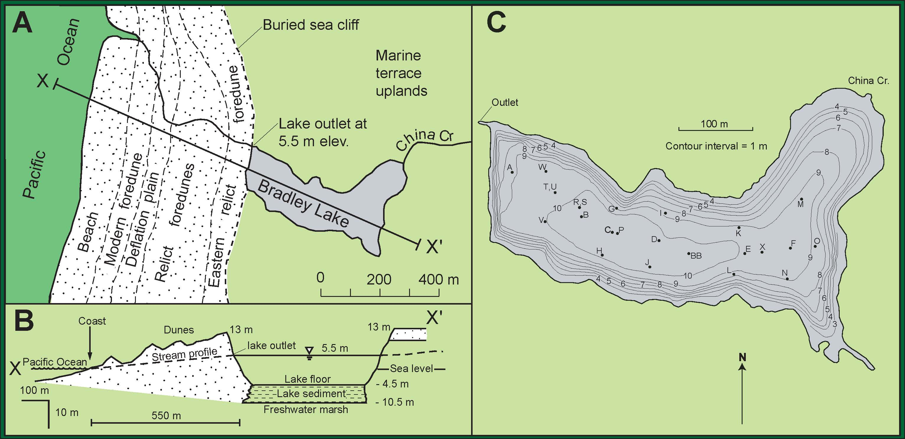
Kelsey et al., 2005
Nelson et al., 2006

Slide 9
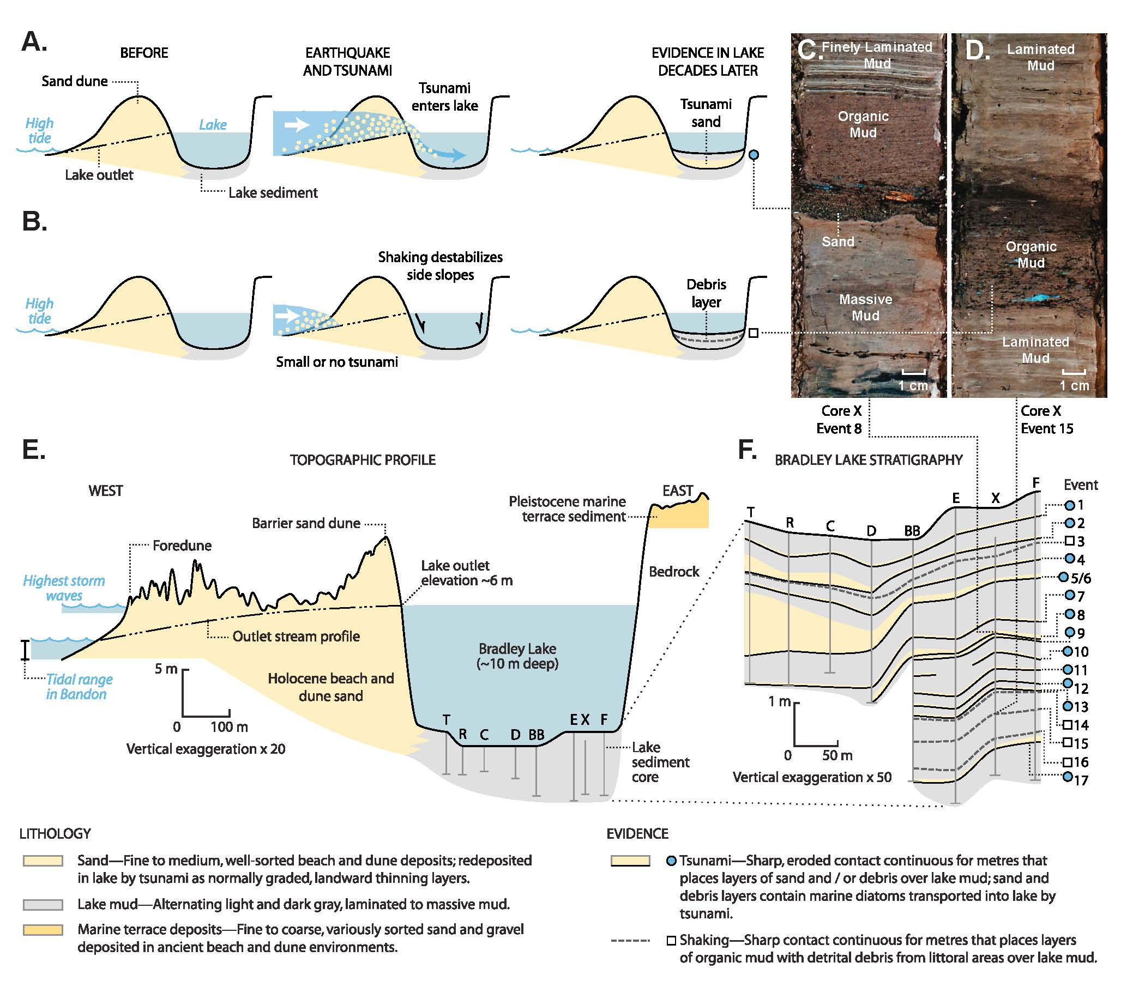
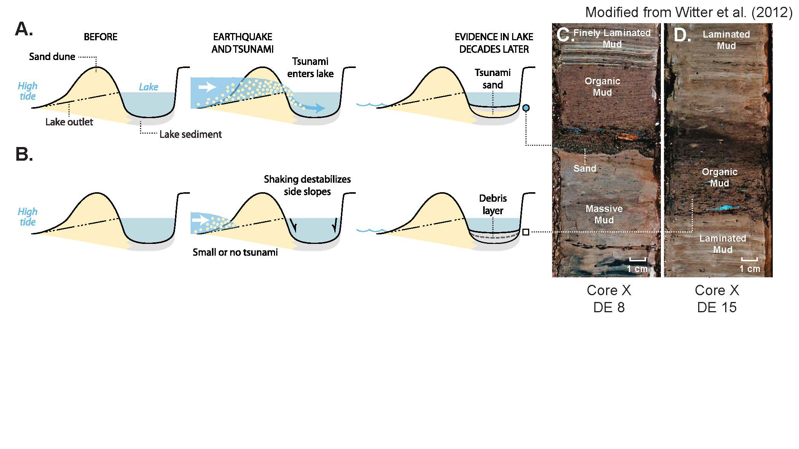
Witter et al., 2012
Conceptual model of tsunami inundation in a coastal lake that leaves a sand deposit in the sedimentary record.
Debris layers lacking evidence for tsunami inundation consist of organic mud that interrupts normal laminated lake mud and are inferred to reflect earthquake shaking that destabilizes basin walls.
Notes:
Stratigraphic evidence of disturbances in Bradley Lake sedimentary record caused by great Cascadia earthquakes and their tsunamis [Kelsey et al., 2005]. (a) Conceptual model of tsunami inundation in a coastal lake that leaves a sand deposit in the sedimentary record. (b) Debris layers lacking evidence for tsunami inundation consist of organic mud that interrupts normal laminated lake mud and are inferred to reflect earthquake shaking that destabilizes basin walls. (c) Photo showing sand deposit interpreted to reflect tsunami inundation. (d) Photo showing organic mud layer inferred to reflect seismic shaking. (e) Topographic profile of coast between the Pacific Ocean and Bradley Lake. (f ) Stratigraphic profile of Bradley Lake sediment. Blue circles denote evidence for tsunami inundation. White squares denote evidence for strong shaking without tsunami overtopping the lake outlet.

Slide 10
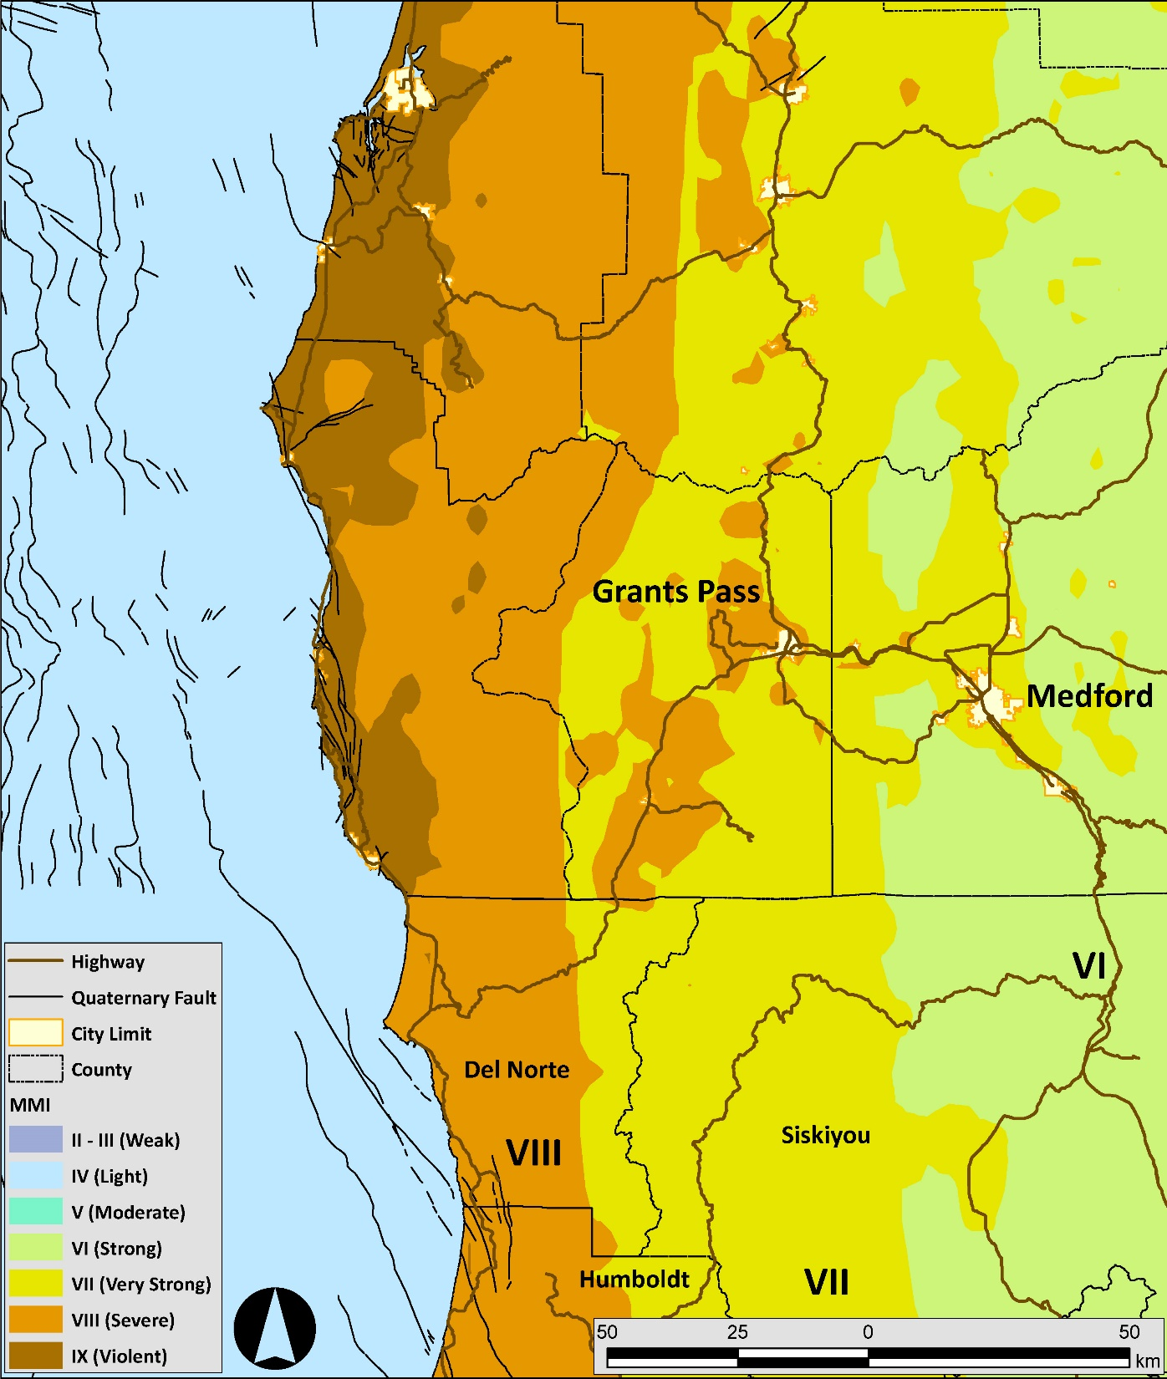
USGS CSZ Scenario Shakemap
Squaw Lake = MMI VI
Bradley Lake = MMI IX
Bradley Lake
Squaw
Lake
MMI IX: Damage considerable in specially designed structures; well-designed frame structures thrown out of plumb. Damage great in substantial buildings, with partial collapse. Buildings shifted off foundations.

Slide 11
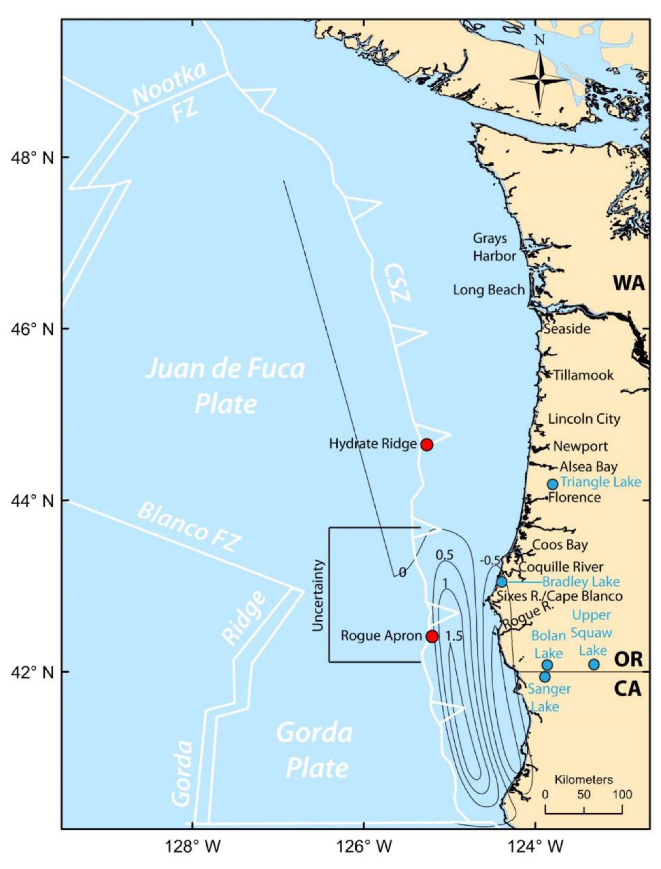
Vertical coseismic deformation (0.5-m contours) of Priest et al. (2014) for a simulated southern Cascadia fault rupture segment D releasing 200 years of slip deficit.
Priest et al., 2014
Priest et al., 2014
(Modified)
Priest et al., 2014
Notes:
Fig. 4 Vertical coseismic deformation (0.5-m contours) of Priest et al. (2014)for a simulated southern Cascadia fault rupture releasing 200 years of slip deficit. Deformation from this source was linearly extrapolated to simulate sources for this study; positive numbers = uplift; negative numbers = subsidence. Red dot at Rogue Apron is location of core hole M9907-31PC-TC; red 30 dot at Hydrate Ridge is core hole RR0207-56PC-TC; FZ = Fracture Zone; CSZ = Cascadia subduction zone; seg. = segment; 31 Uncertainty = uncertainty in northern termination of southern Cascadia ruptures inferred from turbidites found in the Rogue 32 Apron core hole but missing from the Hydrate Ridge core hole. Blue dots are lakes with paleoseismic evidence of southern 33 Cascadia earthquakes. Figure is modified from Priest et al. (2014 )

Slide 12
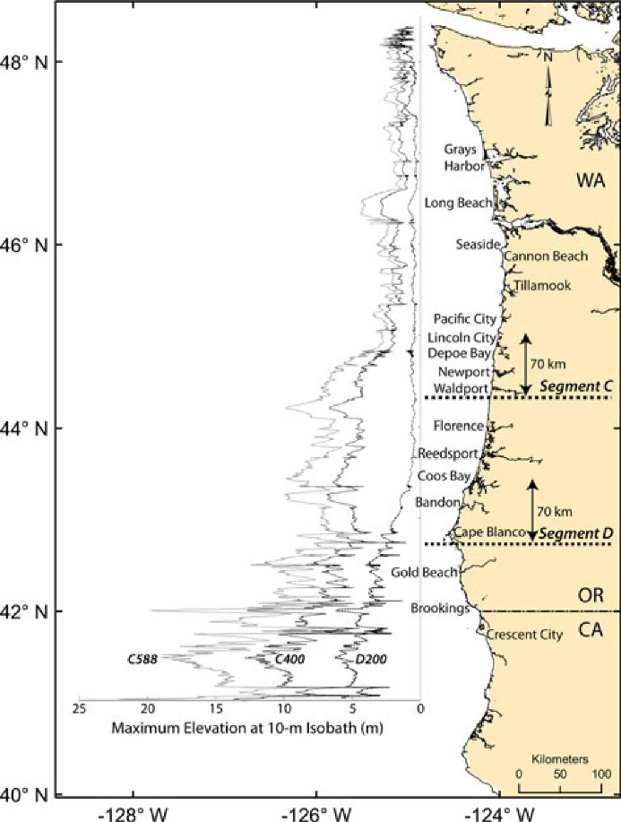
Maximum tsunami amplitudes at the 10-m water depth for simulations:
C588 (segment C, 588 years of strain release)
C400 (segment C, 400 years of strain release)
D200 (segment D, 200 years of strain release).
C588
C400
D200
Priest et al., 2014
Notes:
Maximum tsunami amplitudes at the 10-m water depth for simulations C588 (segment C, 588 years of strain release), C400 (segment C, 400 years of strain release), and D200 (segment D, 200 years of strain release). Segment boundaries are those of Fig. 1

Slide 13
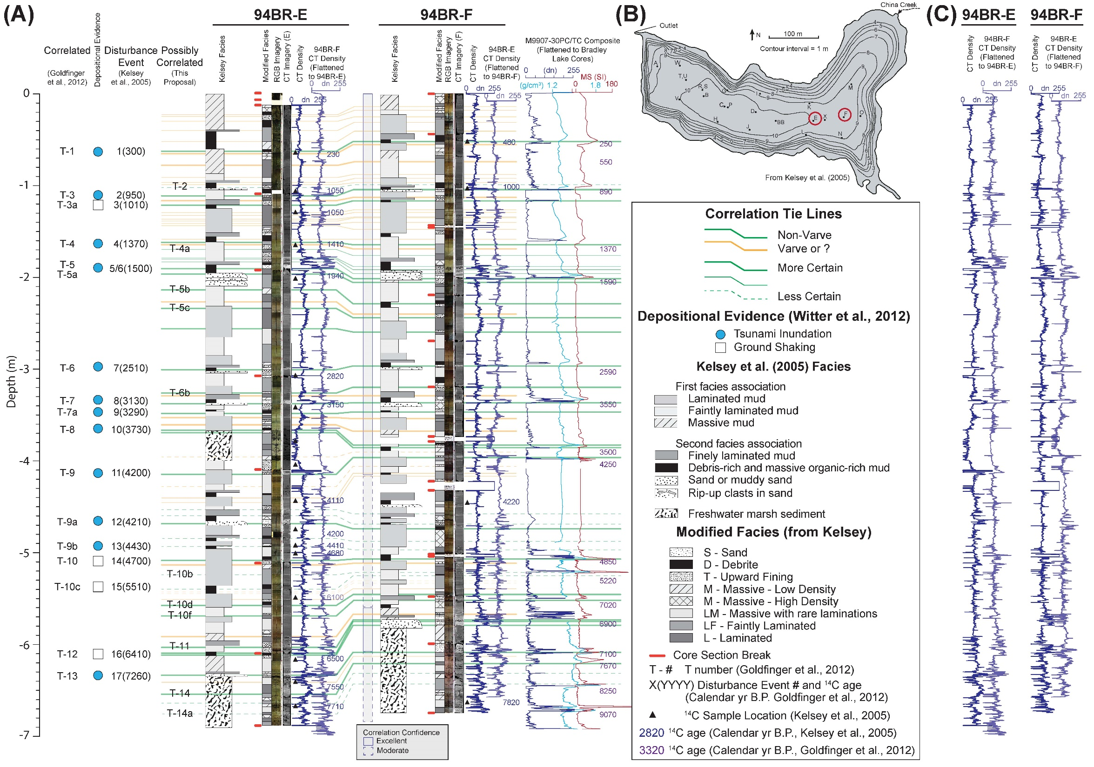

Slide 14
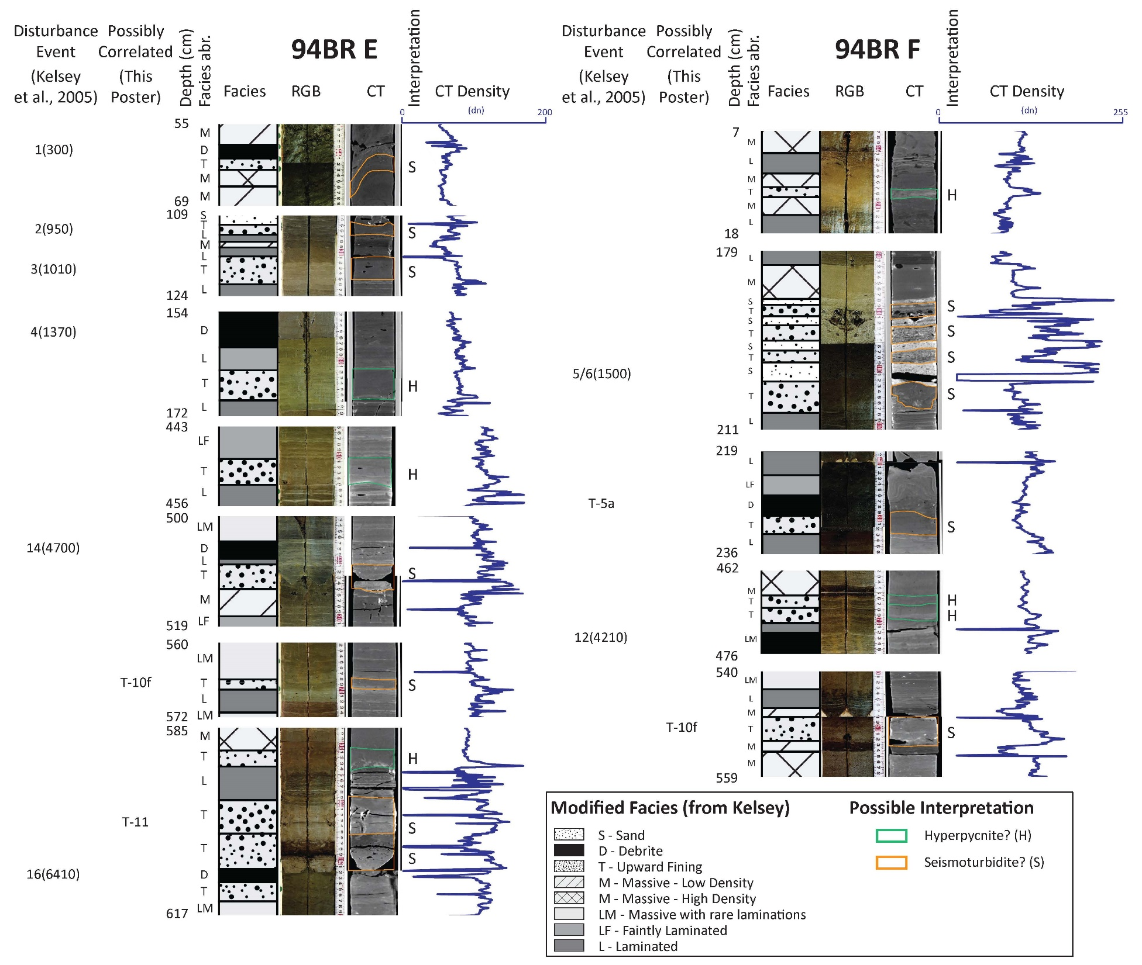
Possible Seismoturbidites
3
4
5

Slide 15
Original Interpretation:
faintly laminated mud
CT Interpretation:
turbidite upward fining
BR94-E-3

Slide 16
Original Interpretation:
faintly laminated mud
CT Interpretation:
turbidite upward fining
BR94-E-4

Slide 17
Original Interpretation:
finely laminated mud
CT Interpretation:
turbidite upward fining
BR94-F-5

Slide 18
Bradley Lake (Kelsey et al., 2005)
420 years (17 DE/7ka)
Segment C (Goldfinger et al., 2016)
320 years
Segment D (Goldfinger et al., 2016)
220 years
Bradley Lake (Patton and Goldfinger, 2016)
280 years (25 earthquakes/7 ka)

Slide 19
Paleoseismic history of the Hikurangi Subduction zone, eastern North Island, and marine research response to the November 13th
Mw 7.8 Marlborough earthquake.
Philip M. Barnes
National Institute of Water & Atmospheric Research, Wellington, New Zealand (NIWA)
Jamie Howarth
GNS Science, Lower Hutt, New Zealand.
and Ship-board Science Party
Alan Orpin, Geoffroy Lamarche, Susanne Woelz, John Mitchell, Peter Gerring, Will Quinn (NIWA) Jason R. Patton (Humboldt State University, USA) Jenni Hopkins (Victoria University of Wellington) Monique McKoewn, Aratrika Ganguly, Simon Banks (Auckland University) Sam Davidson (University of Canterbury)
Media Briefing following R.V. Tangaroa survey TAN1613: November 22nd 2016, NIWA

Slide 20
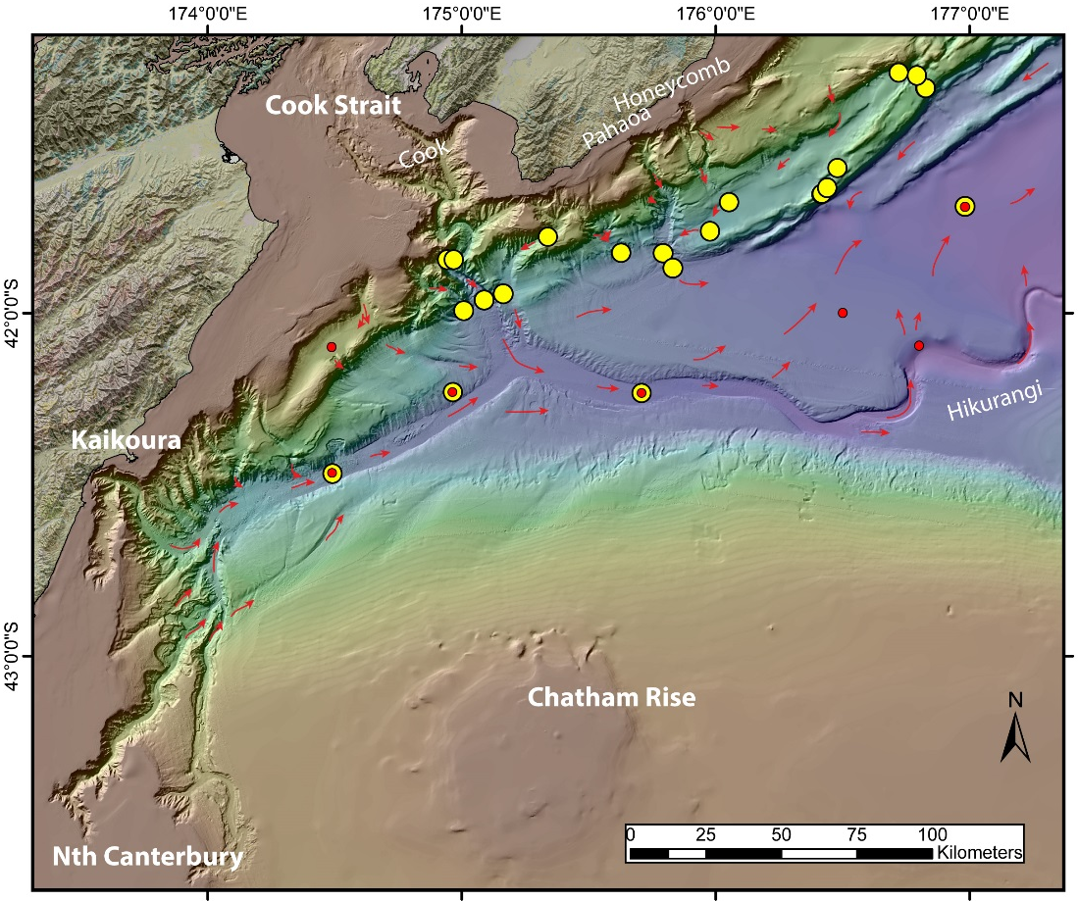
Marine geoscience response to the Nov. 13th Mw 7.8 Marlborough earthquake
1. Was a new turbidite emplaced in the Hikurangi Trough following the November 14th Mw 7.8 Marlborough Earthquake?
Multicorer: 4 short cores at once.
The earthquake presented a very rare opportunity to calibrate paleoseismic data

Slide 21
R/V Tangaroa
R/V Tangaroa
Thank You!

Slide 22
Bradley Lake (Kelsey et al., 2005)
420 years (17 DE/7ka)
Segment C (Goldfinger et al., 2016)
320 years
Segment D (Goldfinger et al., 2016)
220 years
Bradley Lake (Patton and Goldfinger, 2016)
280 years (25 earthquakes/7 ka)
There may or may not be the same number of turbidites in Bradley Lake than there are offshore.
Why?
There may be some threshold:
Tsunami may require larger earthquake to be able to send a tsunami into Bradley Lake.
Segment D ruptures may generate ground shaking but not tsunami for Bradley Lake.
These may not be correct.

Slide 23
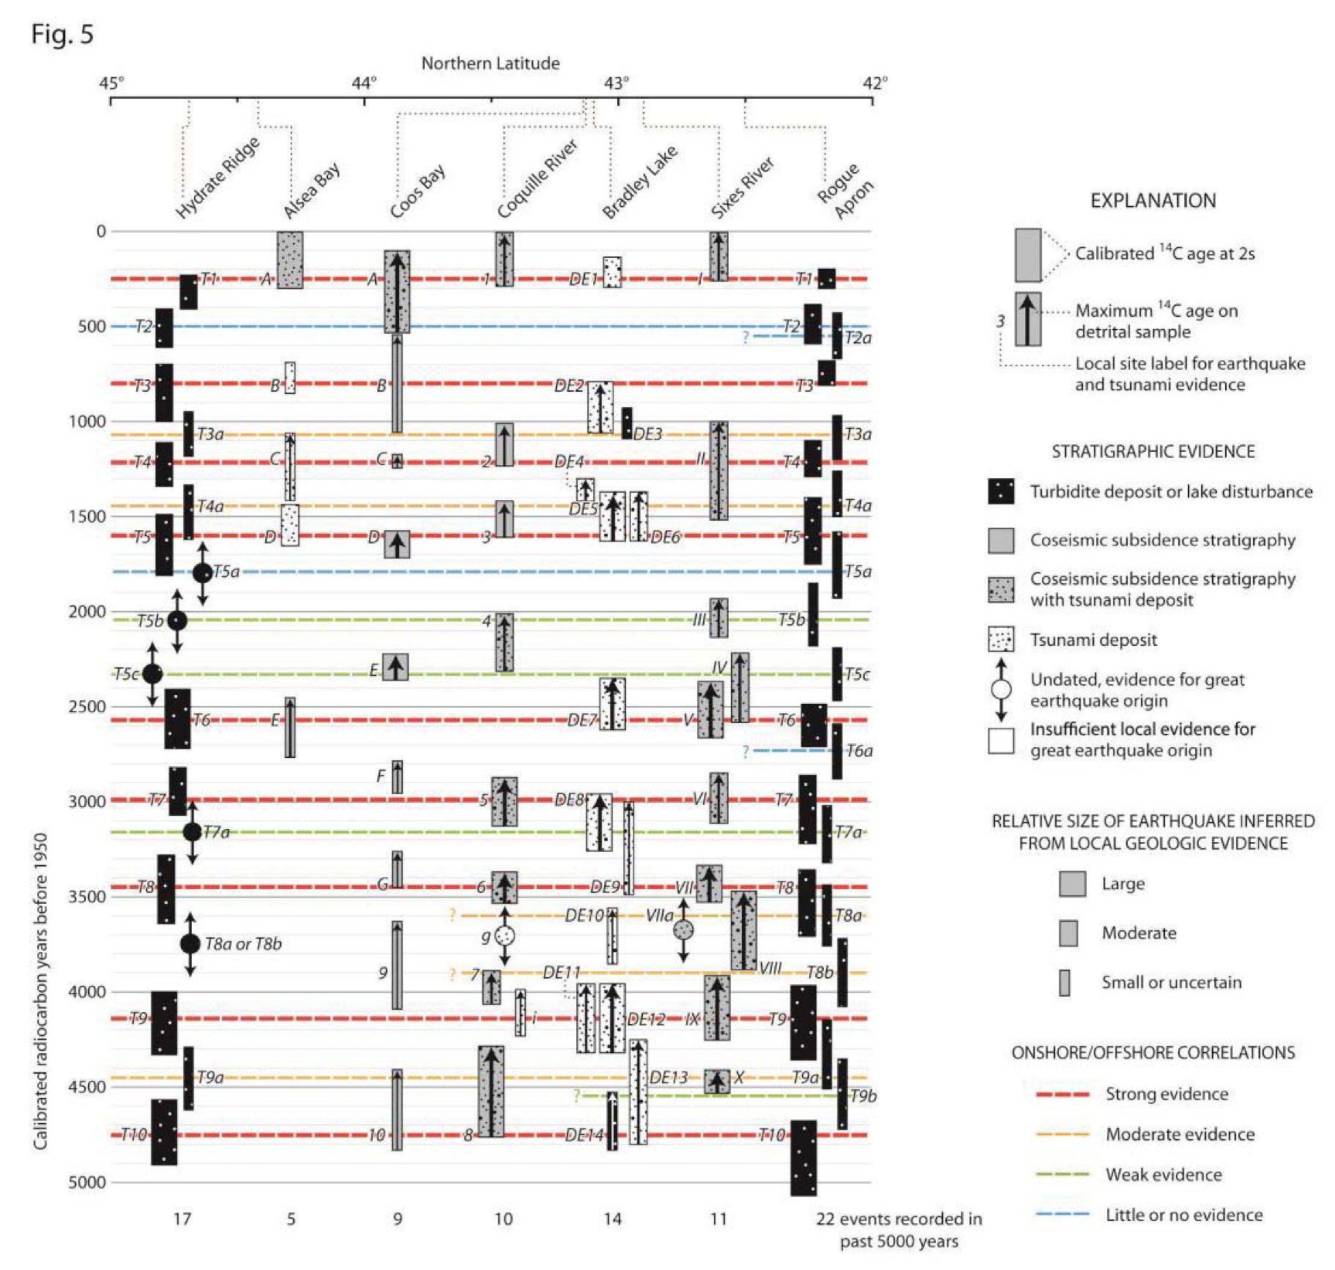
Witter et al., 2012 (modified)
Correlation of radiocarbon data from coastal paleoseismic sites and offshore turbidite sequences in south-central Oregon.
Notes:
Correlation of radiocarbon data from coastal paleoseismic sites in south-central Oregon and offshore turbidite sequences from Hydrate Ridge and Rogue Canyon (in Rogue Apron) modified from Witter et al. (2012) with additional data on Hydrate Ridge and Rogue from Goldfinger et al. (2013b; 2016a) and Coos Bay from Milker et al. (2016). Turbidites are labeled “T”; labels with “a”, “b”, or “c” are thin muddy turbidites; others are thicker sandy turbidites. Stratigraphic correlations of turbidites have been interpreted by Goldfinger et al. (2012) to reflect long (>500 km) fault ruptures (bold dashes) of most of the megathrust from shorter (<500 km) fault segment breaks (thin dashes) along the southern margin. Up arrows denote maximum age estimates on detrital samples. Symbol width represents relative size of earthquake inferred from deposit thickness or amount of subsidence evident in change in microfossil assemblages. Rectangles represent inferred earthquake age ranges in calendar years before 1950, calibrated from radiocarbon dates using Calib 5.0.2 software (Stuiver and Reimer 1993; M. Stuiver, P. J. Reimer, and R. W. Reimer, CALIB 5.0, 2005, available at http://calib.qub.ac.uk/calib/), the calibration database of Reimer et al. (2004) and the marine reservoir database of Hughen et al. (2004). The age ranges presented here have been recalibrated from the original laboratory reported age and are compiled in Goldfinger et al. (2012, Appendix 1) or Goldfinger et al. (2013b). Original age data for Cascadia earthquake records from coastal sites are reported in studies at Alsea Bay (Nelson et al. 2008); Coos Bay (Nelson et al. 1996, 1998; Milker et al. 2016); Coquille River (Witter et al. 2003); Bradley Lake (Kelsey et al. 2005); and Sixes River 51 (Kelsey et al. 2002). See Figs. 1b and 4 for geographic locations.

Slide 25
Original Interpretation:
laminated mud
CT Interpretation:
turbidite upward fining
BR94-E-5

Slide 26
Original Interpretation:
massive mud
CT Interpretation:
turbidite upward fining
BR94-F-1

Slide 27
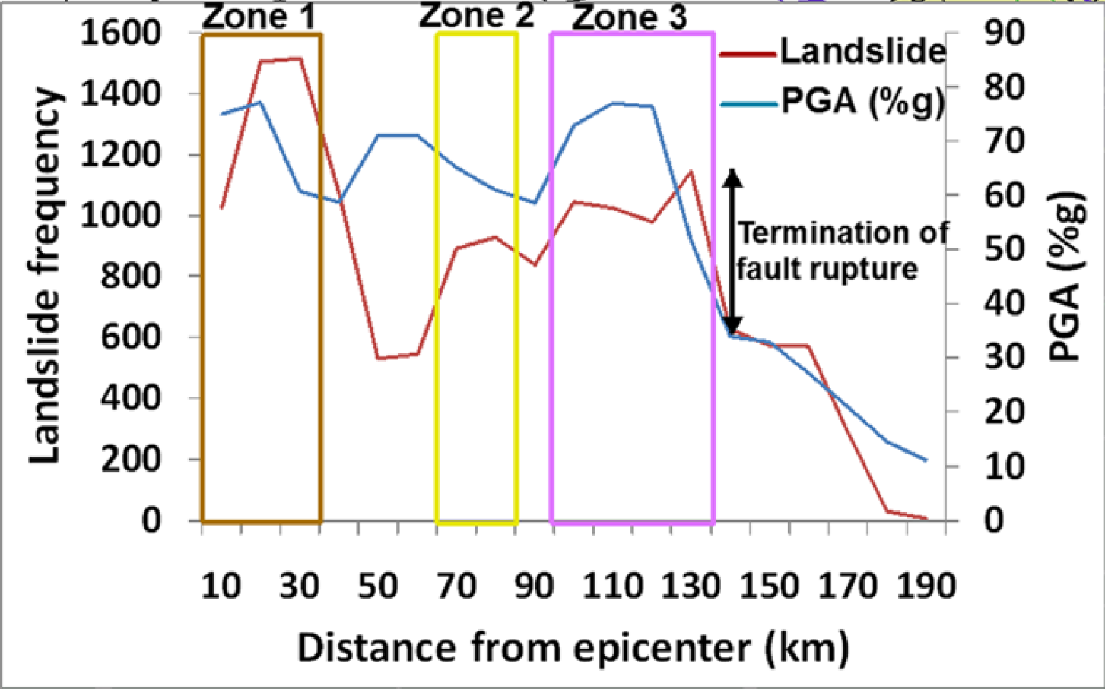
Martha et al., 2016

Slide 28
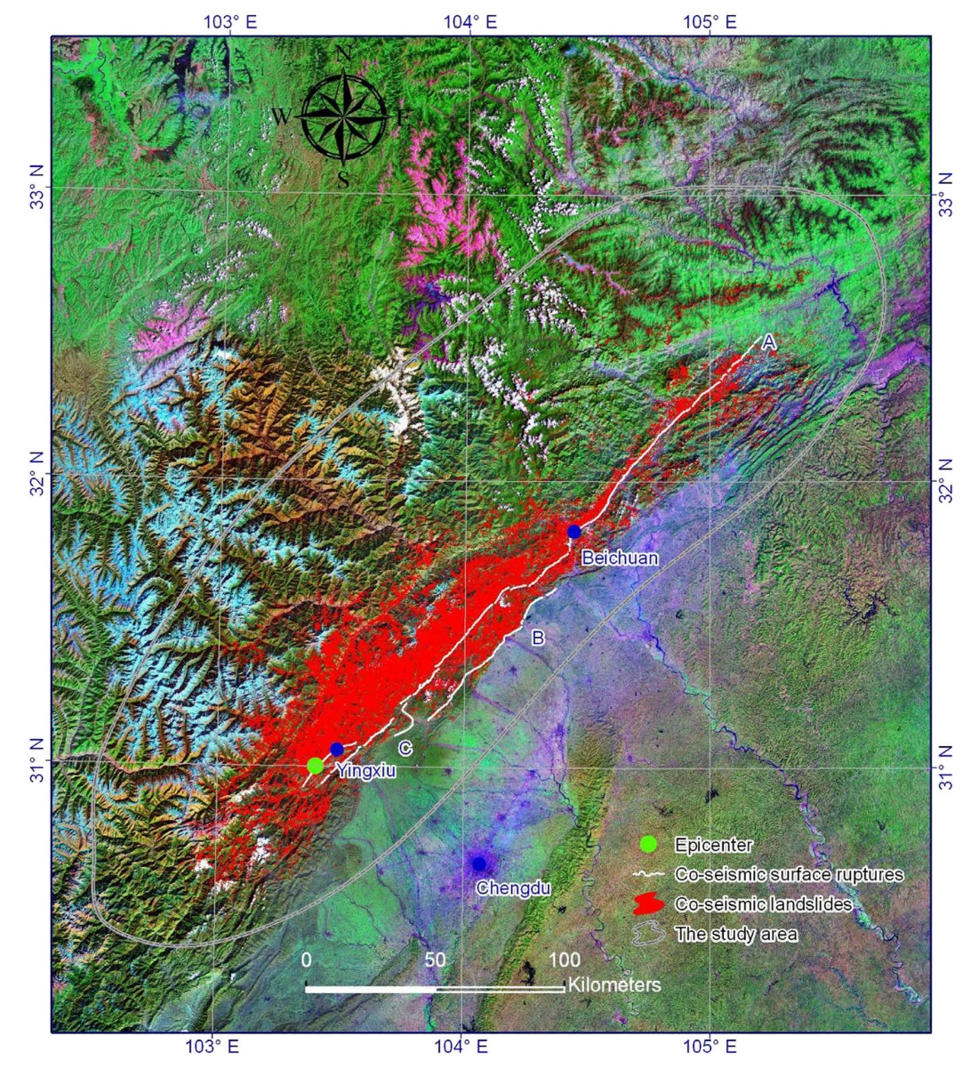
Distribution of coseismic surface ruptures (white lines) and earthquake-triggered landslides (red polygons) triggered by the 2008 Wenchuan earthquake.
Gorum et al., 2011
Xu et al., 2014
Notes:
28
Distribution of coseismic surface ruptures (white lines) and earthquake-triggered landslides (red polygons) triggered by the 2008 Wenchuan earthquake. A the
Yingxiu-Beichuan coseismic surface rupture, B the Guanxian-Jiangyou coseismic surface rupture, C the Xiaoyudong coseismic surface rupture
Fig. 2 Pre- and post-earthquake remote sensing image coverage. a Pre-earthquake; b post-earthquake

Slide 29
Landslide concentration in relation to the total co-seismic slip distribution of the fault rupture: relations are not completely worked out.
Martha et al., 2016
Gorum et al., 2011
Notes:
29
Landslide concentration in relation to the total co-seismic slip distribution of the fault rupture (co-seismic slip distribution model is from Shen et al., 2009). a: The landslide
concentration; b: contour lines of landslide concentration clipped for the projected fault plane boundary; c: the co-seismic slip distribution; d: contour lines of co-seismic slip
distribution.

Slide 30
correlation of landslides with main shock PGA,
correlation of landslides with slope
correlation of landslides with lithology
correlation of landslides with surface deformation
Notes:
Spatial distribution analysis of landslides (black polygons). a. correlation of landslides with main shock PGA, b. correlation of landslides with slope, c. correlation of landslides with lithology (HHG-Higher Himalayan gneiss; CSS-Continental shelf sediments; PG-Palaeozoic granite; CB-Carbonate bands; HHC-Higher Himalayan Crystallines (schist, quartzite and gneiss); QB-Quartzite bands; SS-Slate, Shale, Siltstone, Sandstone and graphite Schist; PAS: Phyllite, Amphibolite, metasandstone and Schist; LG: Leucogranite; LHG-Lesser Himalayan Gneiss; refer Dhital (2015) for detailed legend), and d. correlation of landslides with surface deformation

Slide 31
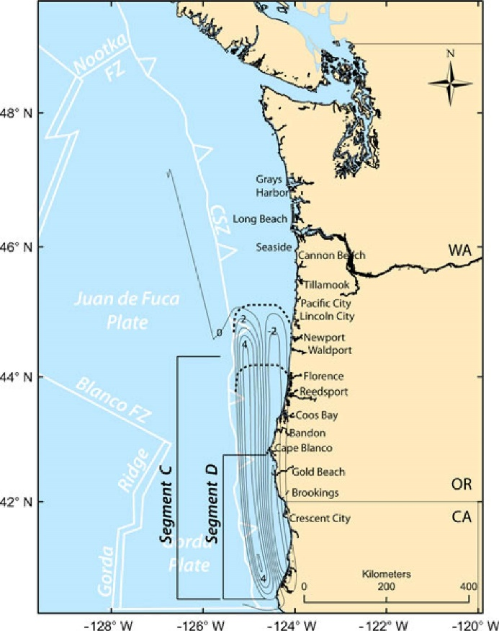
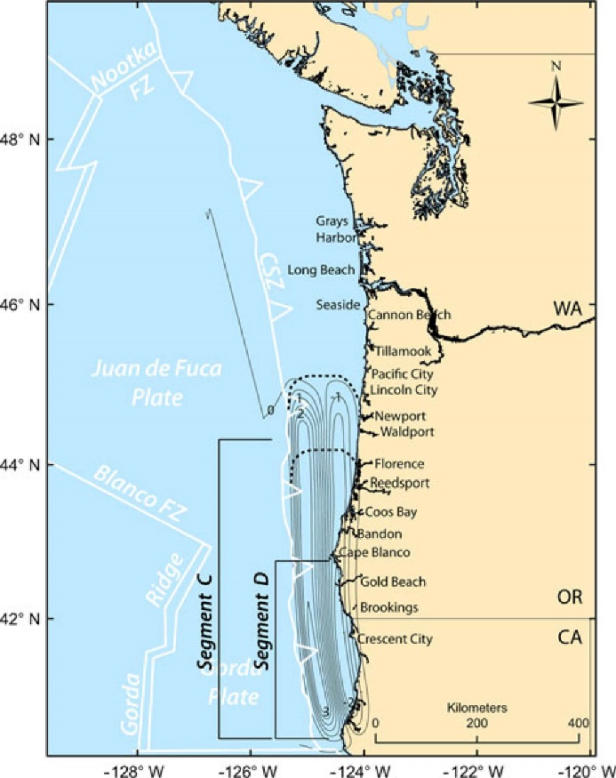
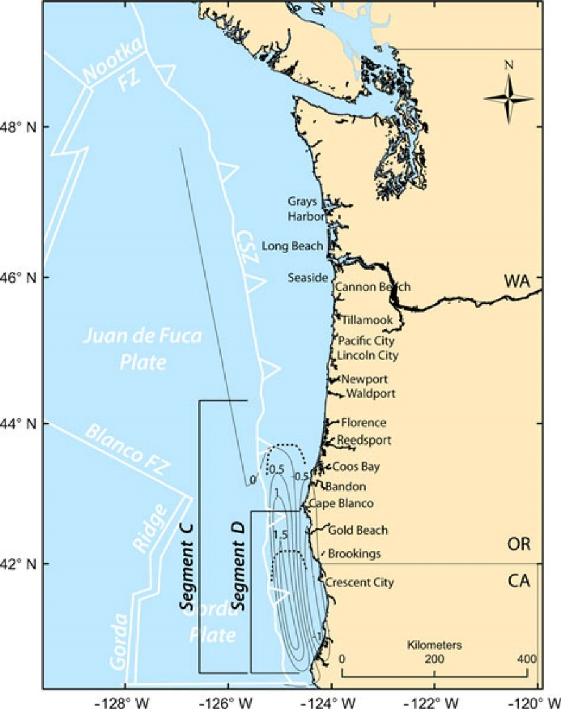
Priest et al., 2014
Priest et al., 2014
Priest et al., 2014
Notes:
Fig. 3 C588 vertical coseismic deformation (1-m contours); positive numbers = uplift; negative numbers = subsidence. Bold dashed lines are north and south limits of uncertainty in location of northern boundary of Segment C from Goldfinger et al. (2012). Segment boundaries are those of Fig. 1
Fig. 4 C400 vertical coseismic deformation (0.5-m contours); positive numbers = uplift; negative numbers = subsidence. Bold dashed lines are north and south limits of uncertainty in location of northern boundary of segment C from Goldfinger et al. (2012)
Fig. 5 D200 vertical coseismic deformation (0.5-m contours); positive numbers = uplift; negative numbers = subsidence. Bold dashed lines are north and south limits of uncertainty in location of northern boundary of segment D from Goldfinger et al. (2012). Segment boundaries are those of Fig. 1

Slide 32
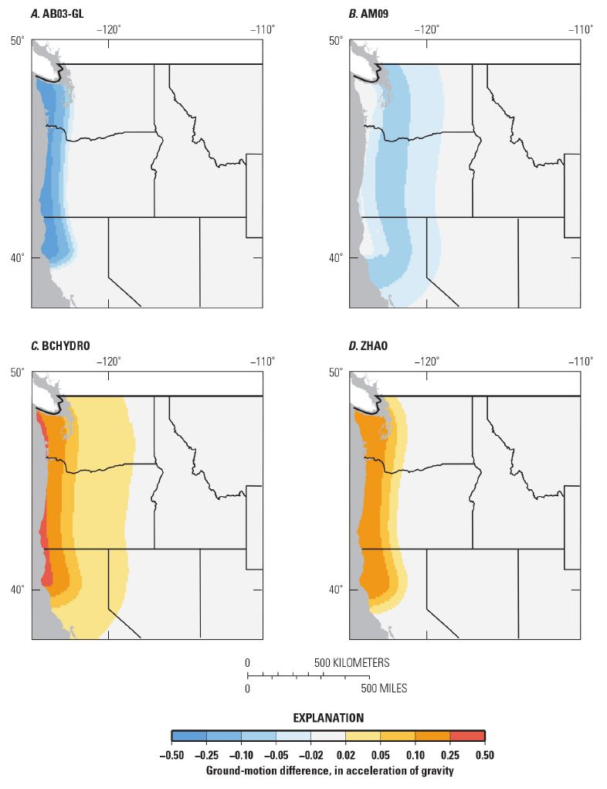
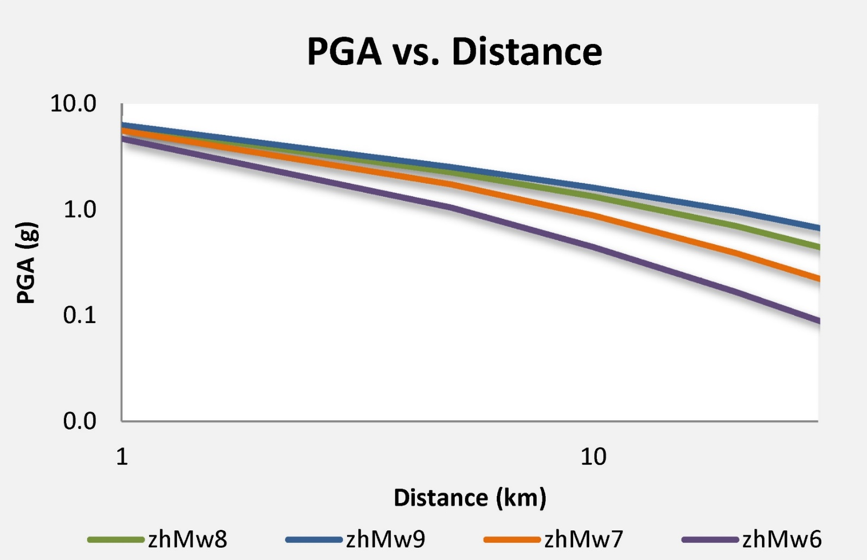
Earthquakes generate strong ground shaking that attenuates with distance from the ruptured earthquake fault
Peak Ground Acceleration (PGA) is plotted in units of g (g =9.81 m/s²), for earthquakes of magnitude 6, 7, 8, and 9
Petersen et al., 2014
Zhao, 2006
Notes:
Figure 115. Maps showing difference in peak ground acceleration from individual subduction-interface ground motion models compared to the 2008 model at 2-percent in 50 years probability of exceedance and VS30 site conditions of 760 meters per second. A, AB03-GL (Atkinson and Boore, 2003) global model; B, AM09 (Atkinson and Macias, 2009); C, BCHYDRO (Addo and others, 2012); and D, ZHAO (Zhao and others, 2006) models.

Slide 33
