Slide 1
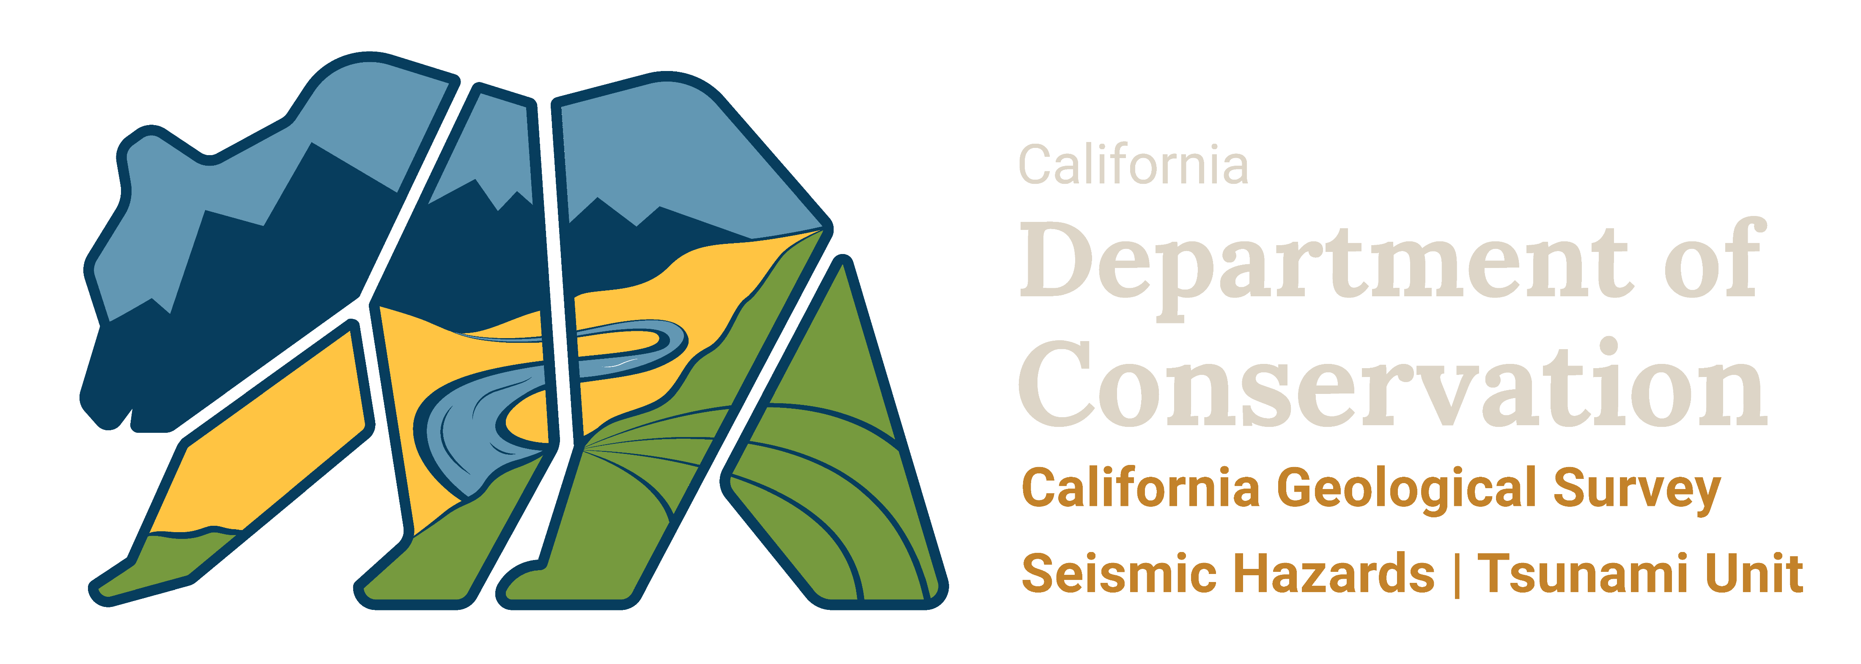

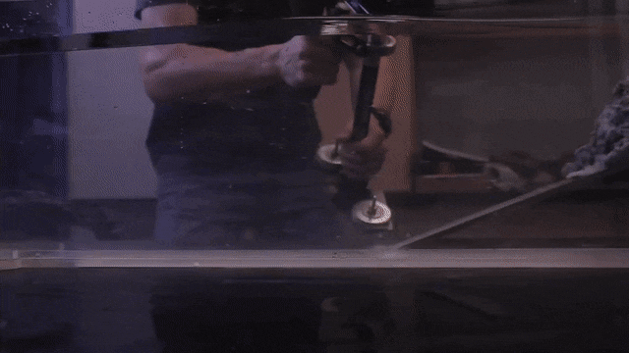
Surf and Turf:
How Active Tectonic Processes Contribute to Sea-Level Rise in Coastal Northern California
Jason “Jay” R. Patton Ph.D. PG 9758
Engineering Geologist
Tsunami Unit/CGS Seismic Hazards Program
Jason.Patton@conservation.ca.gov
also, Adjunct Faculty, HSU Dept. of Geology
There is a large team of geologists who have contributed to the content in this presentation!
tsunami.ca.gov
Notes:
Thanks for having me. I have been studying the tectonics and sea level of Humboldt Bay for over 2 decades. I first started coring sediment here in 1997, when I bought my first sediment corer and the 2002 symposium was my first Humboldt Bay Symposium.
Today I will be discussing our knowledge about prehistoric earthquakes that impact coastal northern California. I will also be presenting about how the tectonics affect sea-level rise in the region.
There are lots of figures with a dense amount of information, so please reach out to me if you want a copy of this presentation. I would be happy to share it. I won’t be able to describe everything in each slide. If you have any questions after the talk is over, please email me as a follow up.

Slide 2
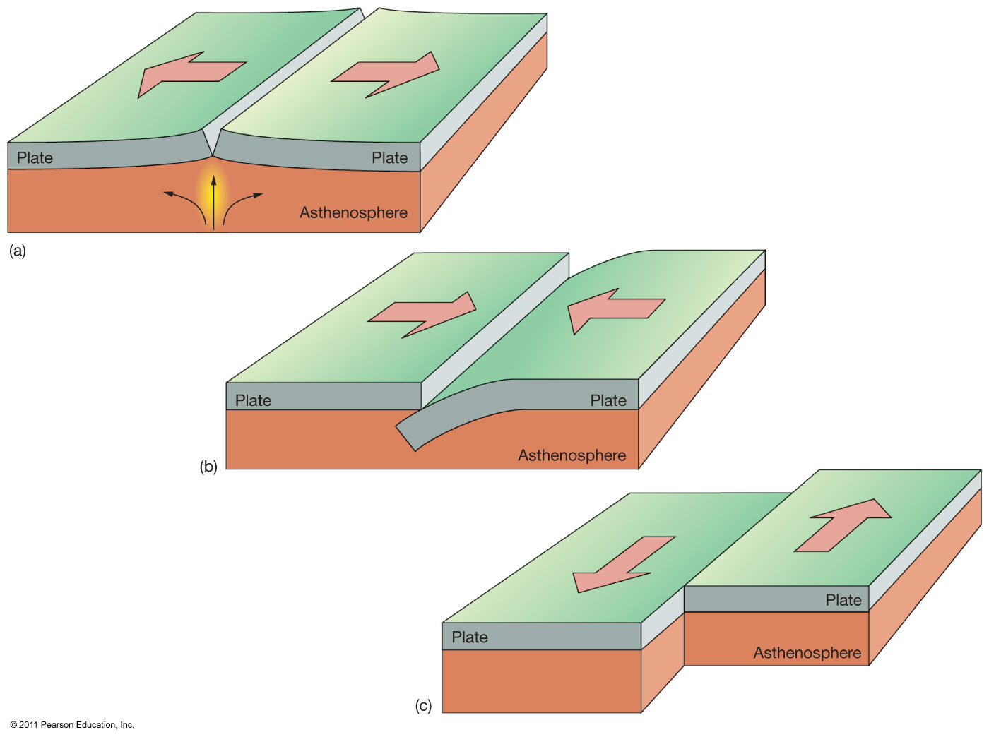
Types of Plate Boundaries
Divergent
Convergent
Transform (strike-slip)
Notes:
There are 3 types of plate boundaries.
Divergent, where plates move away from each other
Convergent, where plates move towards each other
and Transform or Strike-Slip, where plates move side by side, like the San Andreas fault

Slide 3
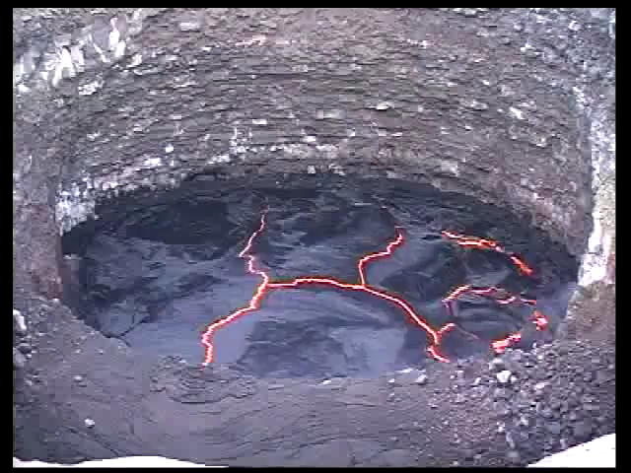
https://www.youtube.com/watch?v=PZjPGdXMMso
Notes:
Here is a hot video showing a “lava lake” from near the East Africa rift in Erta Ale, Ethiopia, a divergent plate boundary.
The lava moves around and cools on the top to form a crust. We can see all 3 types of plate boundaries in this video if we watch it enough.
I include a link to a larger video in the comments of this presentation. https://www.youtube.com/watch?v=vo3qvceeqa8
Orig video link: https://www.youtube.com/watch?v=PZjPGdXMMso

Slide 4
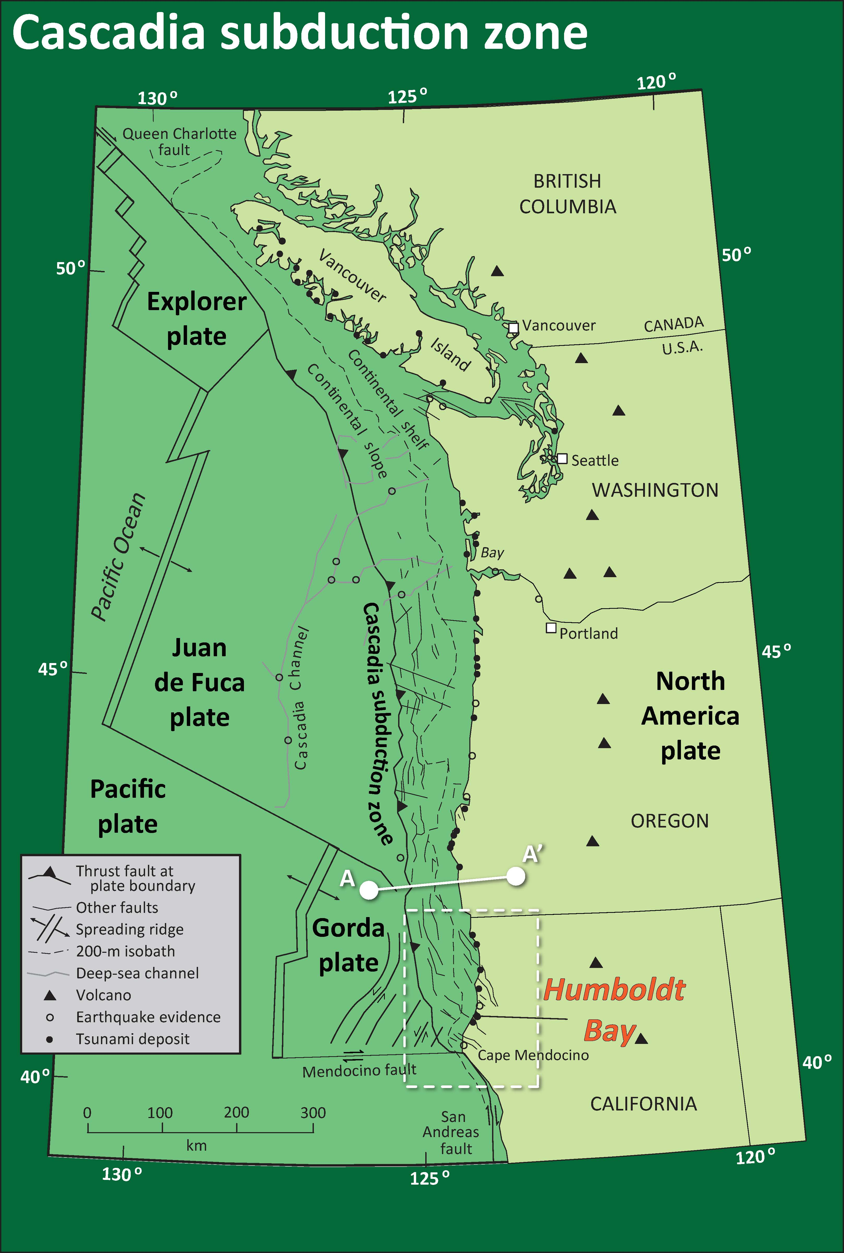
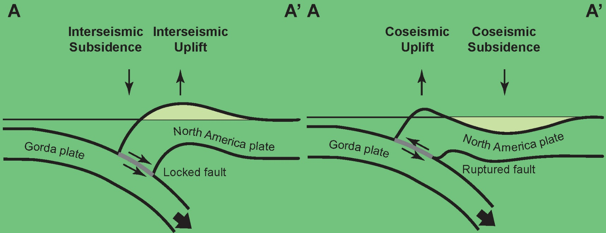
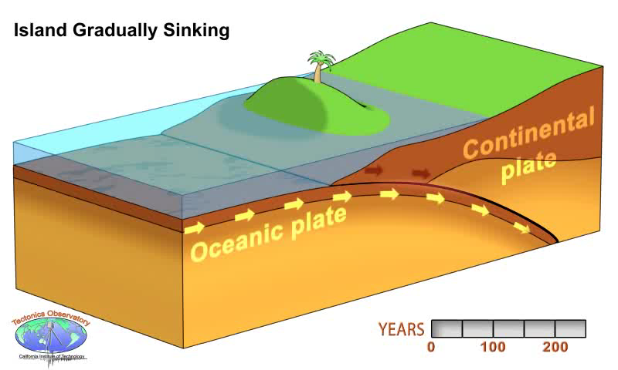
subduction
Notes:
Let’s take a look at the Cascadia subduction zone, a convergent plate boundary.
Here on the left, we have a map of California, Oregon, Washington, and British Columbia, where the Gorda, Juan de Fuca, and Explorer plates subduct beneath the North America plate. In the upper right, note the cross-section A to A prime that shows how the ground moves between and during earthquakes.
Between earthquakes, the fault is stuck like Velcro and the North America continental plate is pulled down like a rubber flip flop. The island with the tree subsides.
When the stress is greater than the strength of the fault (the Velcro), the fault slips and we get an earthquake.
So, between the earthquake (the interseismic period), the island goes down and during an earthquake (the coseismic period) the island goes up. The opposite is true further to the east.
As the crust deforms during an earthquake, it can lift up the water column where it has gravitational potential. Then, the water falls down and with momentum, falls below sea level. This pattern of up and down continues and is called a “gravitational oscillation,” which is the source of energy for a tsunami that radiates outwards.

Slide 5
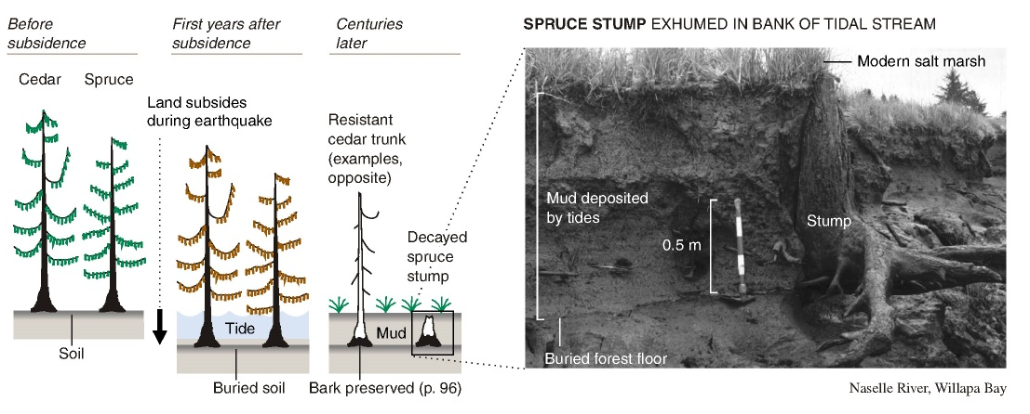
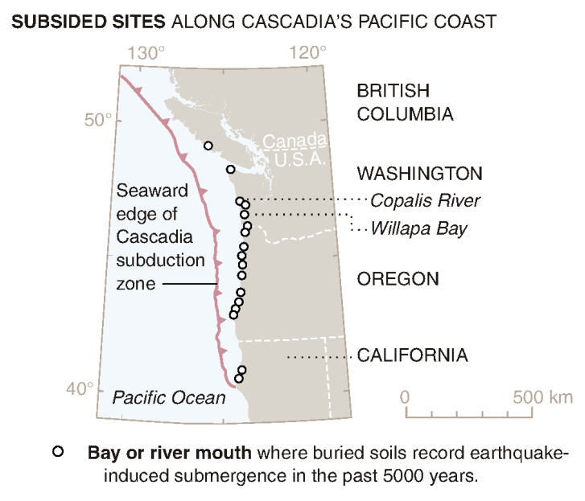
Subduction zone earthquake deformation leaves behind sedimentary evidence.
Atwater & Satake, 2005
Notes:
How do we know this has happened in CSZ in the past?
Imagine you are a happy tree, growing in a soil just above high tide. Then there is an earthquake, and the ground subsides below sea level.
We are no longer happy, as we soon die because of the saltwater inundation.
Over time, sediment fills in covering the soil and the Earth interseismically lifts upwards until plants can grow again. Click
Here is a map where we have found these earthquake buried soils.

Slide 6
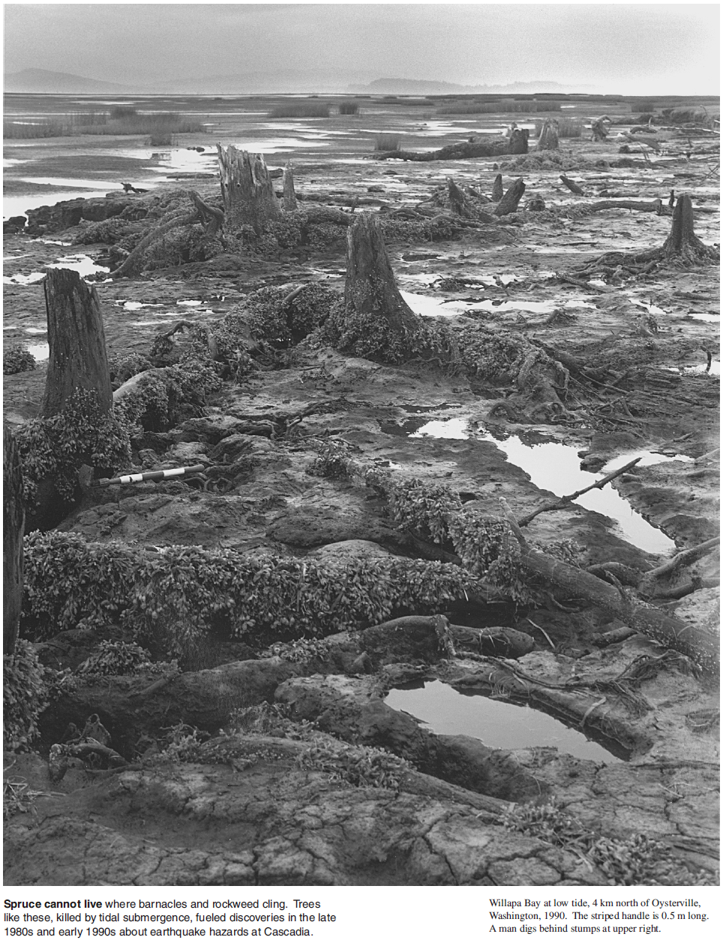
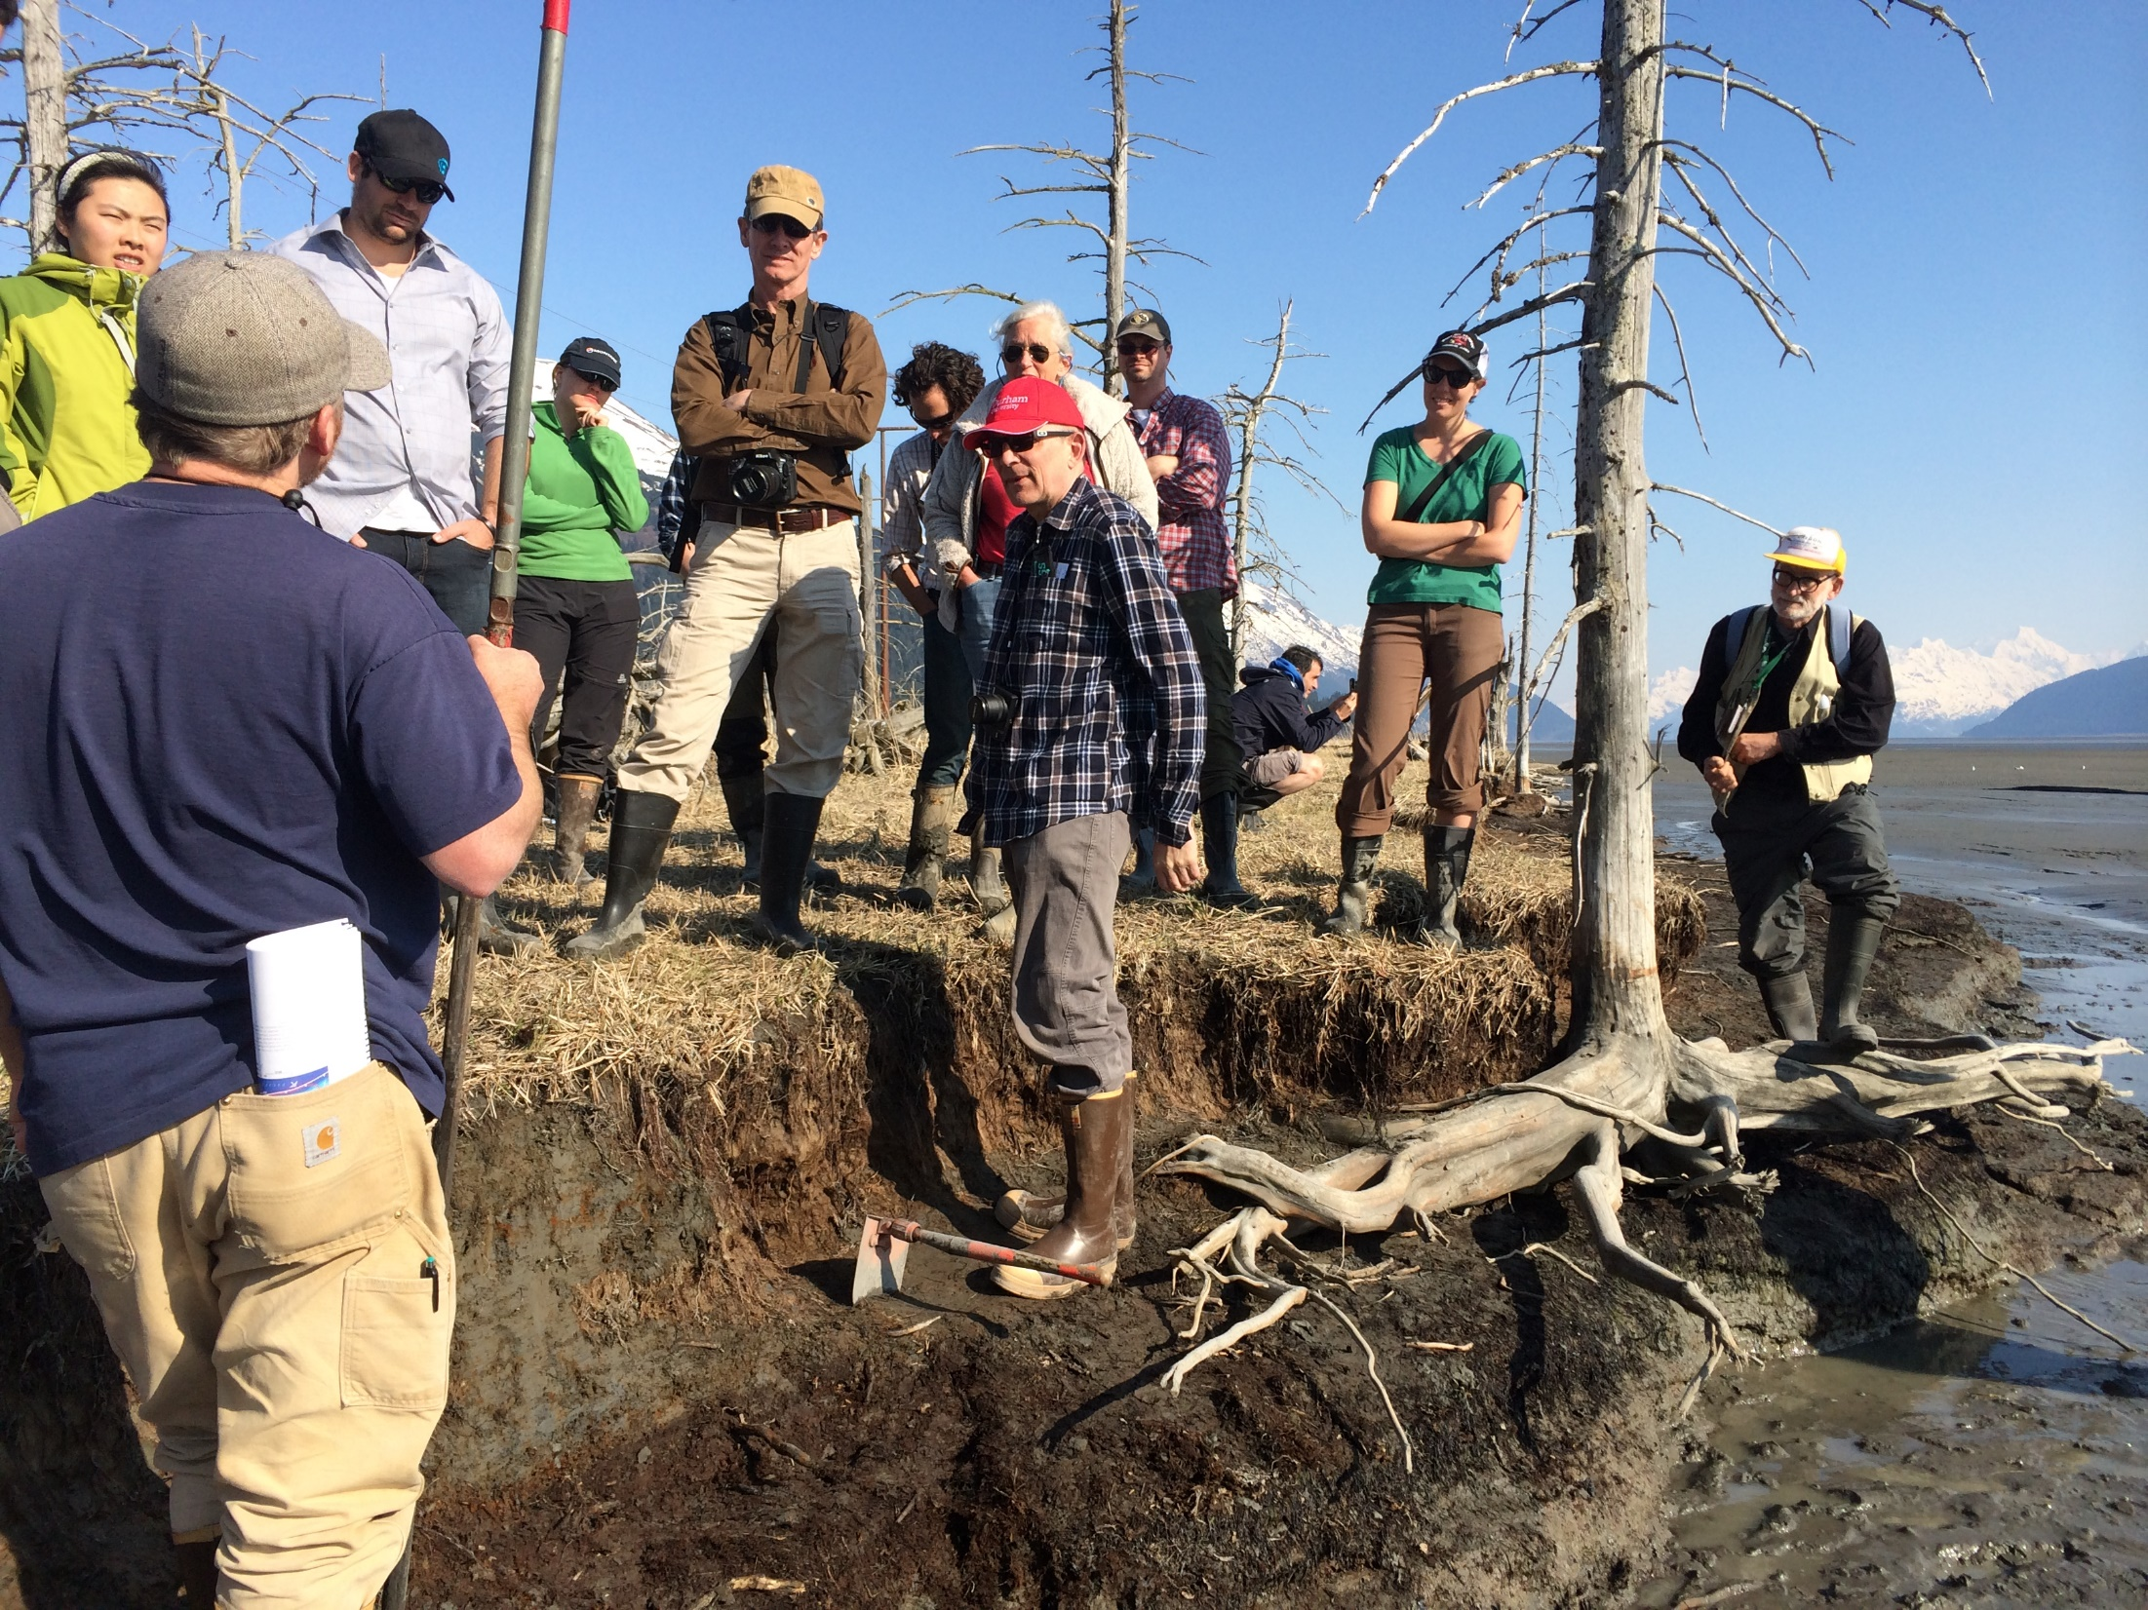
Notes:
Here is a photo from Willapa Bay in coastal Washington. There are barnacles and seaweed growing on these trees. Do barnacles normally grow on trees? NO
These trees were alive before the last CSZ earthquake that happened on January 26, 1700. Click
Here is a photo I took in 2014 at the SSA meeting, a 50-year commemoration of the 1964 Good Friday subduction zone earthquake in Alaska.
The tree was unhappy on March 27 as the nice brown soil it is rooted in coseismically subsided below sea level.
See how the dark brown soil is overlain by lighter gray tidal mud and the modern surface is now being colonized by plants again.

Slide 7
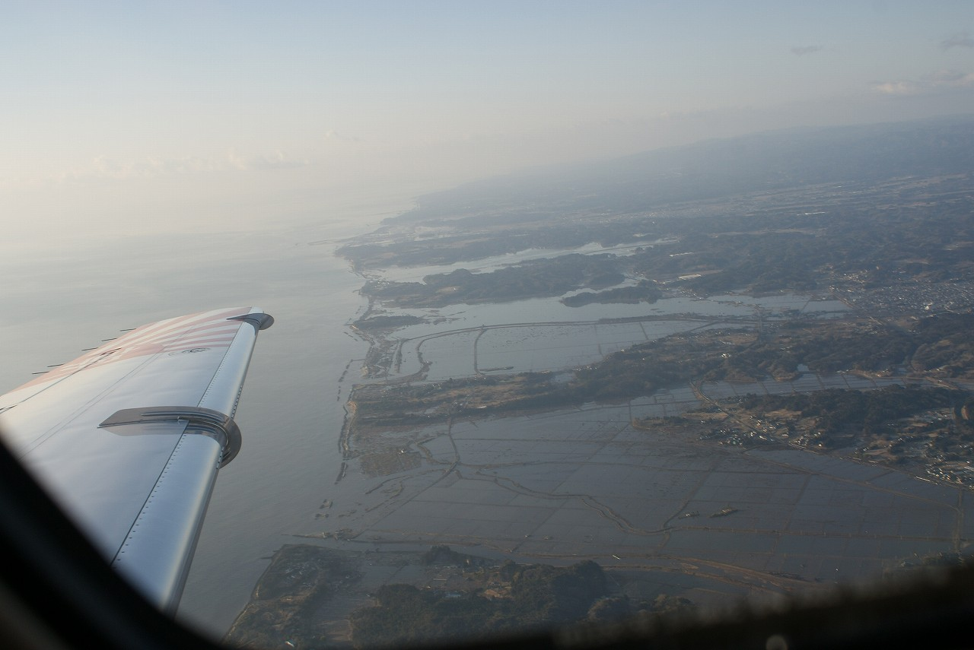
Coseismic subsidence in Japan, 2011.03.11
Arcata
Eureka
Table Bluff
Eel River Valley
Photo Credit: Kenji Satake
Notes:
Here is an image my colleague Satake san took after the 2011 Tōhoku-oki subduction zone earthquake and tsunami in Japan.
The areas that are flooded were above high tide before the earthquake but are now below tide due to coseismic subsidence. Click
I like this as it reminds me of the Humboldt Bay region, how it might look after a CSZ event. However, based on our geodetic data, this is far from being certain.

Slide 8
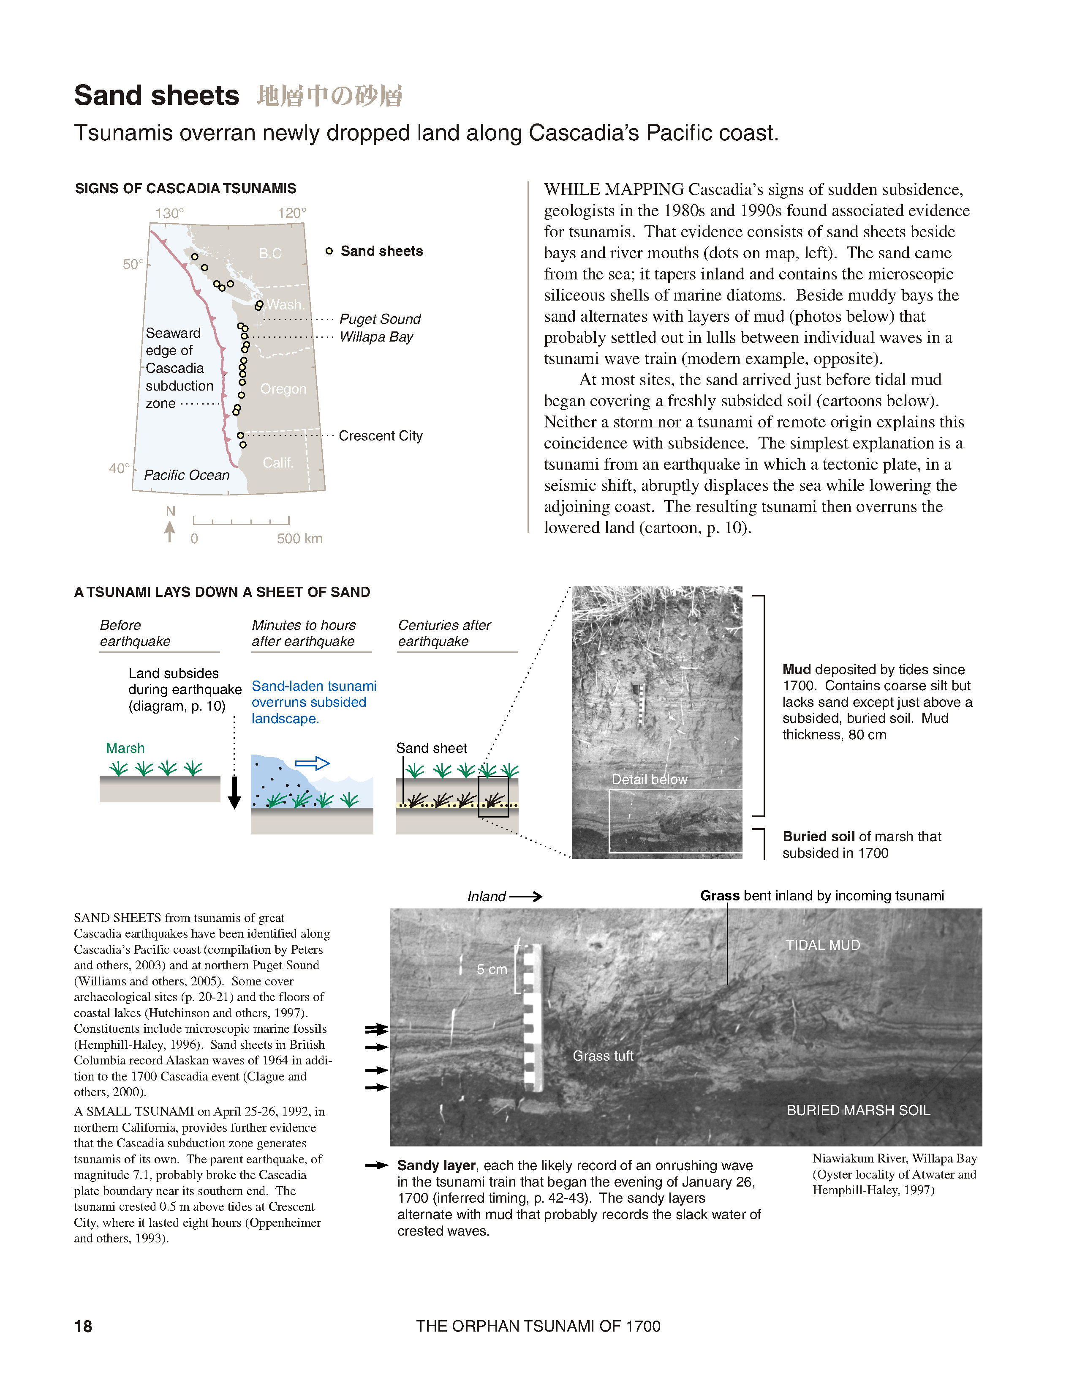
past
tsunami
evidence
Atwater et al., 2005
Notes:
If the earthquake generates a tsunami and there is sand along the path of the tsunami, the tsunami may create a tsunami deposit overlying the buried soil.
There is evidence for CSZ tsunami along the entire coast in this map. Including Click

Slide 9
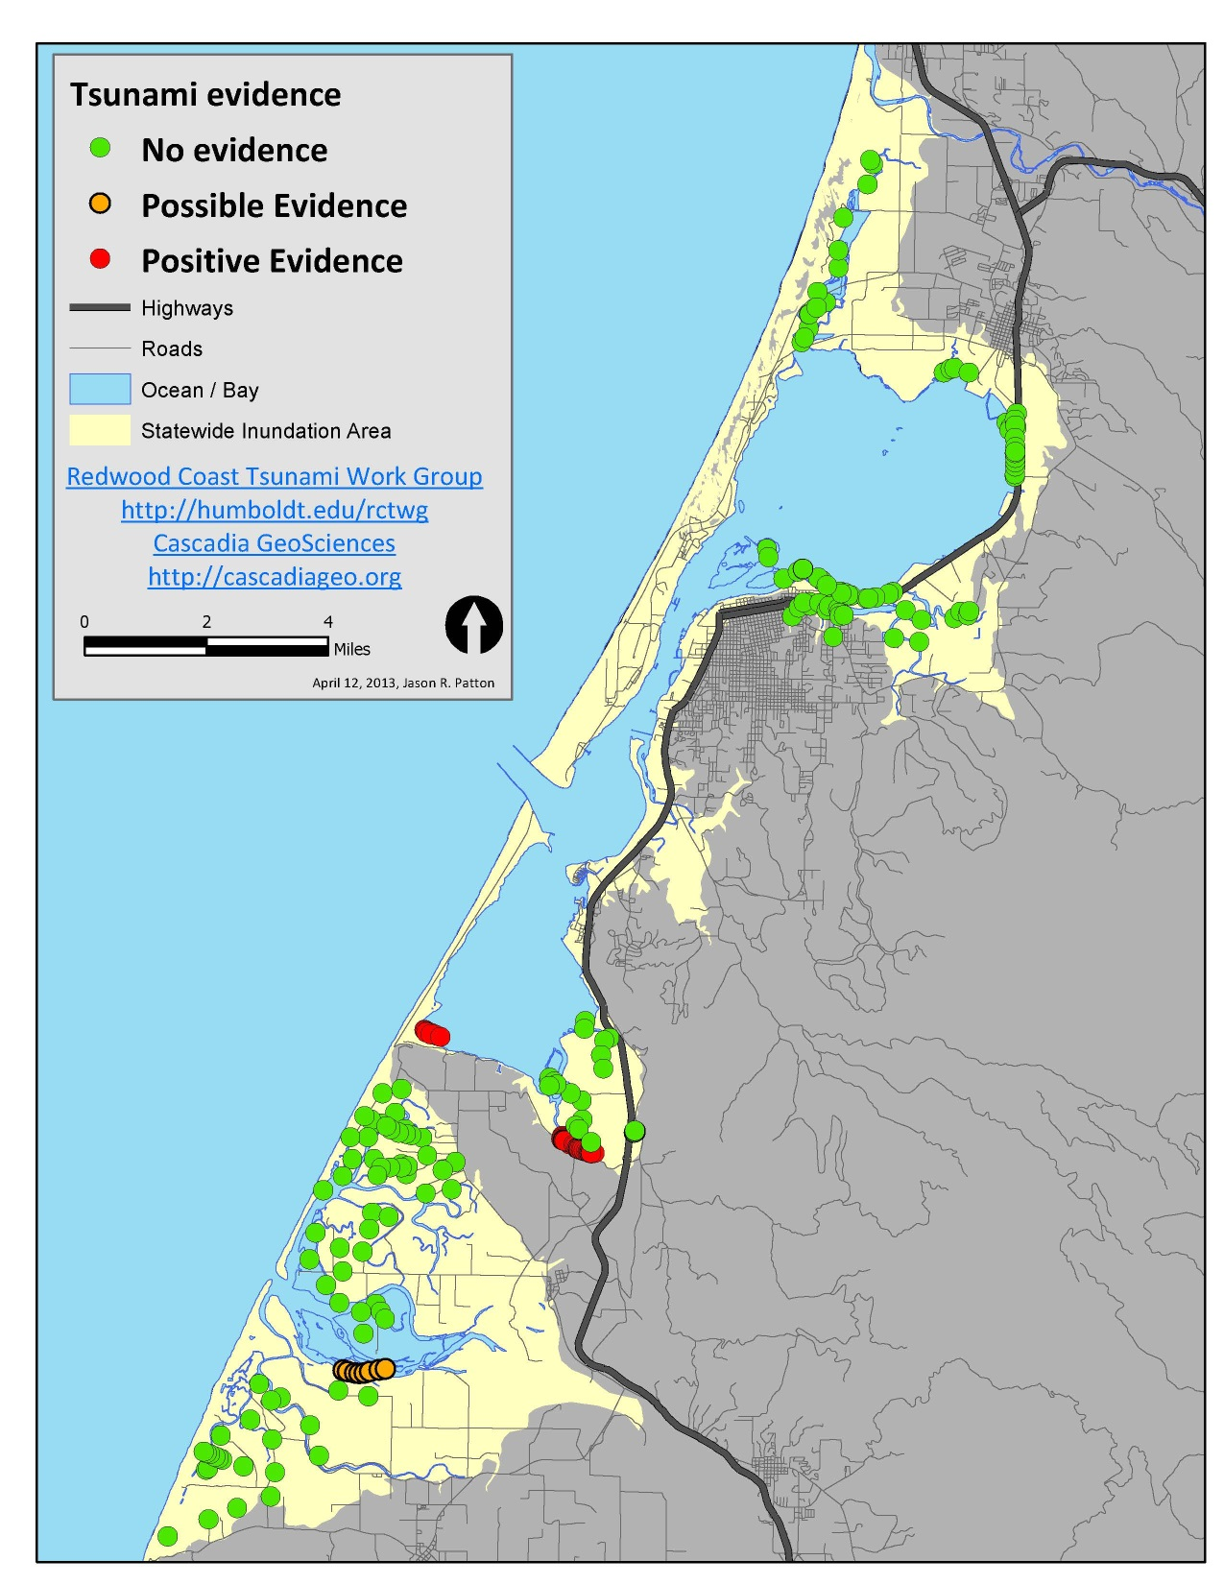
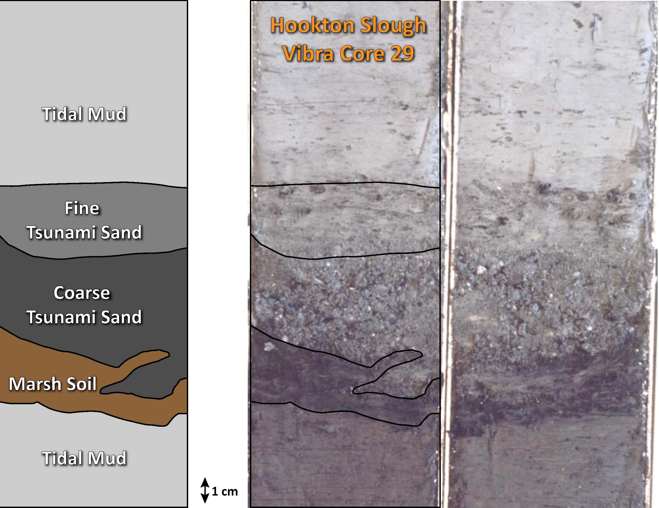
Humboldt Bay
Earthquake/tsunami evidence
Patton, 2004
Hookton Slough
Notes:
… including in Humboldt Bay, where I worked with Rob Witter and Harvey Kelsey to document evidence for coseismic subsidence and prehistoric tsunami along the margin of Humboldt Bay.
On the left is a core we collected from along Hookton Slough, a trib to Humboldt Bay. We interpret this to have a once-happy brown marsh soil, overlain by a coarse sand and sandy mud we interpret to be a tsunami deposit, then again overlain by tidal mud.
The map on the right shows core locations where we have evidence for coseismic subsidence in green and tsunami deposits in red.

Slide 10
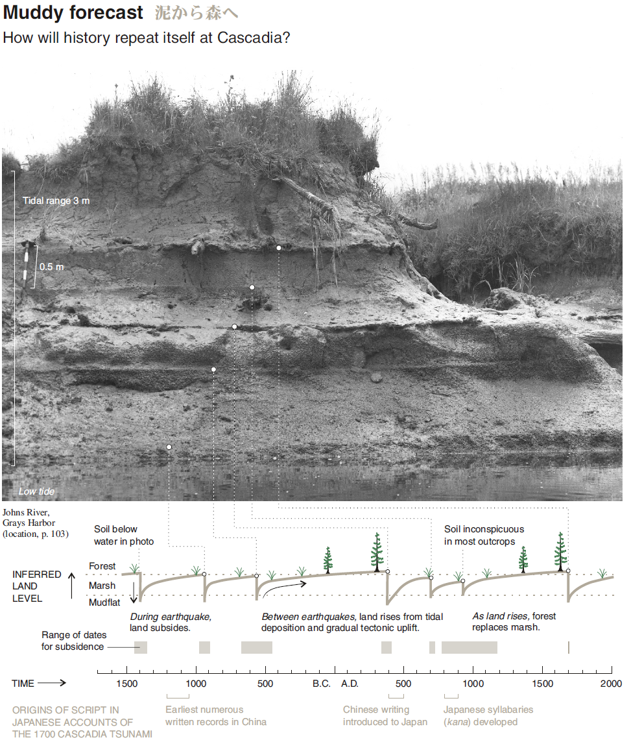
Atwater et al., 2005
Compilation of
earthquake evidence
Geologic evidence for prehistoric Cascadia subduction zone earthquakes exists along the shoreline from California to Canada.
Dr. Atwater compiled these data in a free to download paper:
The Orphan Tsunami:
USGS Professional Paper 1707
Notes:
Brian Atwater in 2005 published a compilation of the earthquake records in Cascadia. Each horizontal line in the photo represents an earthquake buried soil.
Download this professional paper for free to learn more, search for “the orphan tsunami.”

Slide 11
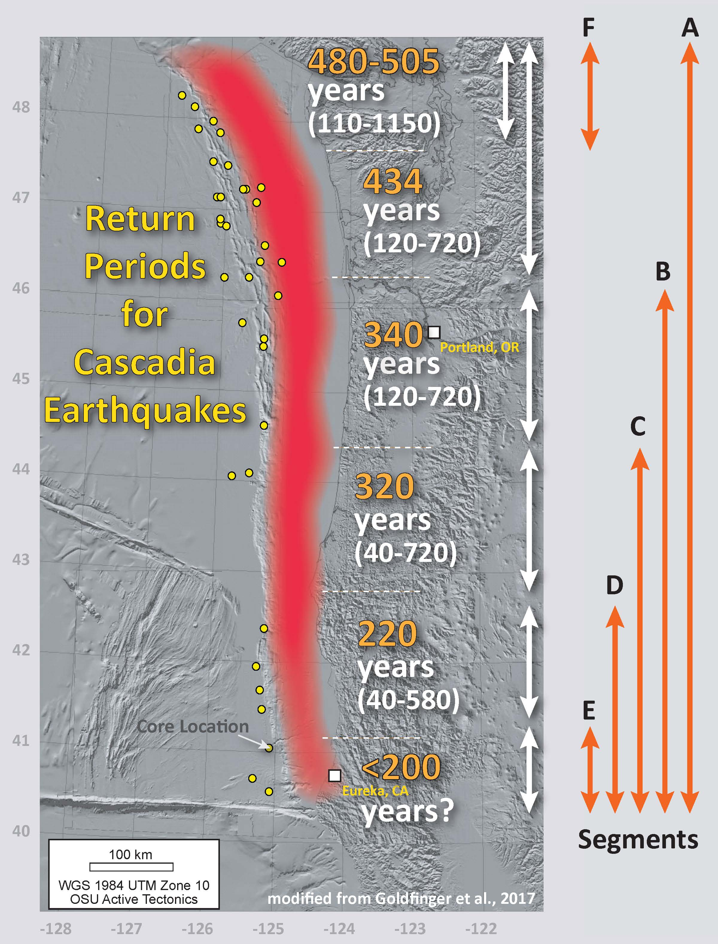
Earthquake Recurrence Pattern
Using sediment cores collected in the deep sea offshore of Cascadia, we found evidence for earthquake triggered submarine landslide deposits (“turbidites”).
These data, combined with onshore data, allowed us to conclude that the subduction zone has earthquakes in different places at different times (in places called “segments”).
Using this 10,000-year record of earthquakes, we have estimates of how frequently these earthquakes recur in these different segments.
This updated illustration shows
these recurrence intervals. >>>
Notes:
Using sediment cores collected in the deep sea offshore of Cascadia, we found evidence for earthquake triggered submarine landslide deposits called “turbidites.”
These data, combined with onshore data, allowed us to conclude that the subduction zone has earthquakes in different places at different times (in places called “segments”).
Using this 10,000-year record of earthquakes, we have estimates of how frequently these earthquakes recur in these different segments.
This updated illustration shows these recurrence intervals. Note that the return period for Cascadia quakes in northern CA and southern OR is about 220 years.
Text from earlier talk:
Following work we have done after we published our USGS professional paper, we identified additional earthquake records and even found a fault segment that causes earthquakes limited to the northern margin. This on the right is an updated list of recurrence intervals for each of these segments, with latitudinal ranges shown by the orange arrows.
Our recent work offshore of northern California, where we have identified turbidites from crustal earthquakes like the 1980 Trinidad and 1992 Cape Mendocino earthquakes, suggest that the records found in the Trinidad canyon and further south (segment E) likely include non megathrust sources. The recurrence interval for turbidites near the mouth of Eel Canyon is at least as low as about 40 years. We will be presenting this work at AGU.

Slide 12
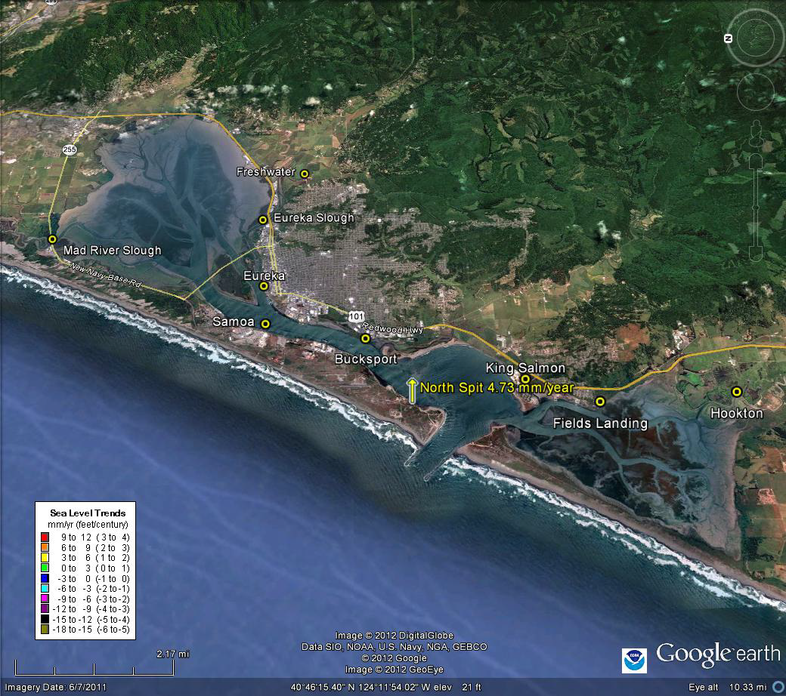
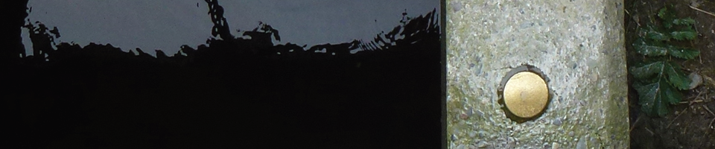
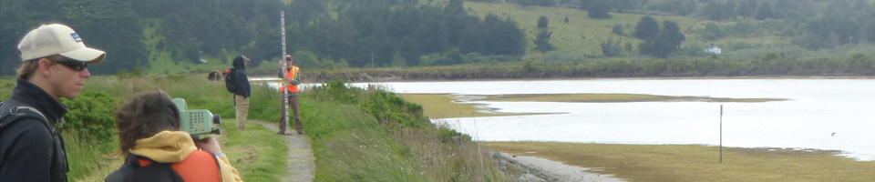
BUT what does this mean for Sea-Level Rise?
Humboldt Bay Vertical Reference System Working Group (HumBayVert)
http://hbv.cascadiageo.org
Cascadia GeoSciences, Northern Hydrology, HSU Geology, U of O Geology, & Humboldt Bay Initiative members
Notes:
BUT what does this earthquake stuff mean for sea-level rise in the Humboldt Bay region?
Enter the Humboldt Bay Vertical Reference System Working Group formed by Todd Williams. Todd formed this group of over 30 local, state, and federal organizations and stakeholders to address anomalous tide gage data from NOAA and benchmark survey data from Cal Trans.

Slide 13
Geodesy is the science of accurately measuring and understanding the Earth's geometric shape, orientation in space, and gravity field.
… measuring and understanding the Earth's geometric shape…
We sought geodetic data to evaluate the plate tectonic deformation as it contributes to spatial variation in sea-level rise rates.
https://oceanservice.noaa.gov/facts/geodesy.html
Notes:
We used geodesy, the science of measuring and understanding Earth’s geometric shape, to evaluate the plate tectonic deformation as it contributes to spatial variation in sea-level rise rates in coastal northern California.

Slide 14
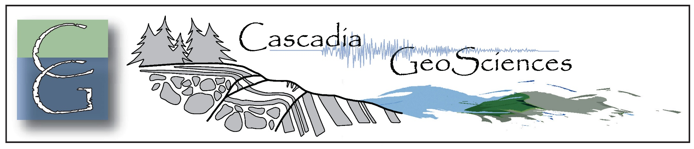



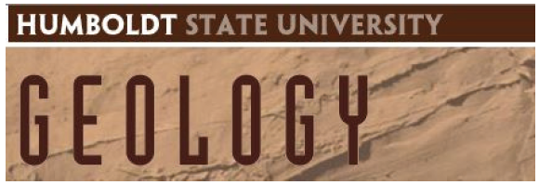

Humboldt Bay Vertical Reference System Working Group
(founded by Todd Williams, M.S.)
  US. Fish and Wildlife Service
  Northern Hydrology
  Pacific Watershed Associates
  Humboldt State University
  University of Oregon
Tide Gages
Benchmark Leveling
GPS
Notes:
Following several workshops, a subset of HumbayVert sought funding from the USFWS to use tide gage data, benchmark leveling data, and GPS data to independently evaluate the vertical land motion here. The key players in this project came from a variety of organizations in consulting, academia, and government.

Slide 15
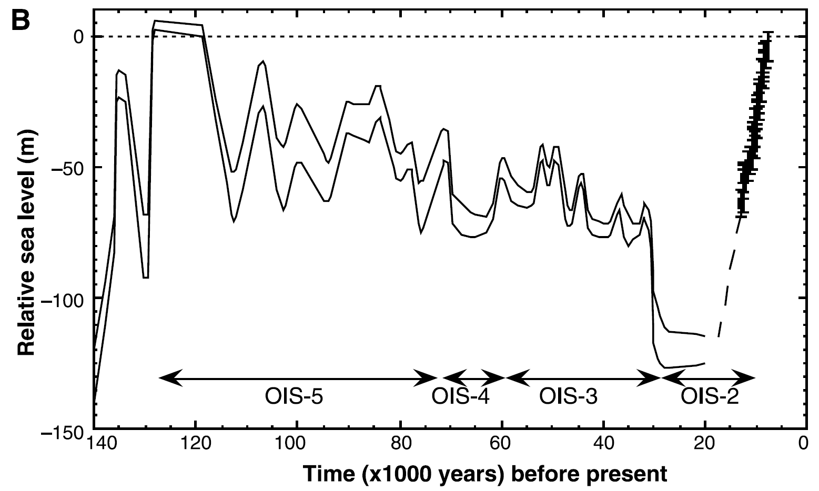
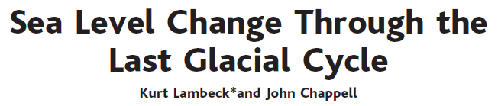
SCIENCE VOL 292 27 APRIL 2001
Relative sea level at Huon Peninsula, Papua New Guinea
Notes:
Hopefully a review slide for everyone here, this plot shows relative sea level at Huon Peninsula, Papua New Guinea, for the past 140,000 years inferred from the height-age relations of raised reefs and from submerged fossil corals for the past 13,000 years. The fluctuations are the result of the glacial cycle induced changes in continental-based ice volumes. Since the last glacial maximum, about 22ka, sea level has been rising due to melting glaciers, thermal expansion, and other factors. Based on the most recent analysis in the northeast Pacific from Ray Weldon and others, the current rate of sea-level rise is less than about 2 mm/yr.
2018 paper: https://doi.org/10.1002/2017JC013257 2021 paper: https://doi.org/10.3390/w13030281

Slide 16
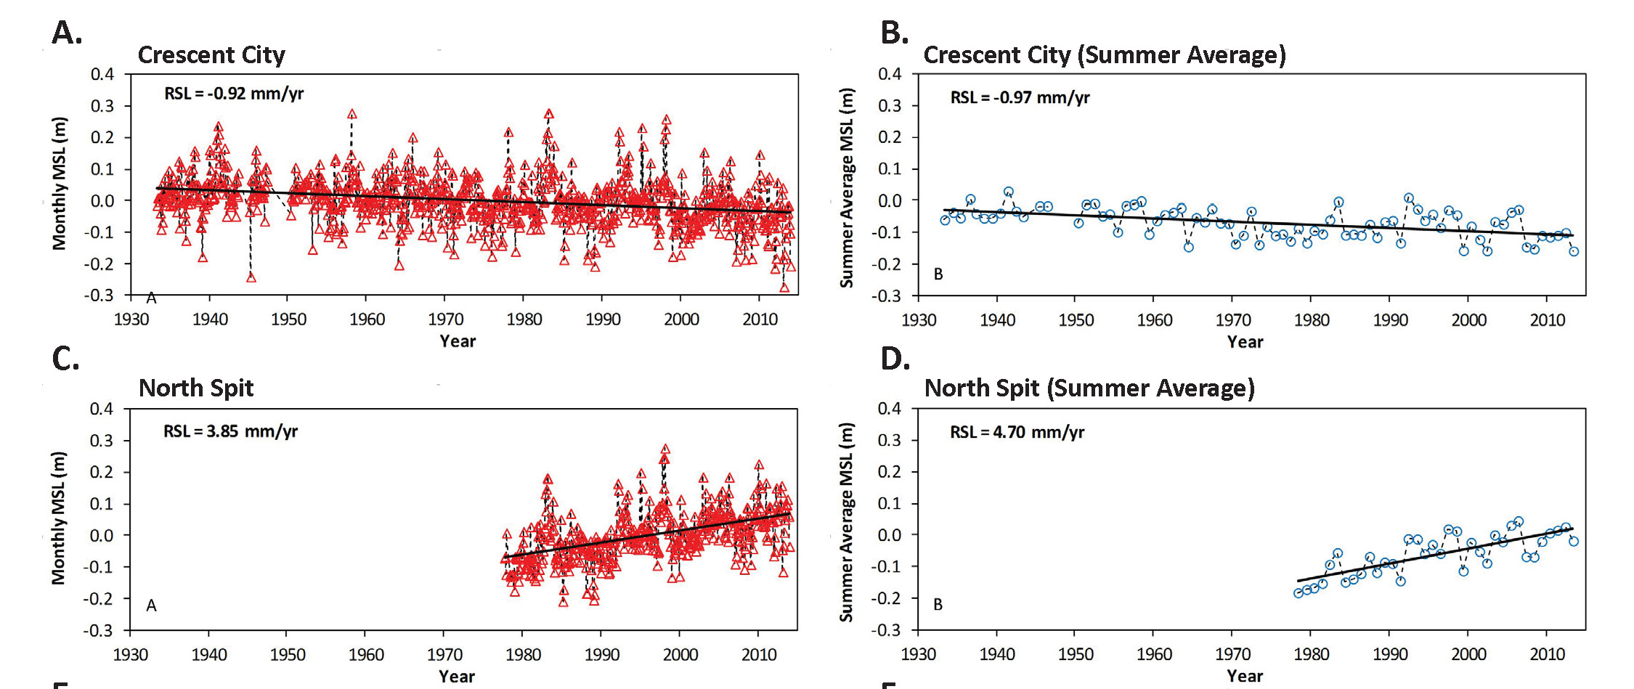
North Spit
Relative Sea-Level
Tide Gage data from Crescent City and North Spit; monthly means in red and summer average in blue.
What is going on in Crescent City? Why is sea level falling there?
Notes:
Here are tide gage data from the Crescent City and the North Spit tide gages. Monthly means are in red and the three-month summer average is in blue. Kopp 2014 suggests that the summer average is better to evaluate SLR rates because it mostly eliminates confounding factors like storm surge.
What is going on in Crescent City? Why is sea level is going down?
What is going on at the North Spit? Why is sea level is rising faster than 2 mm/yr?

Slide 17
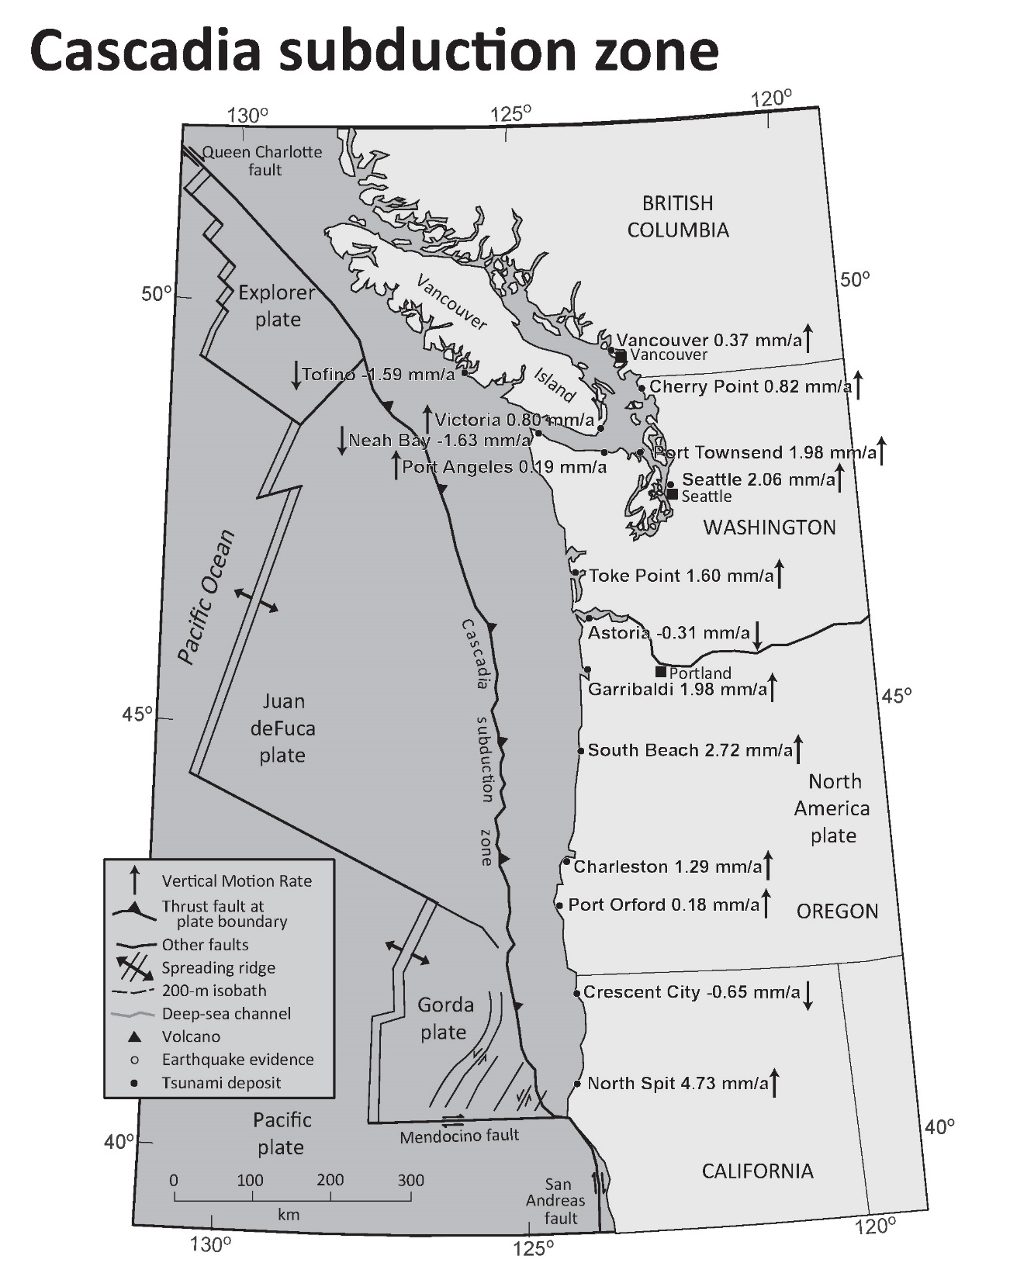
If sea level is falling, that means that the land is rising faster than sea level.
If sea level is rising faster than regional sea level, that means that the land is subsiding (going down).
The crust at the Crescent City tide gage is experiencing tectonic uplift and the crust at the North Spit tide gage is tectonically subsiding.
Notes:
If sea level is falling at a tide gage, that means that the land is rising faster than sea level is rising.
Likewise, if sea level at a tide gage is rising faster than the regional sea level rate, that means that the land is subsiding (going down).
The short answer is that the crust at the Crescent City tide gage is experiencing tectonic uplift and the crust at the North Spit tide gage is tectonically subsiding.
BUT to better answer these important questions, we need to know more about the spatial variation in vertical land motion.

Slide 18
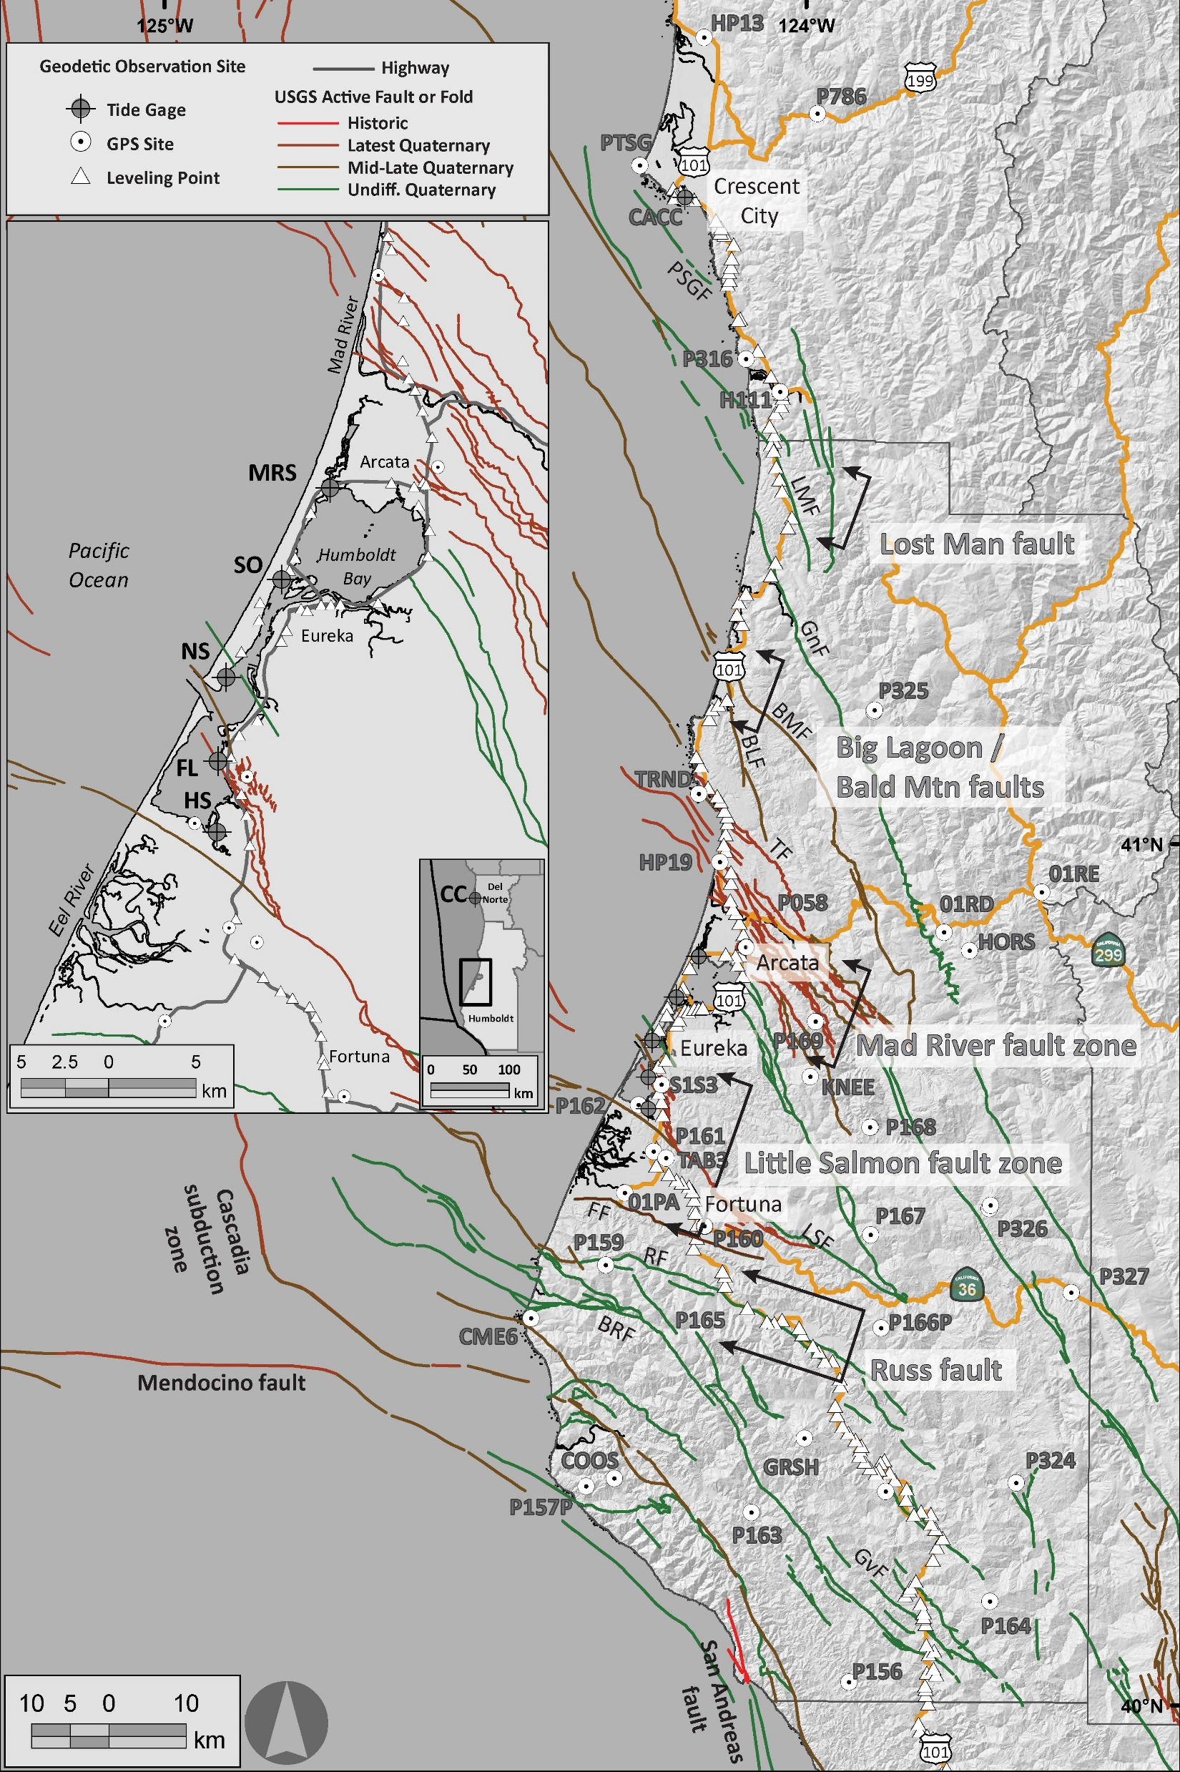
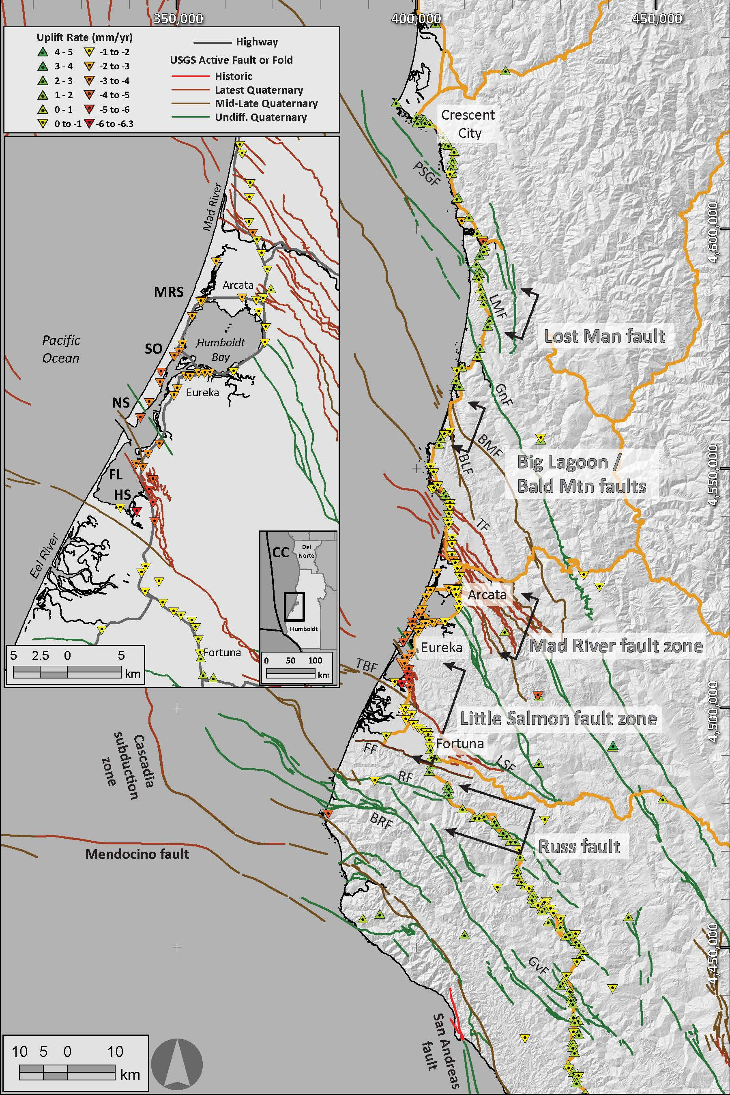

We use three types of geodetic data:
  Tide Gage
  GPS Site
  Benchmark Site
<<< This map shows the spatial distribution of geodetic sites in our study.
The next map series shows the results from our analyses.
Notes:
As I mentioned, we use three independent types of geodetic data.
The map on the left shows how our data points are well distributed across the region. I also plot the known active faults in the region as they may also control vertical land motion. CLICK
Here we see the results of our analyses. Downward pointing triangles (warmer colors) represent subsidence and upward pointing triangles (cooler colors) represent uplift.

Slide 19
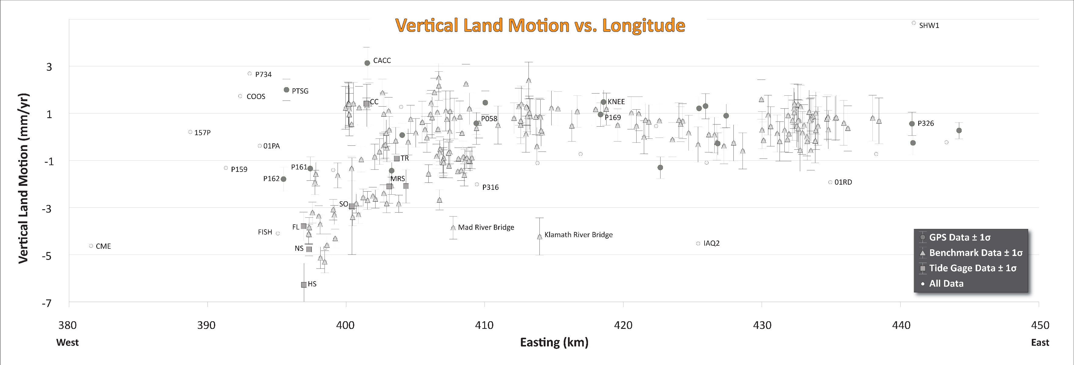
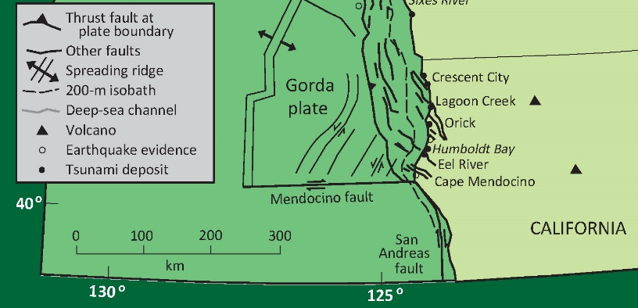
West
East
All geodetic data provide evidence for westward down warping of the crust associated with Cascadia subduction zone tectonics.
Notes:
Here is a West-East cross section of these data with vertical land motion on the vertical axis. Click All geodetic data provide evidence for westward down warping of the crust. We attribute this phenomena to the locked megathrust subduction zone fault. However, upper plate crustal faults also appear to be controlling vertical land motion.

Slide 20
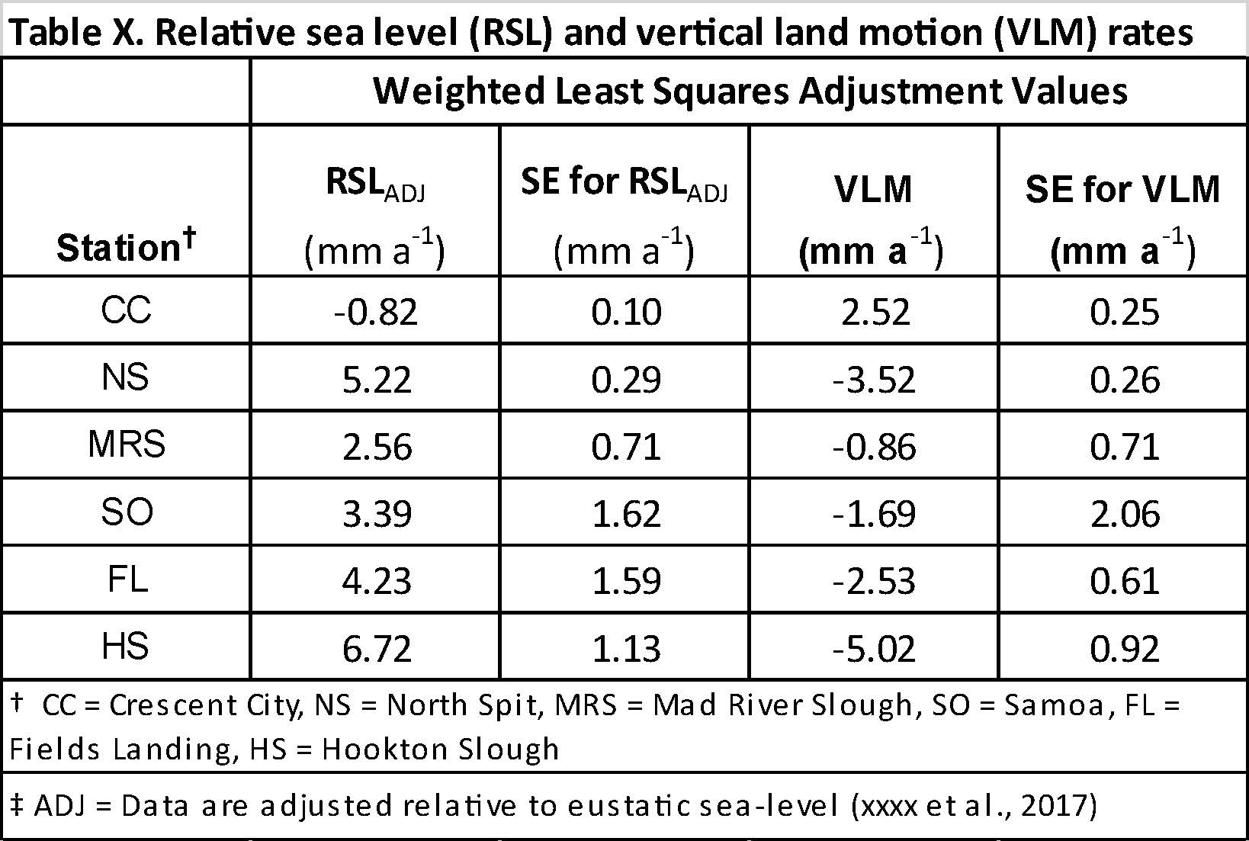
DRAFT TABLE
Thank You!
Jason “Jay” R. Patton Ph.D. PG 9758
Engineering Geologist
Tsunami Unit/CGS Seismic Hazards Program
Jason.Patton@conservation.ca.gov
also, Adjunct Faculty, HSU Dept. of Geology
There is a large team of geologists who have contributed to the content in this presentation!
Are there
any questions?
California Department of Conservation | tsunami.ca.gov
List of Partners
    California Geological Survey
    California Governor's Office of Emergency Services
    County and City Officials in Humboldt County
    Redwood Coast Tsunami Work Group
    National Weather Service
    Humboldt State University
    University of Southern California
    AECOM
    National Tsunami Hazard Mitigation Program
Notes:
Here is a table with our updated estimates of sea-level rise and vertical land motion. I am happy to answer any questions, now or afterwards.

Slide 22
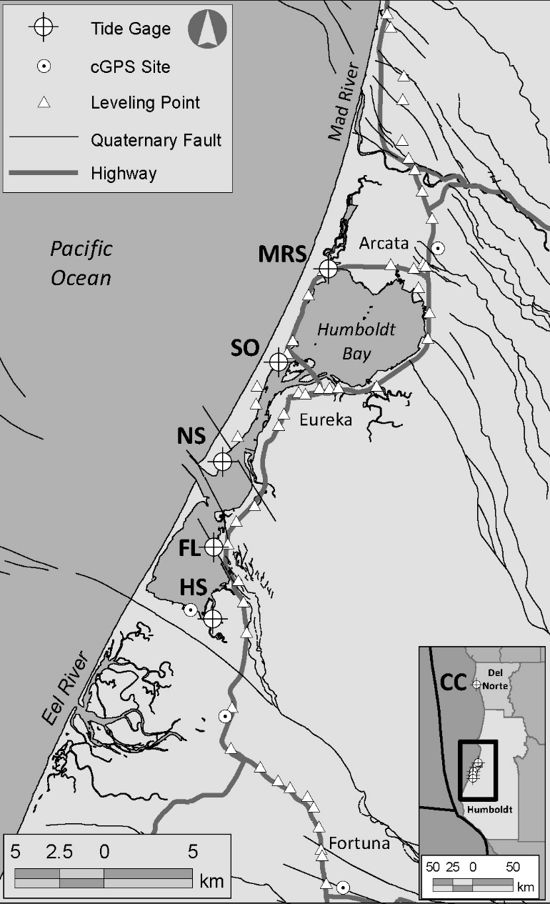
Tide Gage Sites (1970’s-2010’s)
  Crescent City (NOAA; 1930’s)
  Mad River Slough (NHE)
  Samoa (ACOE, Towill)
  North Spit (NOAA)
  Fields Landing (ACOE, Towill)
  Hookton Slough (HBV)

Slide 23
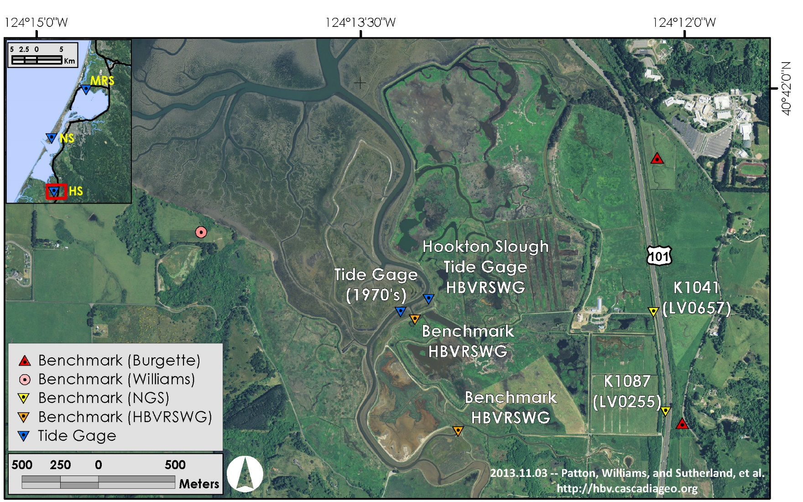
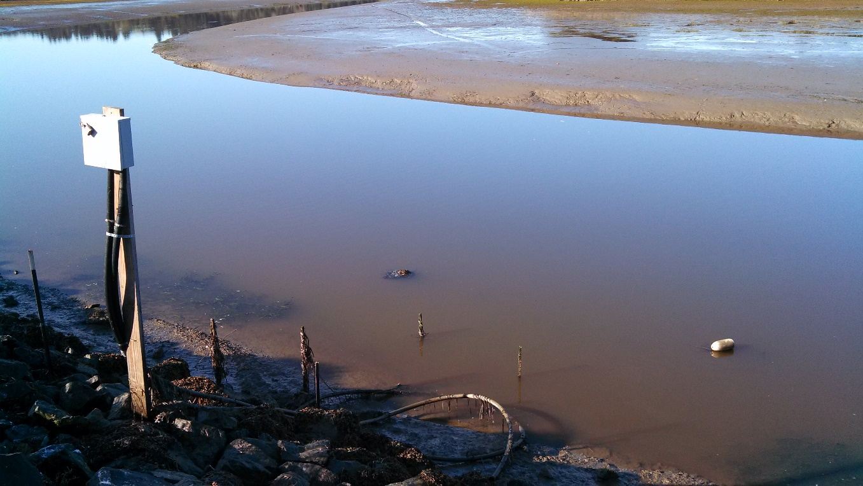
Hookton Slough

Slide 24
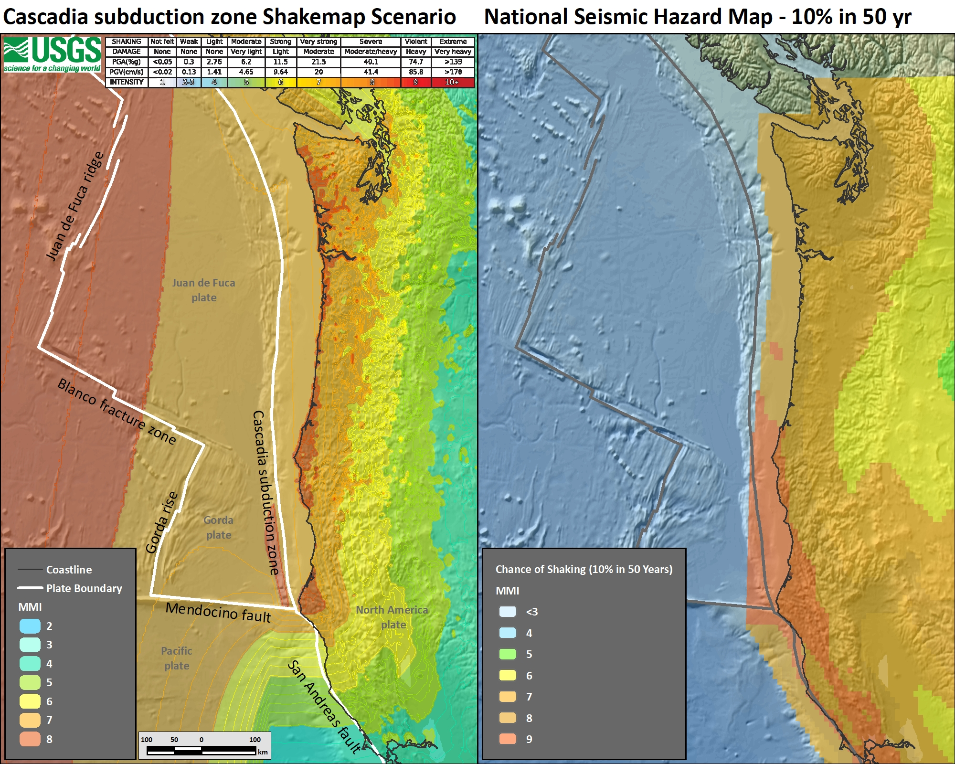
Seismic Hazards
in the
Pacific Northwest
Why do we care?
Left:
A map displaying a USGS model for Shaking Intensity from a M9 Cascadia megathrust fault earthquake.
Right:
The USGS Seismic Hazards Map (2018) for the chance of shaking from all fault sources.
We care because, as a society, we want to prevent suffering.
Notes:
As a society, we want to prevent suffering. It is as simple as that.
These two maps use USGS data to show earthquake hazards with color. Warmer colors = higher hazard.
The map on the left is a USGS earthquake scenario shakemap for the CSZ, showing how strongly it might shake during a CSZ earthquake using the MMI scale. The further away from the earthquake, the less intense the shaking will be.
The map on the right is from the USGS National Seismic Hazard Map, which includes all known active faults. So, it not only includes the CSZ and San Andreas plate boundary faults, but also crustal faults not along the plate boundary.

Slide 25
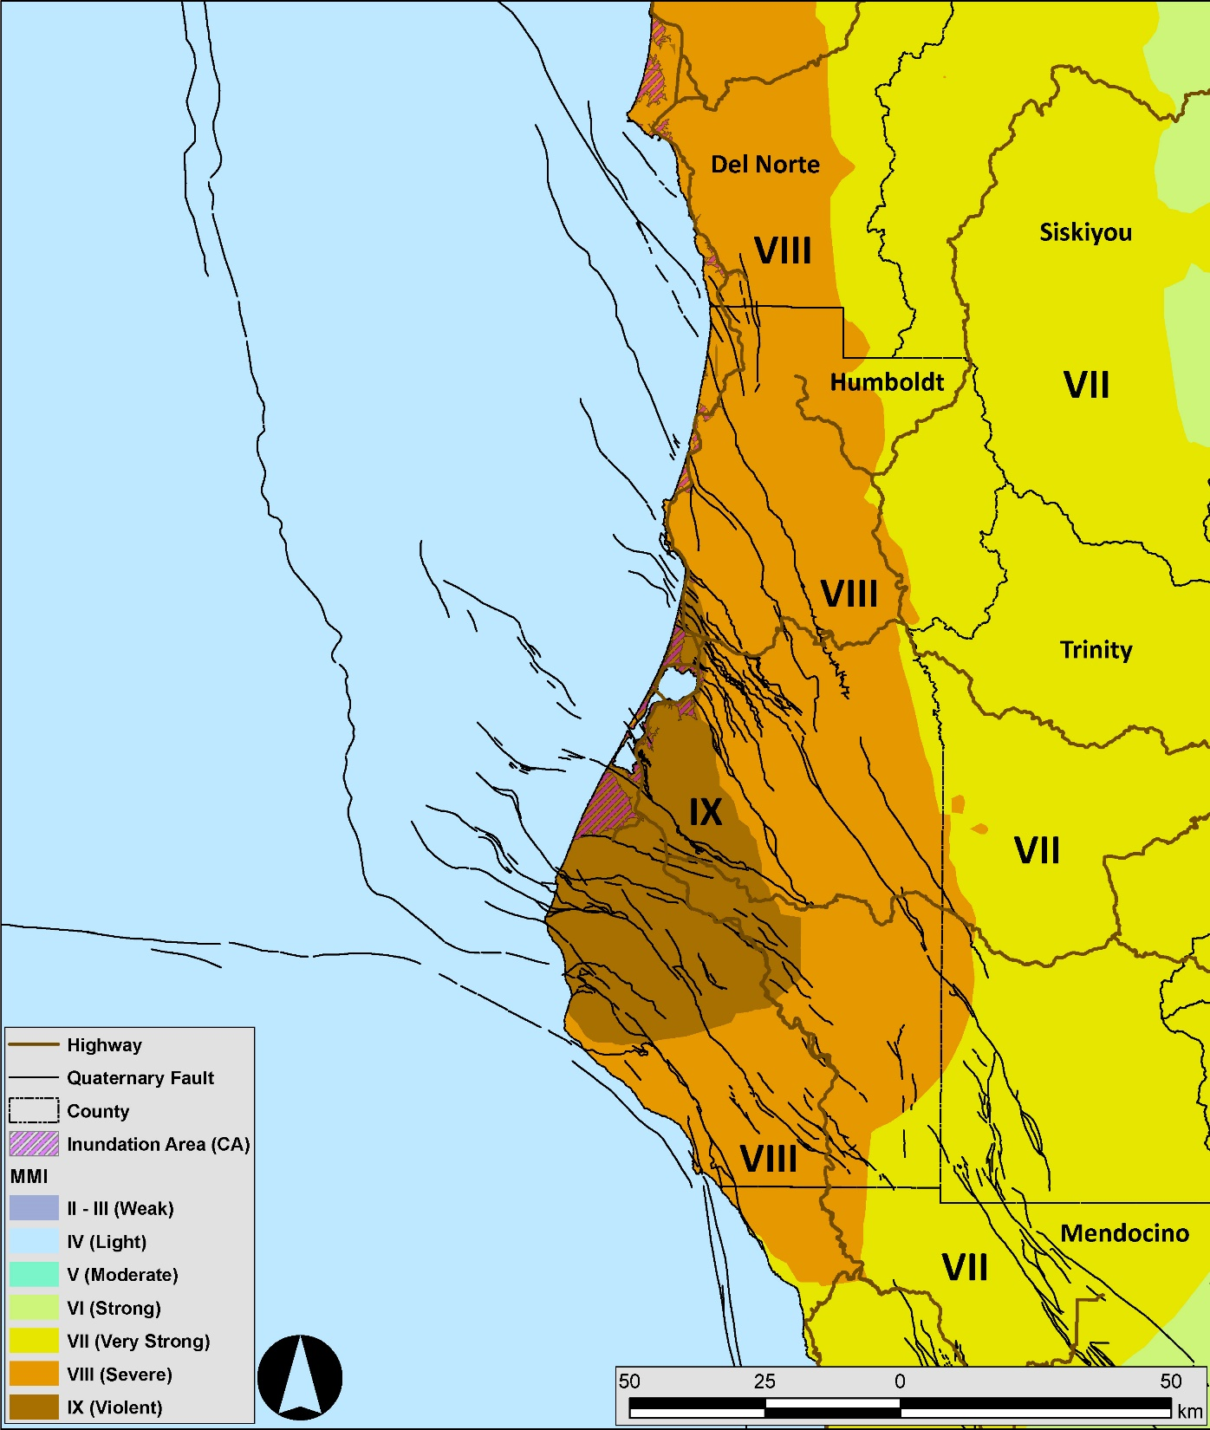
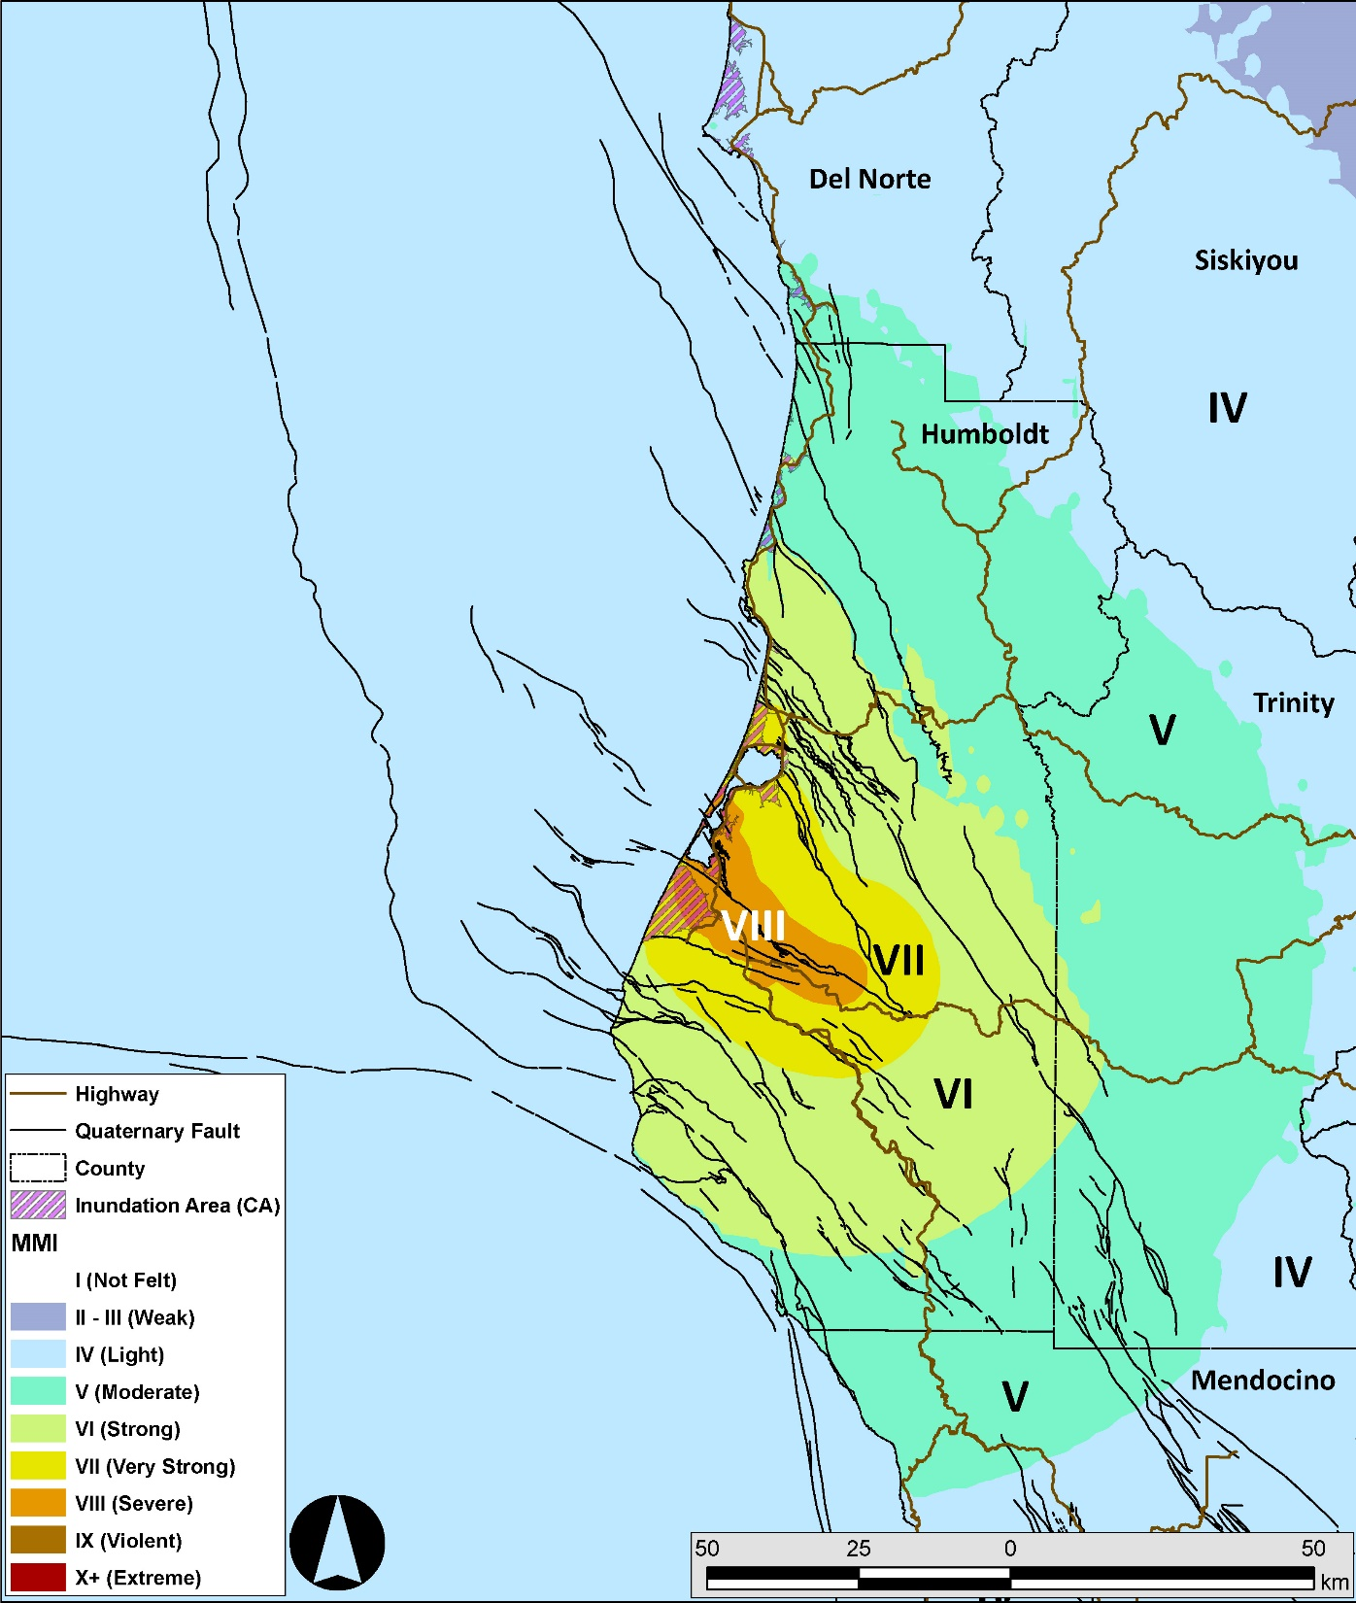
MMI IX: Some well-built wooden structures destroyed; Most masonry and frame structures destroyed with foundations
Cascadia
Earthquake
Scenario
Crustal Fault
Earthquake
(Little Salmon fault)
Scenario
Notes:
Here is a larger scale view of northern California, Humboldt County. On the left is the scenario shakemap for the CSZ where there may be intensities exceeding MMI 9.
On the right is a scenario shakemap for the Little Salmon fault, an active crustal fault that Tyler Ladinsky here at CGS is studying. So, there are lots of faults and lots of hazard we need to consider.

Slide 26
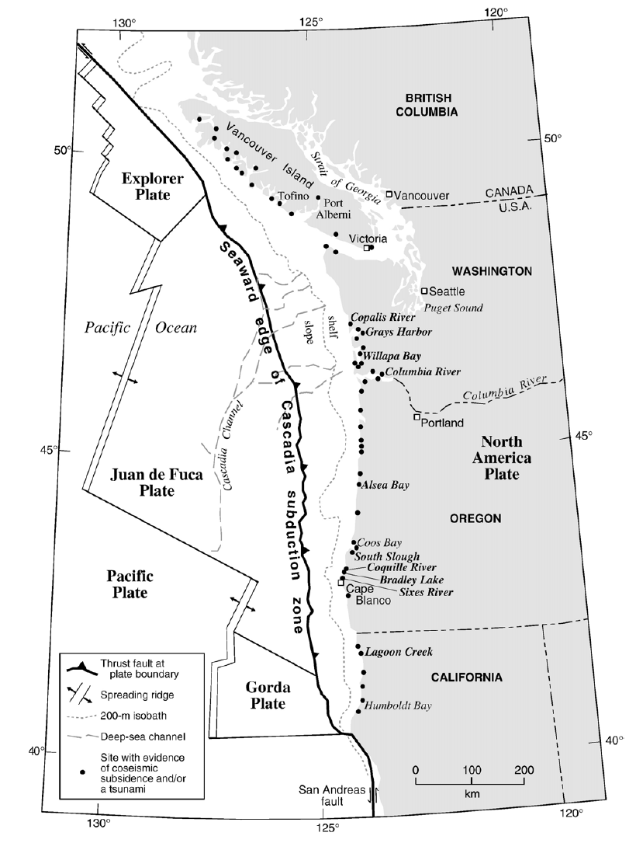
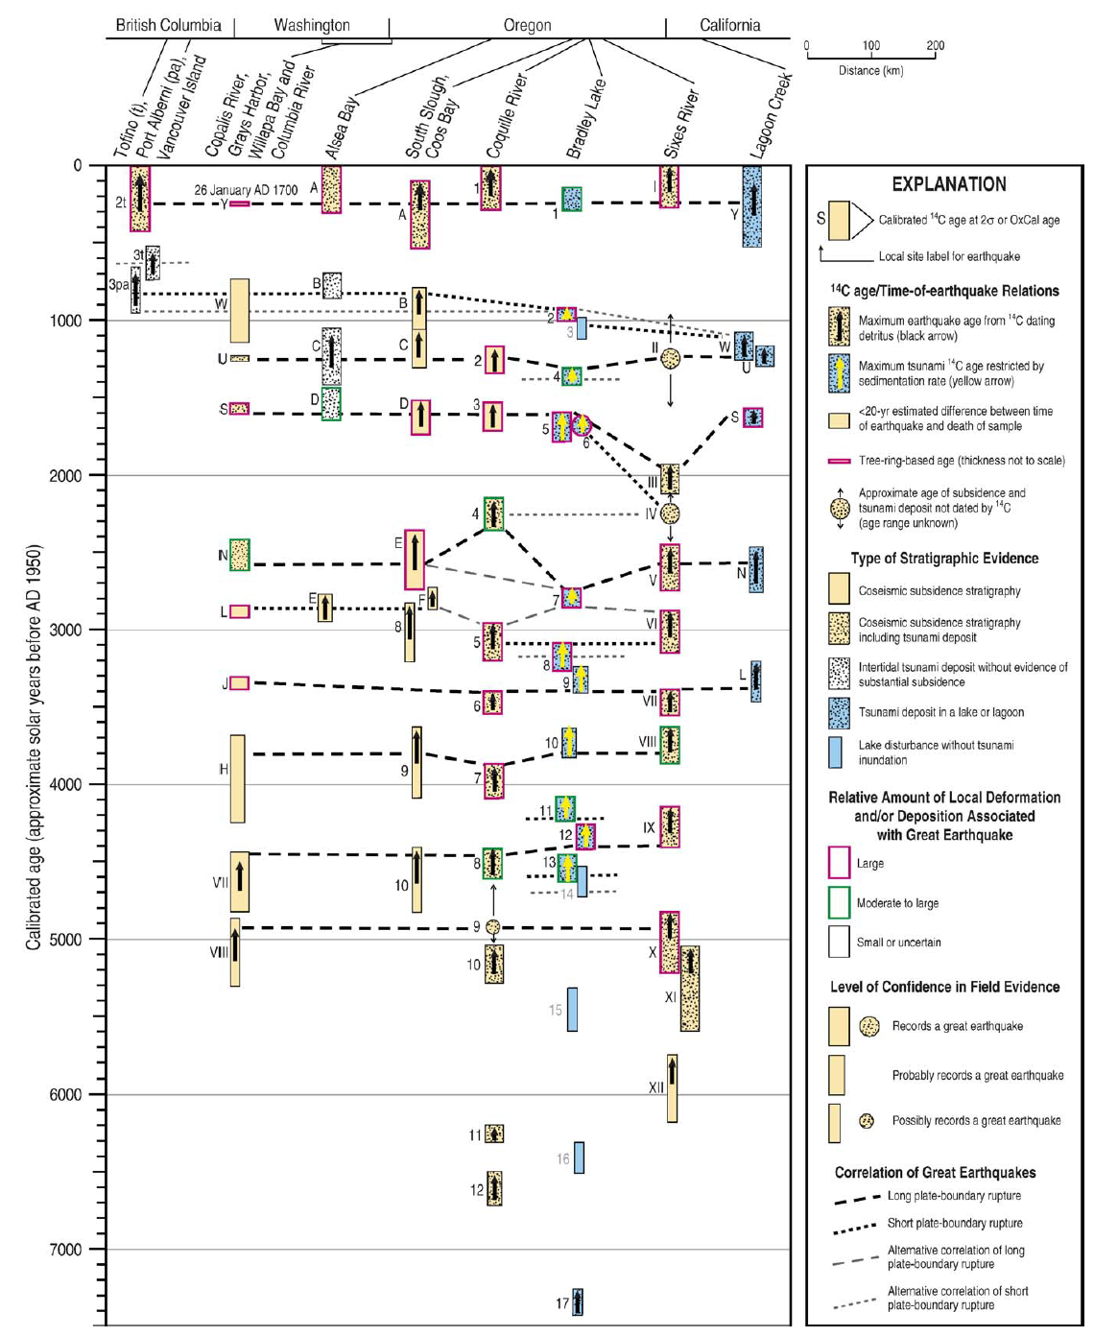
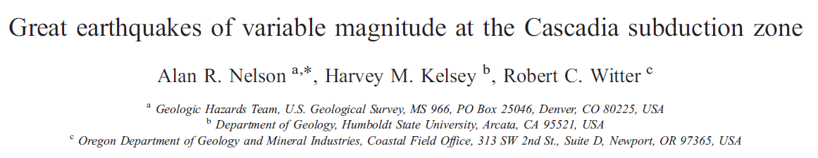
North
South
(2006)
Time (years)
Compilation is based on correlation using radiocarbon ages.
Notes:
One of the biggest challenges for megathrust paleoseismologists is correlating their stratigraphic evidence from location to location. These earthquake buried soils are not continuous across the landscape, they do not extend from British Columbia, through Washington and Oregon, to California.
The reason it is important to correlate these data from site to site is that this helps constrain the earthquake size. The larger of an area that has evidence for an earthquake at a particular time tells us that the earthquake had a larger magnitude. Earthquake size is controlled by the area that slipped, the amount the fault slipped, and some information about the crust (the bulk modulus) and how much it can deform elastically. For subduction zones, the length of the fault (for Cascadia, this is measured roughly north to south) is generally the primary control of earthquake size, all other things being equal.
To date (sorry for the pun), the primary method to correlate these evidences of earthquakes is by using radiocarbon ages. However, due to the way radiocarbon ages are calculated and calibrated, these results have uncertainty which can cause problems with correlation.
The map on the left shows a compilation of paleoseismic data from Big Al (2006), where each dot represents a paleoseismic site that they evaluated.
On the right is a “space-time” diagram, with distance (north on the left, south on the right) on the horizontal axis and time (1950 at the top and 7000 years ago on the bottom). Each site is listed at the top (don’t try to read this now). For each earthquake record there is a rectangle that represents the age estimate for that earthquake. Note the vertical size of these rectangles as this represents the uncertainty of that radiocarbon age (some may call this the “error”).
The dashed lines represent how these authors correlated earthquake evidence from site to site. In some cases, it is difficult or impossible to correlate these evidences.

Slide 27
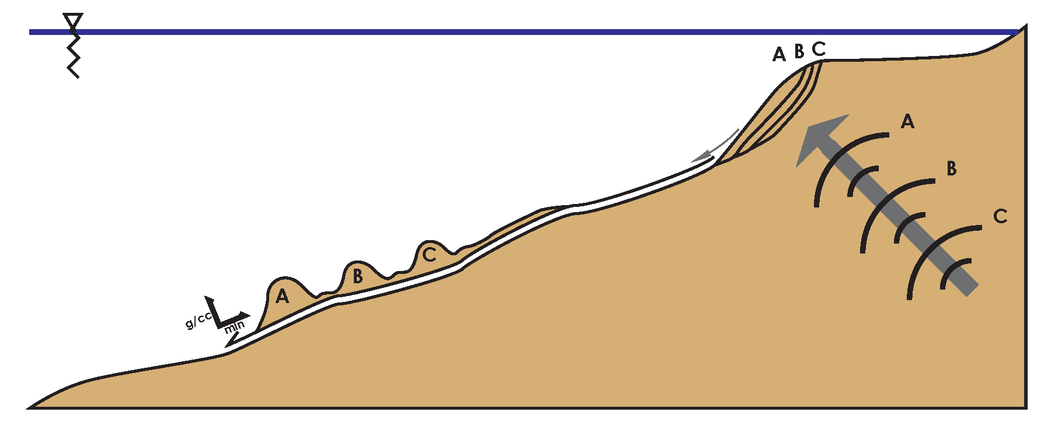
Earthquakes, ground motions, landslides, turbidity currents, and turbidites:
Seismic Forcing of Slope Stability
  Earthquake creates Ground Motions
  Ground Motions trigger Landslides
  Landslides transform into Turbidity Currents
  Turbidity Currents leave deposits called Turbidites
Submarine Landslides
Turbidity Current
Ground Motion
Earthquake
Notes:
27
So, what do turbidites have to do with earthquakes?
The hypothesis is this:
An earthquake generates strong ground motions Click, let’s say in three big pulses in this example. Click
Each pulse of energy triggers a submarine slope failure, so 3 landslides.
As the landslide moves downslope, it transforms from a debris flow into a turbidity current with three main pulses of high energy flow.
The turbidity current is deposited downslope and the structure (the layering) of the turbidite includes layers representing these 3 pulses.
You might ask, “Jay, do you have any examples of this?” Click

Slide 28
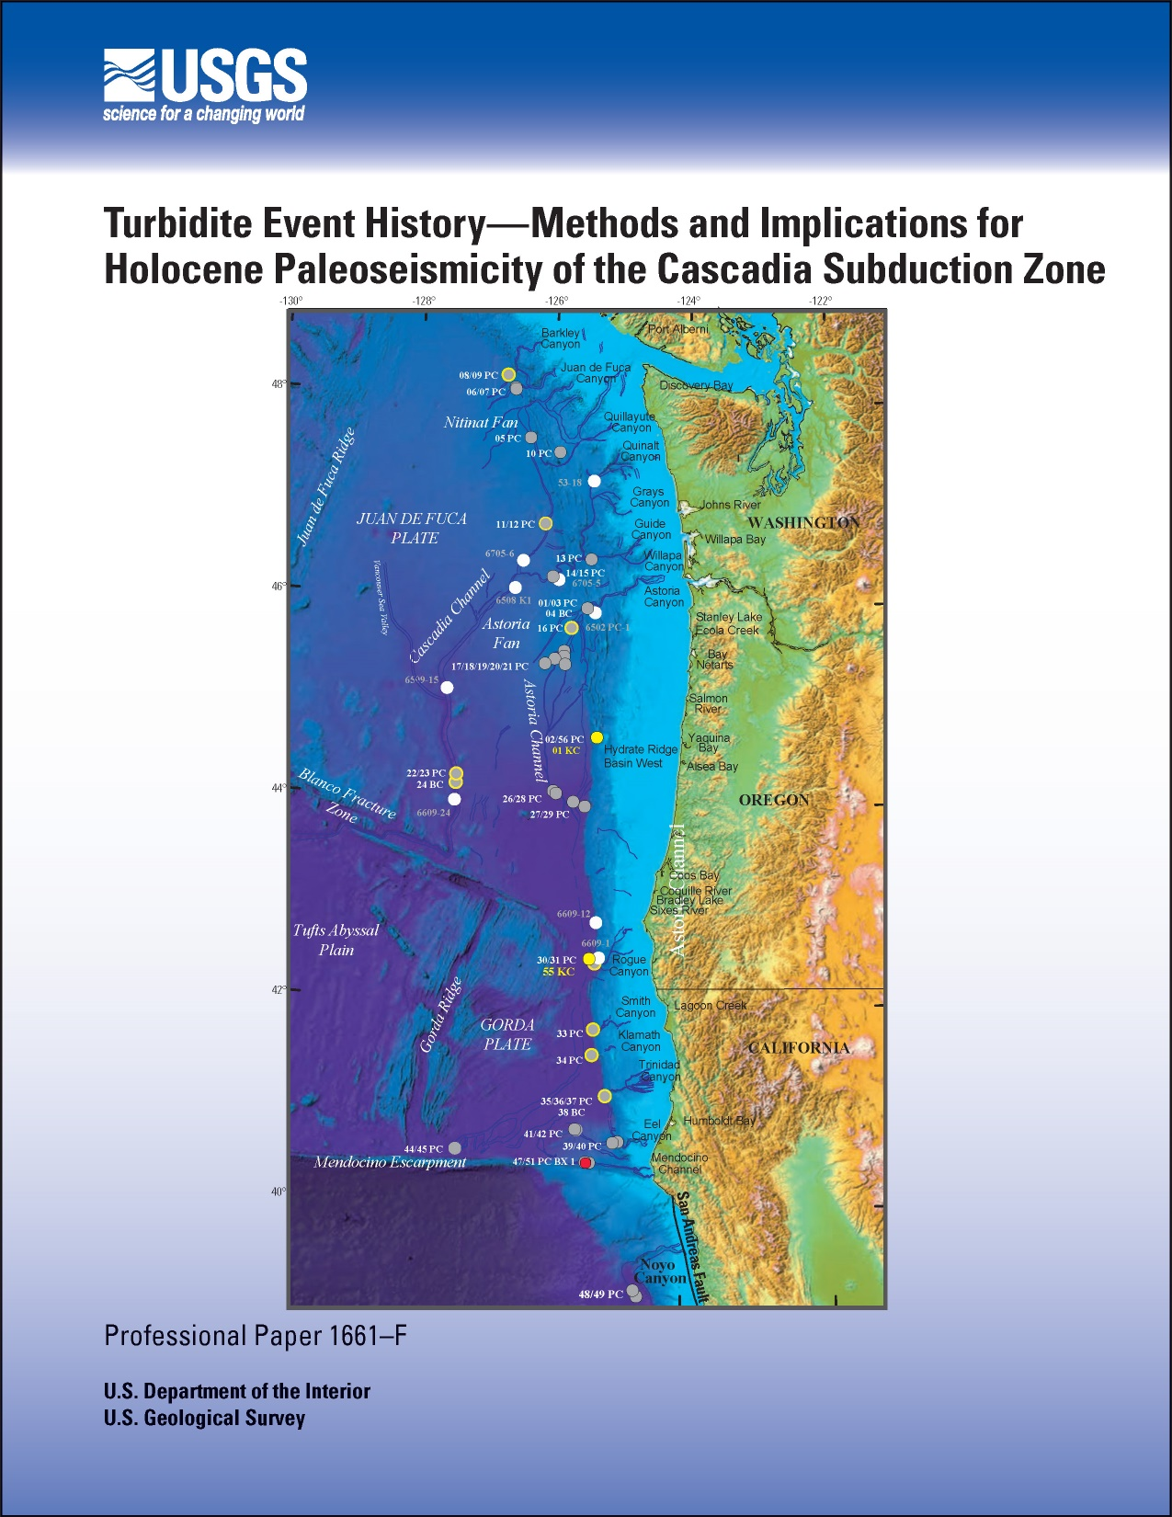
Turbidite Event History—Methods and Implications for Holocene Paleoseismicity of the Cascadia Subduction Zone
Chris Goldfinger¹, C. Hans Nelson², Ann E. Morey¹, Joel E. Johnson¹, Jason R. Patton¹, Eugene Karabanov³, Julia Gutiérrez-Pastor², Andrew T. Eriksson1, Eulàlia Gràcia⁴, Gita Dunhill⁵, Randolph J. Enkin⁶, Audrey Dallimore⁷, and Tracy Vallier⁸
USGS Professional Paper 1661-F
1 Oregon State University, Corvallis, OR
2 Instituto Andaluz de Ciencias del la Tierra, Universidad de Granada, Granada, Spain
3 Institute of Geochemistry, Siberian Branch of Russian Academy of Sciences, Irkutsk, Russia; Chevron Energy Technology Company, Houston, TX
4 Centre Mediterrani d’Investigacions Marines i Amvientals Unitat de Tecnologia Marina, Barcelona, Spain
5 Department of Earth and Environmental Sciences, California State University, East Bay, Hayward, CA
6 Geological Survey of Canada—Pacific, Sydney, B.C., Canada
7 Geological Survey of Canada—Pacific, Sydney, B.C., Canada; Royal Roads University, Victoria, B.C., Canada
8 U.S. Geological Survey, Menlo Park, CA
Notes:
These data are all presented in our USGS Professional Paper, free to download.
Some things to remember.
We want to correlate cores that have unique sediment sources across a broad region.
The largest distance between cores with the same turbidite is the minimum distance for ground shaking from an earthquake. In other words, a turbidite that can be correlated over a larger distance means that the earthquake that triggered that turbidity current was a larger earthquake than that for a turbidite that is correlated over a smaller distance.
We will now look at two cores that satisfy these things, they have unique sources, and their sources are 250 km from each other.

