Slide 1
USGS Tsunami Sources Powell Center Working Group on Tsunami Sources:
Probabilistic Tsunami Hazard Assessment for Pacific Sources (sans AAZ/CSZ)
Jason “Jay” R. Patton – California Geological Survey
*Marie C Eble – Physical Oceanographer
Christodoulos Kyriakopoulos – University of Memphis
Patrick J Lynett – University of Southern California
*Dmitry Nicolsky – University of Alaska Fairbanks
*Stephanie Ross – USGS
Kenny J Ryan – Air Force Research Laboratory Albuquerque
Hong Kie Thio – AECOM
*Rick I Wilson – California Geological Survey
No, one cannot tsurf a tsunami!
https://dribbble.com/shots/696822-Surfing-Tsunami-Animated
* = Principal Investigator
AGU fall meeting 15 December 2023
Notes:
Today I present a summary of the results from the March 2023 U.S. Geological Survey Tsunami Sources Powell Center Working Group Probabilistic Tsunami Hazard Assessment for tsunami sources in the Pacific Basin not including Alaska-Aluetians or Cascadia.
My coauthors, who have seen some of this presentation before, are listed here. The PIs are asterisked.

Slide 2
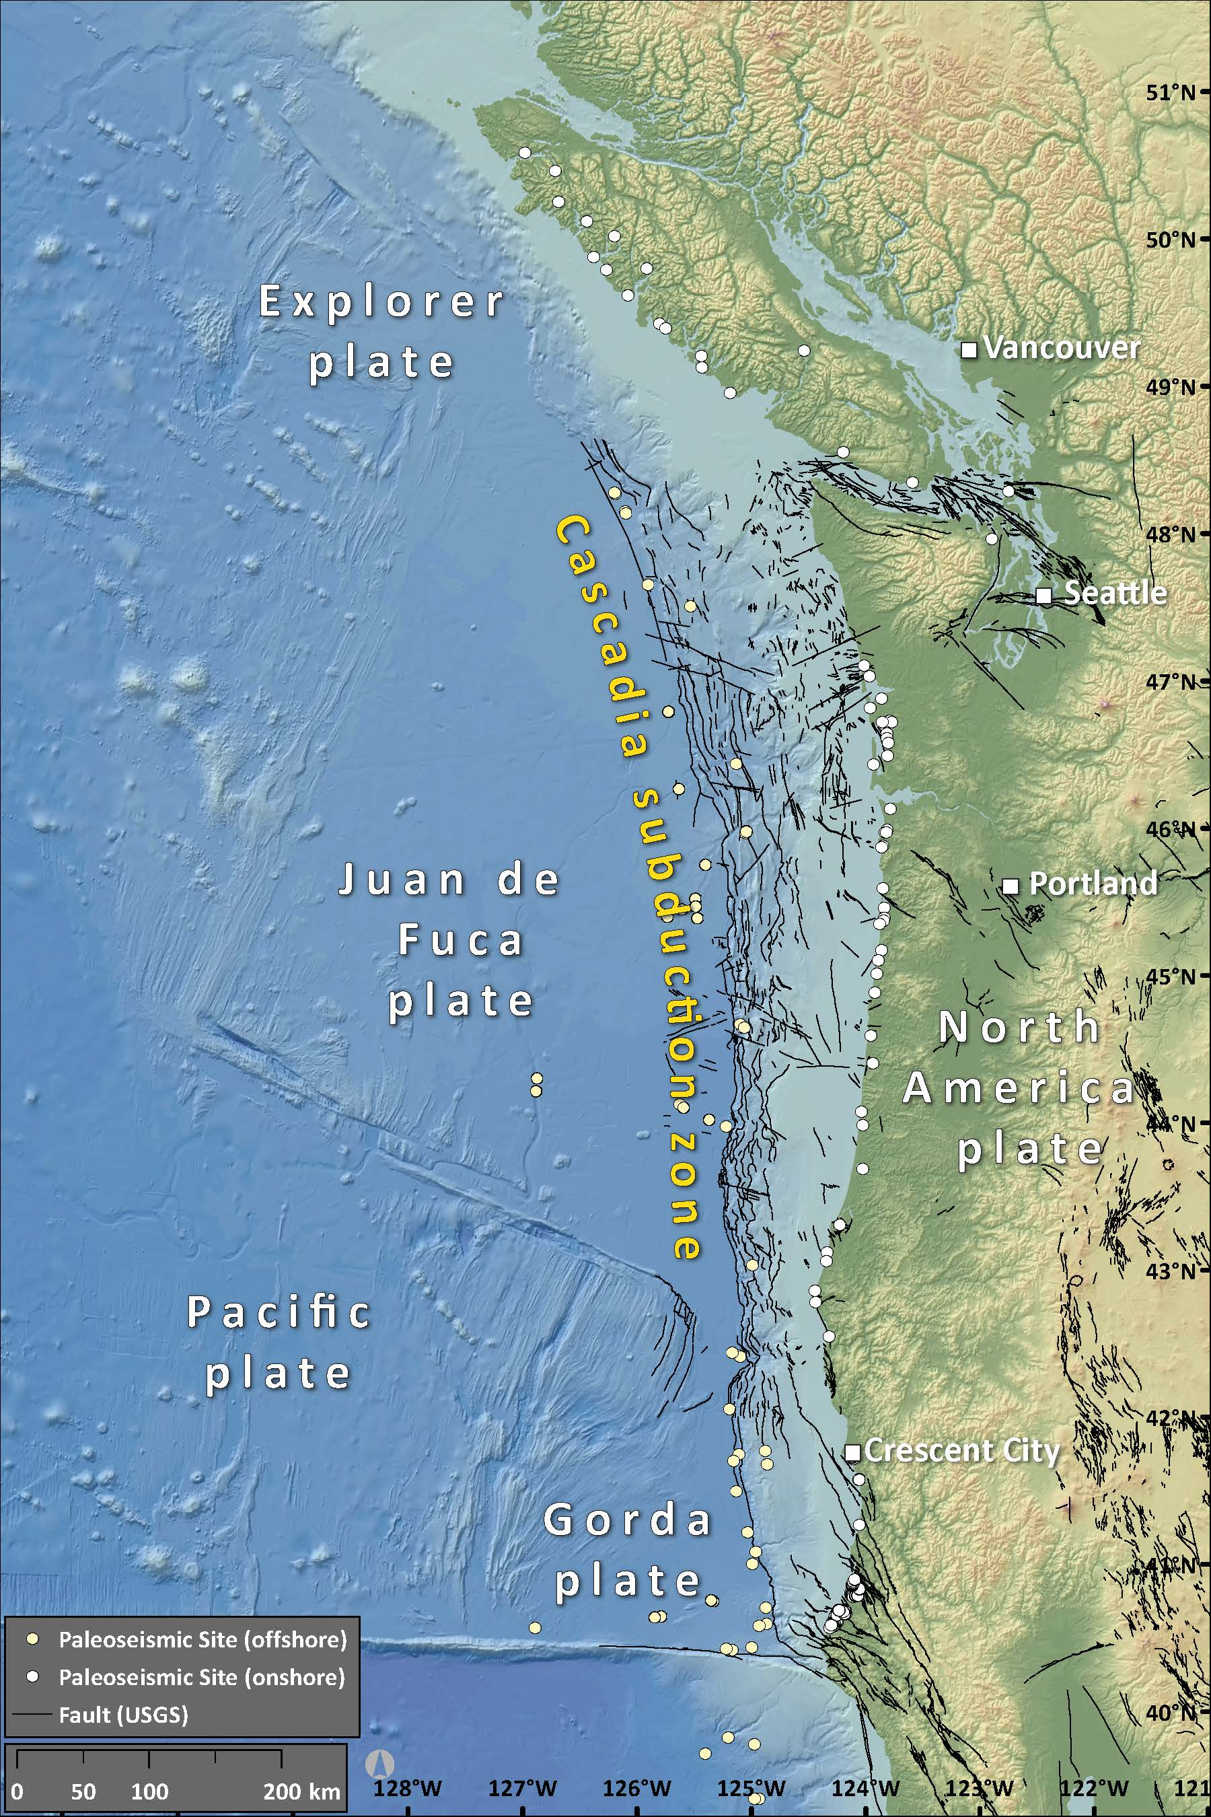
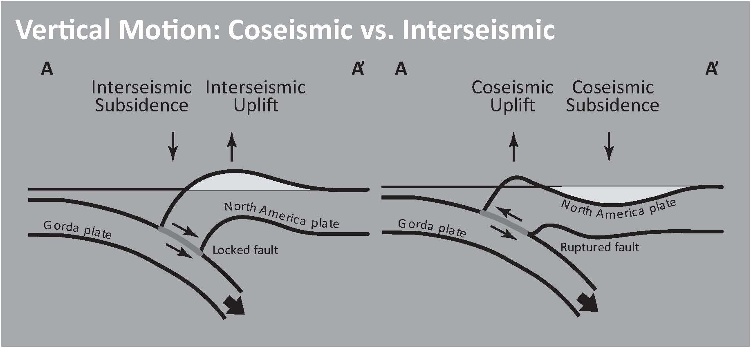
Notes:
While Cascadia was the focus of a separate and devoted meeting, I use this illustration to remind us of the processes that happen at subduction zones.
A subduction zone is a convergent plate boundary where oceanic plates subduct beneath a continental or oceanic plate. The plates deform in different ways during different parts of the earthquake cycle. In some places the plates move in ways that cause tsunami. Subduction zone fault systems throughout the Pacific were the focus of this workshop. However, we focused on sources that have a significant contribution to the tsunami hazards for U.S. states and territories.

Slide 3
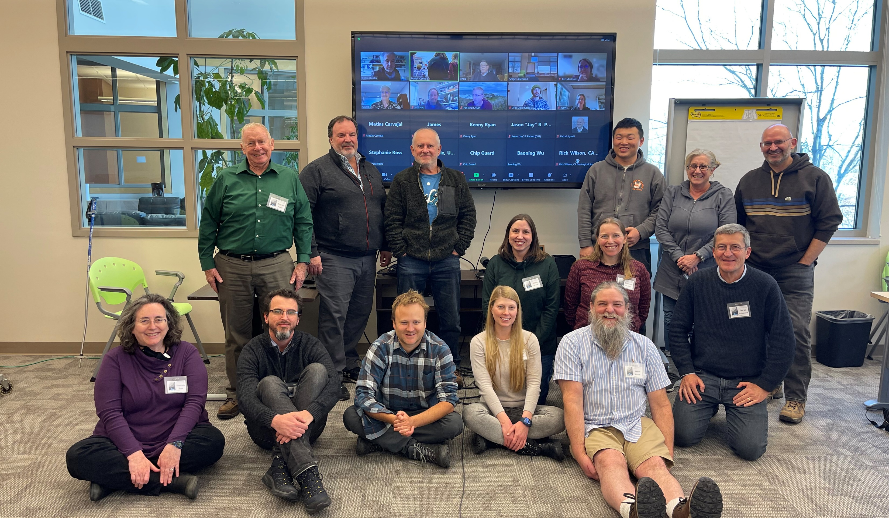
In March 2023 live and remote participants in the photo gathered to discuss peer reviewed literature that has implications for tsunamigenesis along subduction zones that surround the Pacific Basin.
The presentations and discussion were used to develop a logic tree that will be used as input for Probabilistic Tsunami Hazard Assessment (PTHA) for these sources. One major goal is to keep this PTHA consistent with the USGS NSHM 2023 update.
Notes:
In March 2023 live and remote participants in the photo gathered to discuss peer reviewed literature that has implications for tsunamigenesis along subduction zones that surround the Pacific Basin other than the Alaska-Aleutian and Cascadia subduction zones.
The presentations and discussion were used to develop a logic tree that will be used as input for Probabilistic Tsunami Hazard Assessment (PTHA) for these sources. One major goal is to keep this PTHA consistent with the USGS NSHM 2023 update.

Slide 4
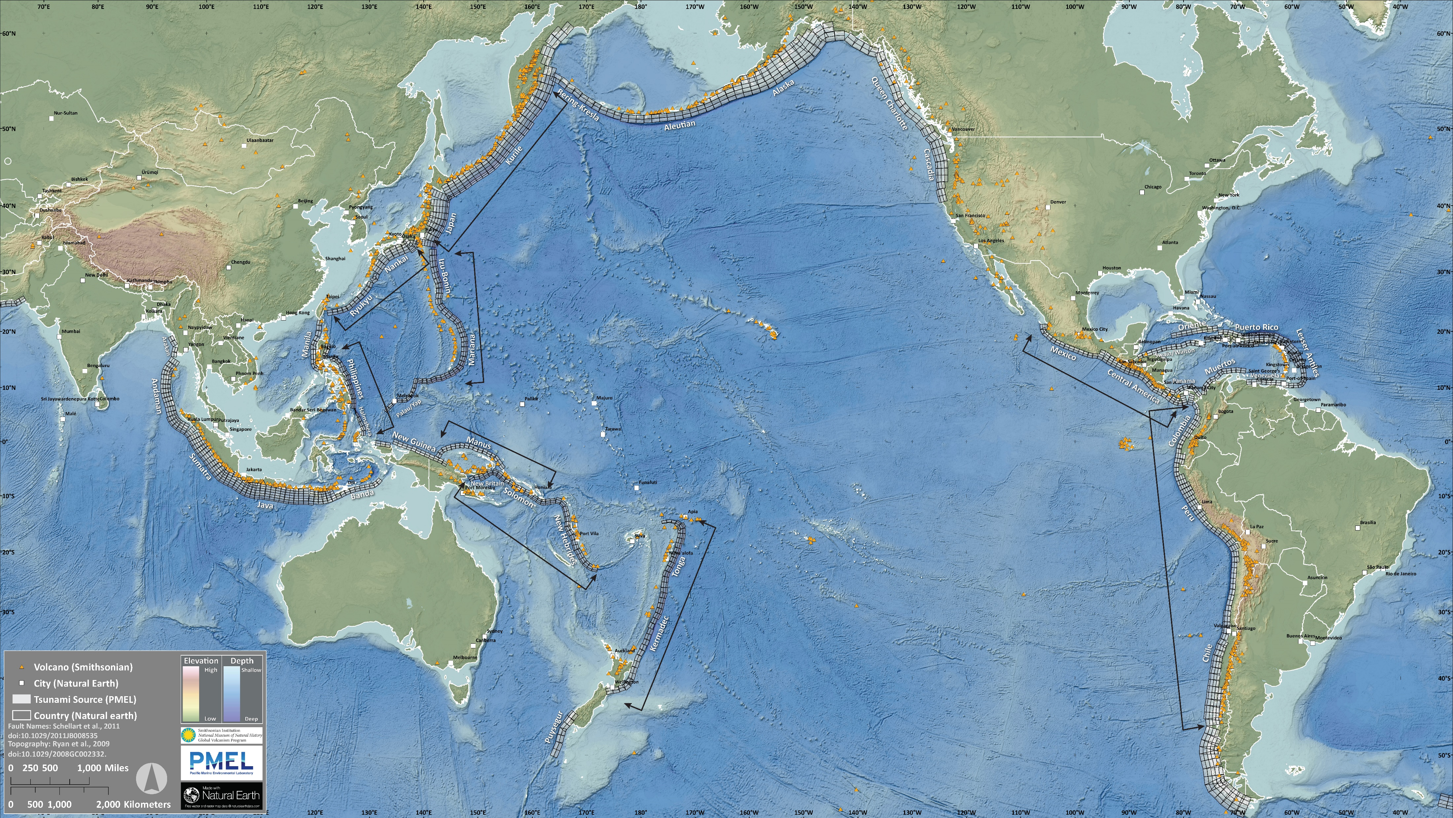
The Participants chose to organize the margins in the following way:
Chile/Colombia/Ecuador/Peru
Central America
Tonga/Kermadec/Hikurangi
New Britain/ Solomon/Vanuatu
Manus/Kilinailau
Marianas/East Philippines/Izu-Bonin
Japan/Nankai/Ryukyu
Kamchatka/Kuril.
Notes:
Here is a map that shows the subduction zones in the Pacific. The rectangles are fault elements that comprise the NOAA PMEL tsunami source models. We are not using these for tsunami modeling but they are great to help us visualize most of the megathrust faults.
I highlight the sources that we considered during the meeting. The participants chose to organize the margins based on this list.

Slide 5
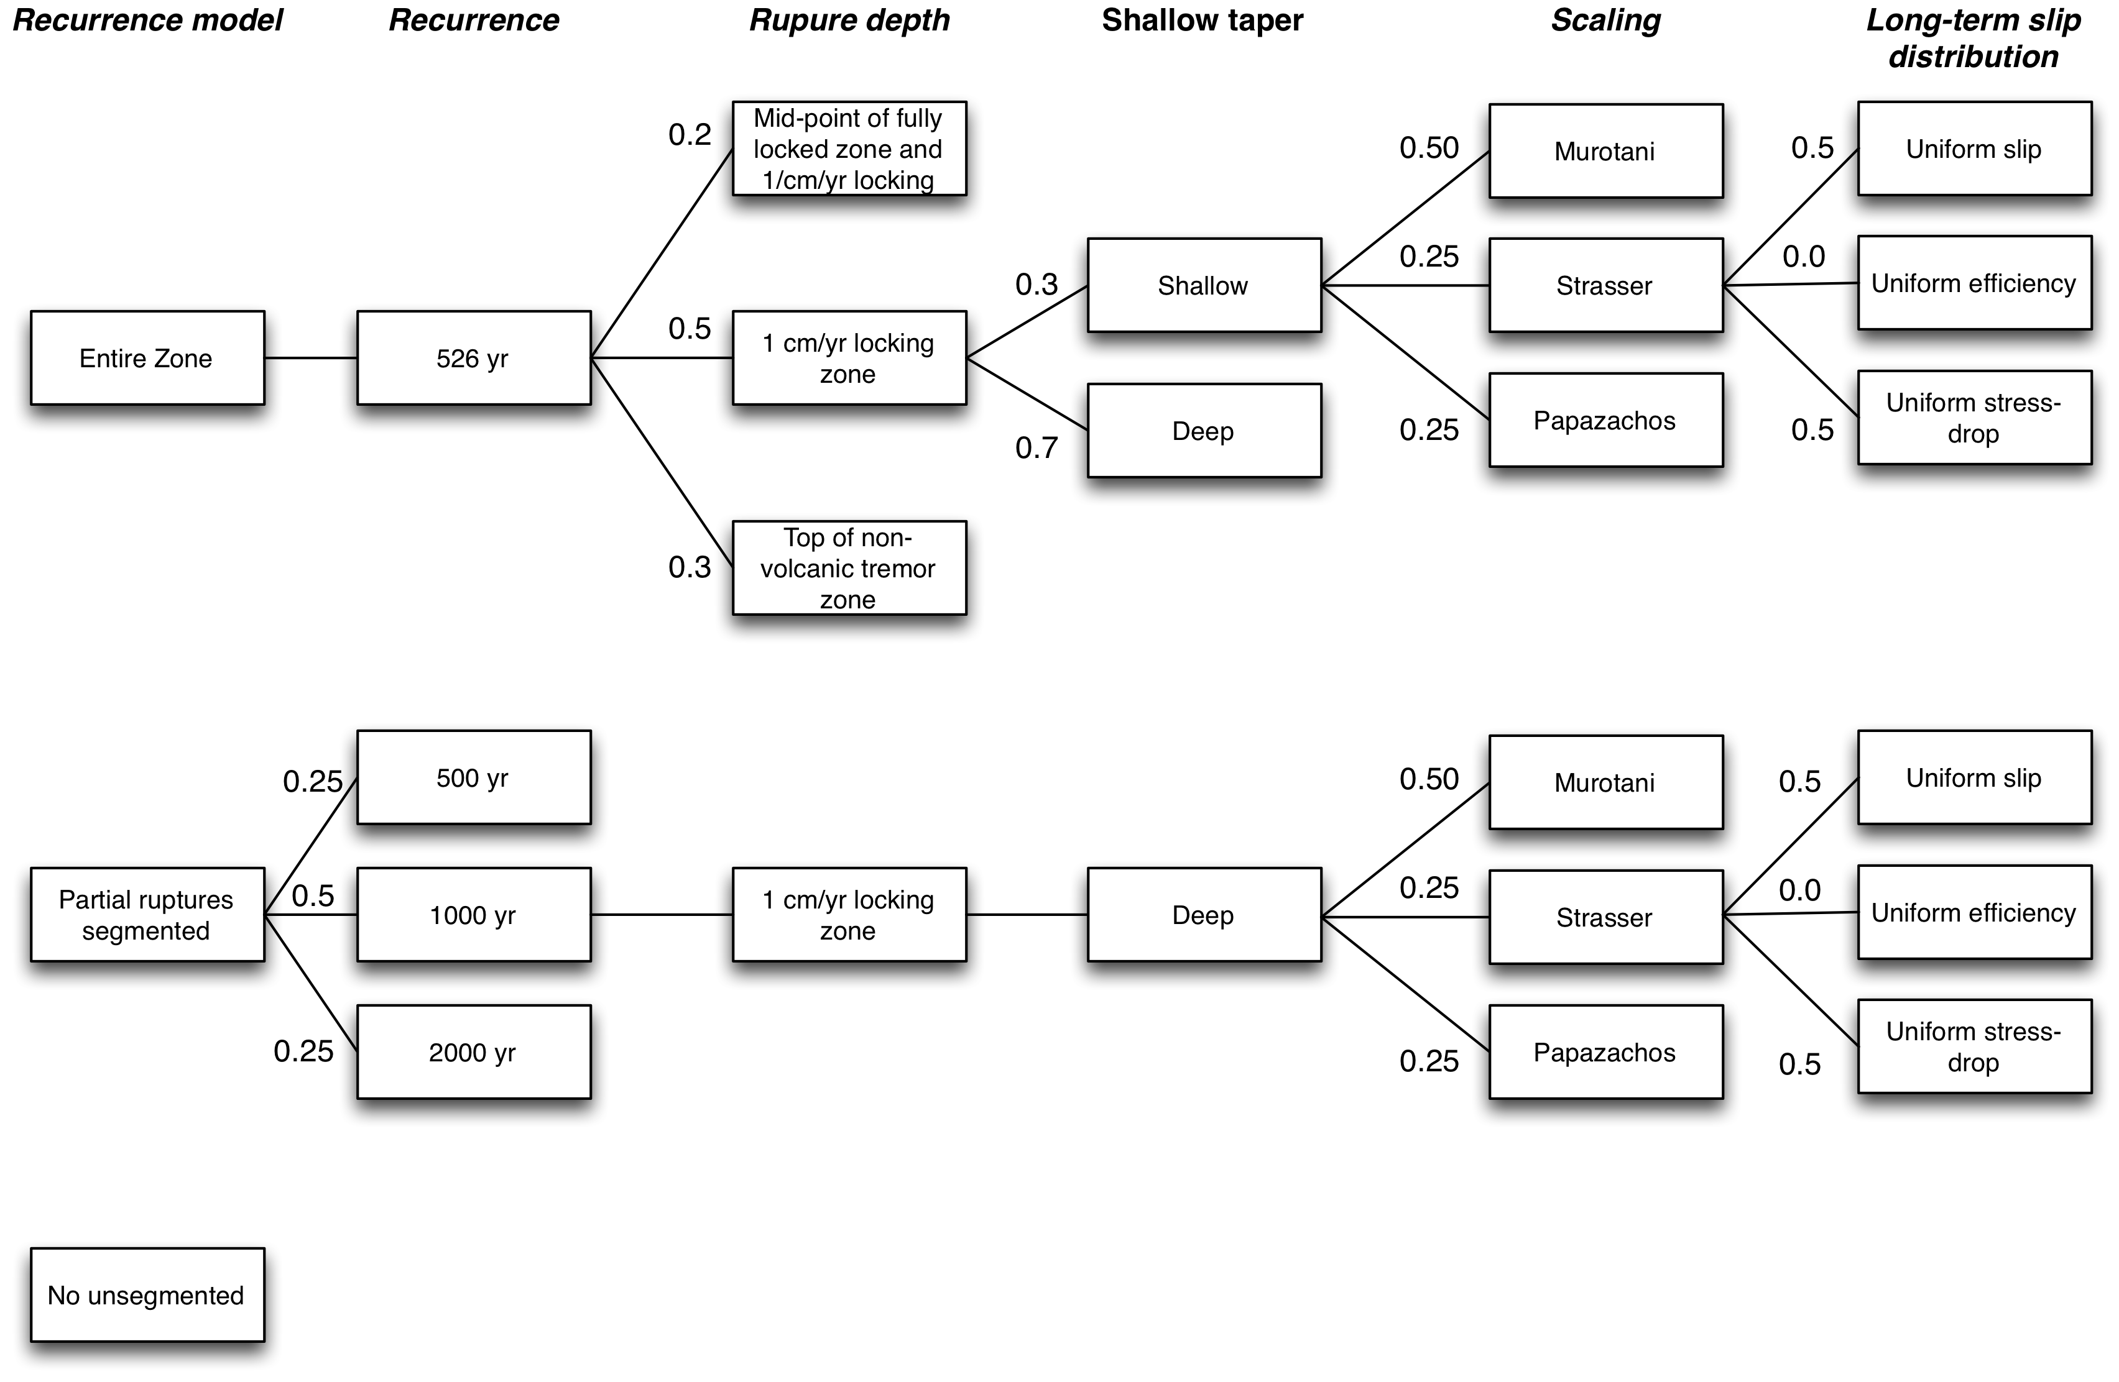
PTHA and Logic Trees
Probabilistic tsunami hazard assessment (PTHA) is a process used to develop a framework to inform tsunami modeling and hazards analyses.
This process uses a logic tree approach to collate the entire suite of possible and probable tsunamigenic behavior of tsunami sources relevant to the area of interest.
A logic tree is a way to calculate the relative likelihood for each of all possible scenarios for a given phenomenon.
From Hong Kie Thio presentation
Notes:
Probabilistic tsunami hazard assessment (PTHA) is a process used to develop a framework to inform tsunami modeling and hazards analyses.
This process uses a logic tree approach to collate the entire suite of possible and probable tsunamigenic behavior of tsunami sources relevant to the area of interest.
A logic tree is a way to calculate the relative likelihood for each of all possible scenarios for a given phenomenon.

Slide 6
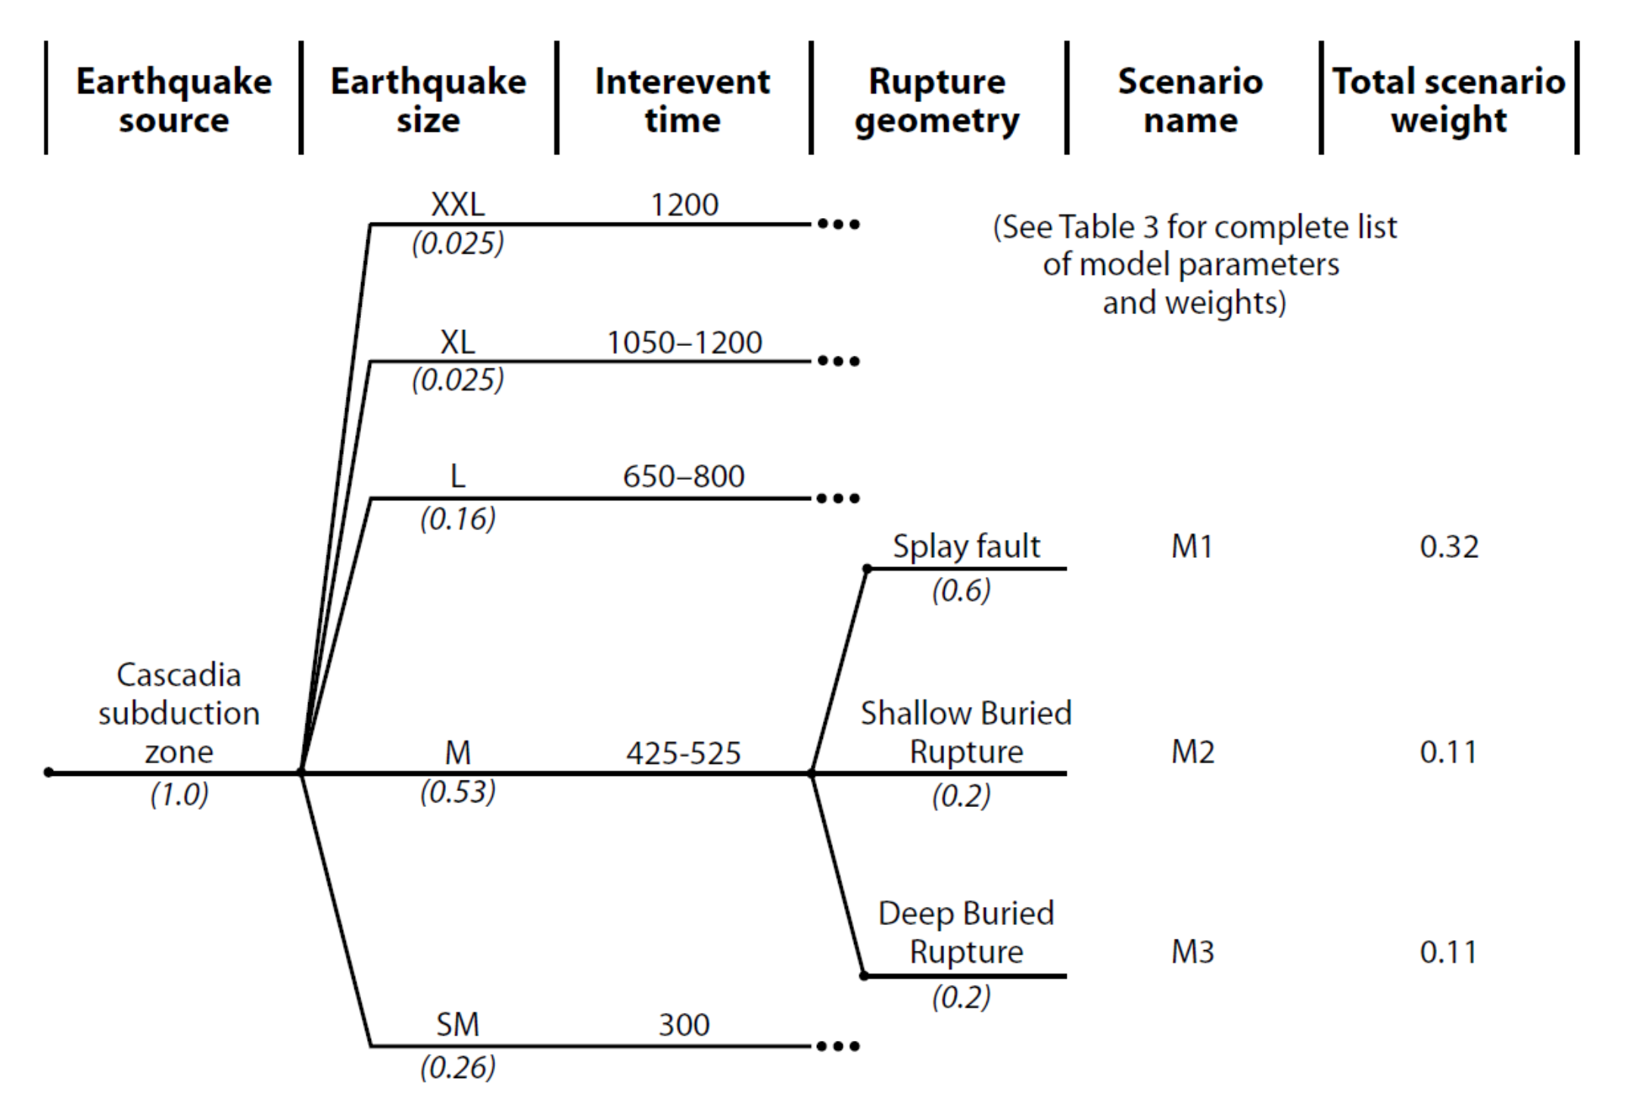
PTHA and Logic Trees
In the logic tree, each possible scenario is organized as a separate branch.
Each branch is given a weight, based on expert opinion, that represents the chance that a scenario may happen.
Branch weights, for each splay, are additive vertically & sum to 1:
0.025 + 0.025 + 0.16 + 0.53 + 0.26 = 1 (or 100%)
The weights for each splay are multiplied horizontally to calculate the scenario weight:
0.053 * 0.2 = 0.11 (or 11%)
The result is the total weight for each scenario.
These total weights also add up to 1, vertically (or 100%).
0.025
0.025
0.16
0.53
0.2
0.11
0.26
From Hong Kie Thio presentation
Notes:
In the logic tree, each possible scenario is organized as a separate branch. Each branch is given a weight, based on expert opinion, that represents the chance that a scenario may happen
Here is an example logic tree from Oregon that they used for their tsunami hazards analyses. This shows the parameters (branches) that encapsulate the variation in EQ size (based on interevent time) and rupture geometry.
Some key parts of this tree are that:
Branch weights, for each splay, are additive vertically & sum to 1: if we add up the weights .025 + .025 + .16 + .53 + .26 we get 1
The weights for each splay are multiplied horizontally to calculate the scenario weight: so, for a medium sized earthquake with a shallow buried rupture, the likelihood is .053 * .2 = .11 or 11%
The result is the total weight for each scenario. These total weights also add up to 1, vertically (or 100%).

Slide 7
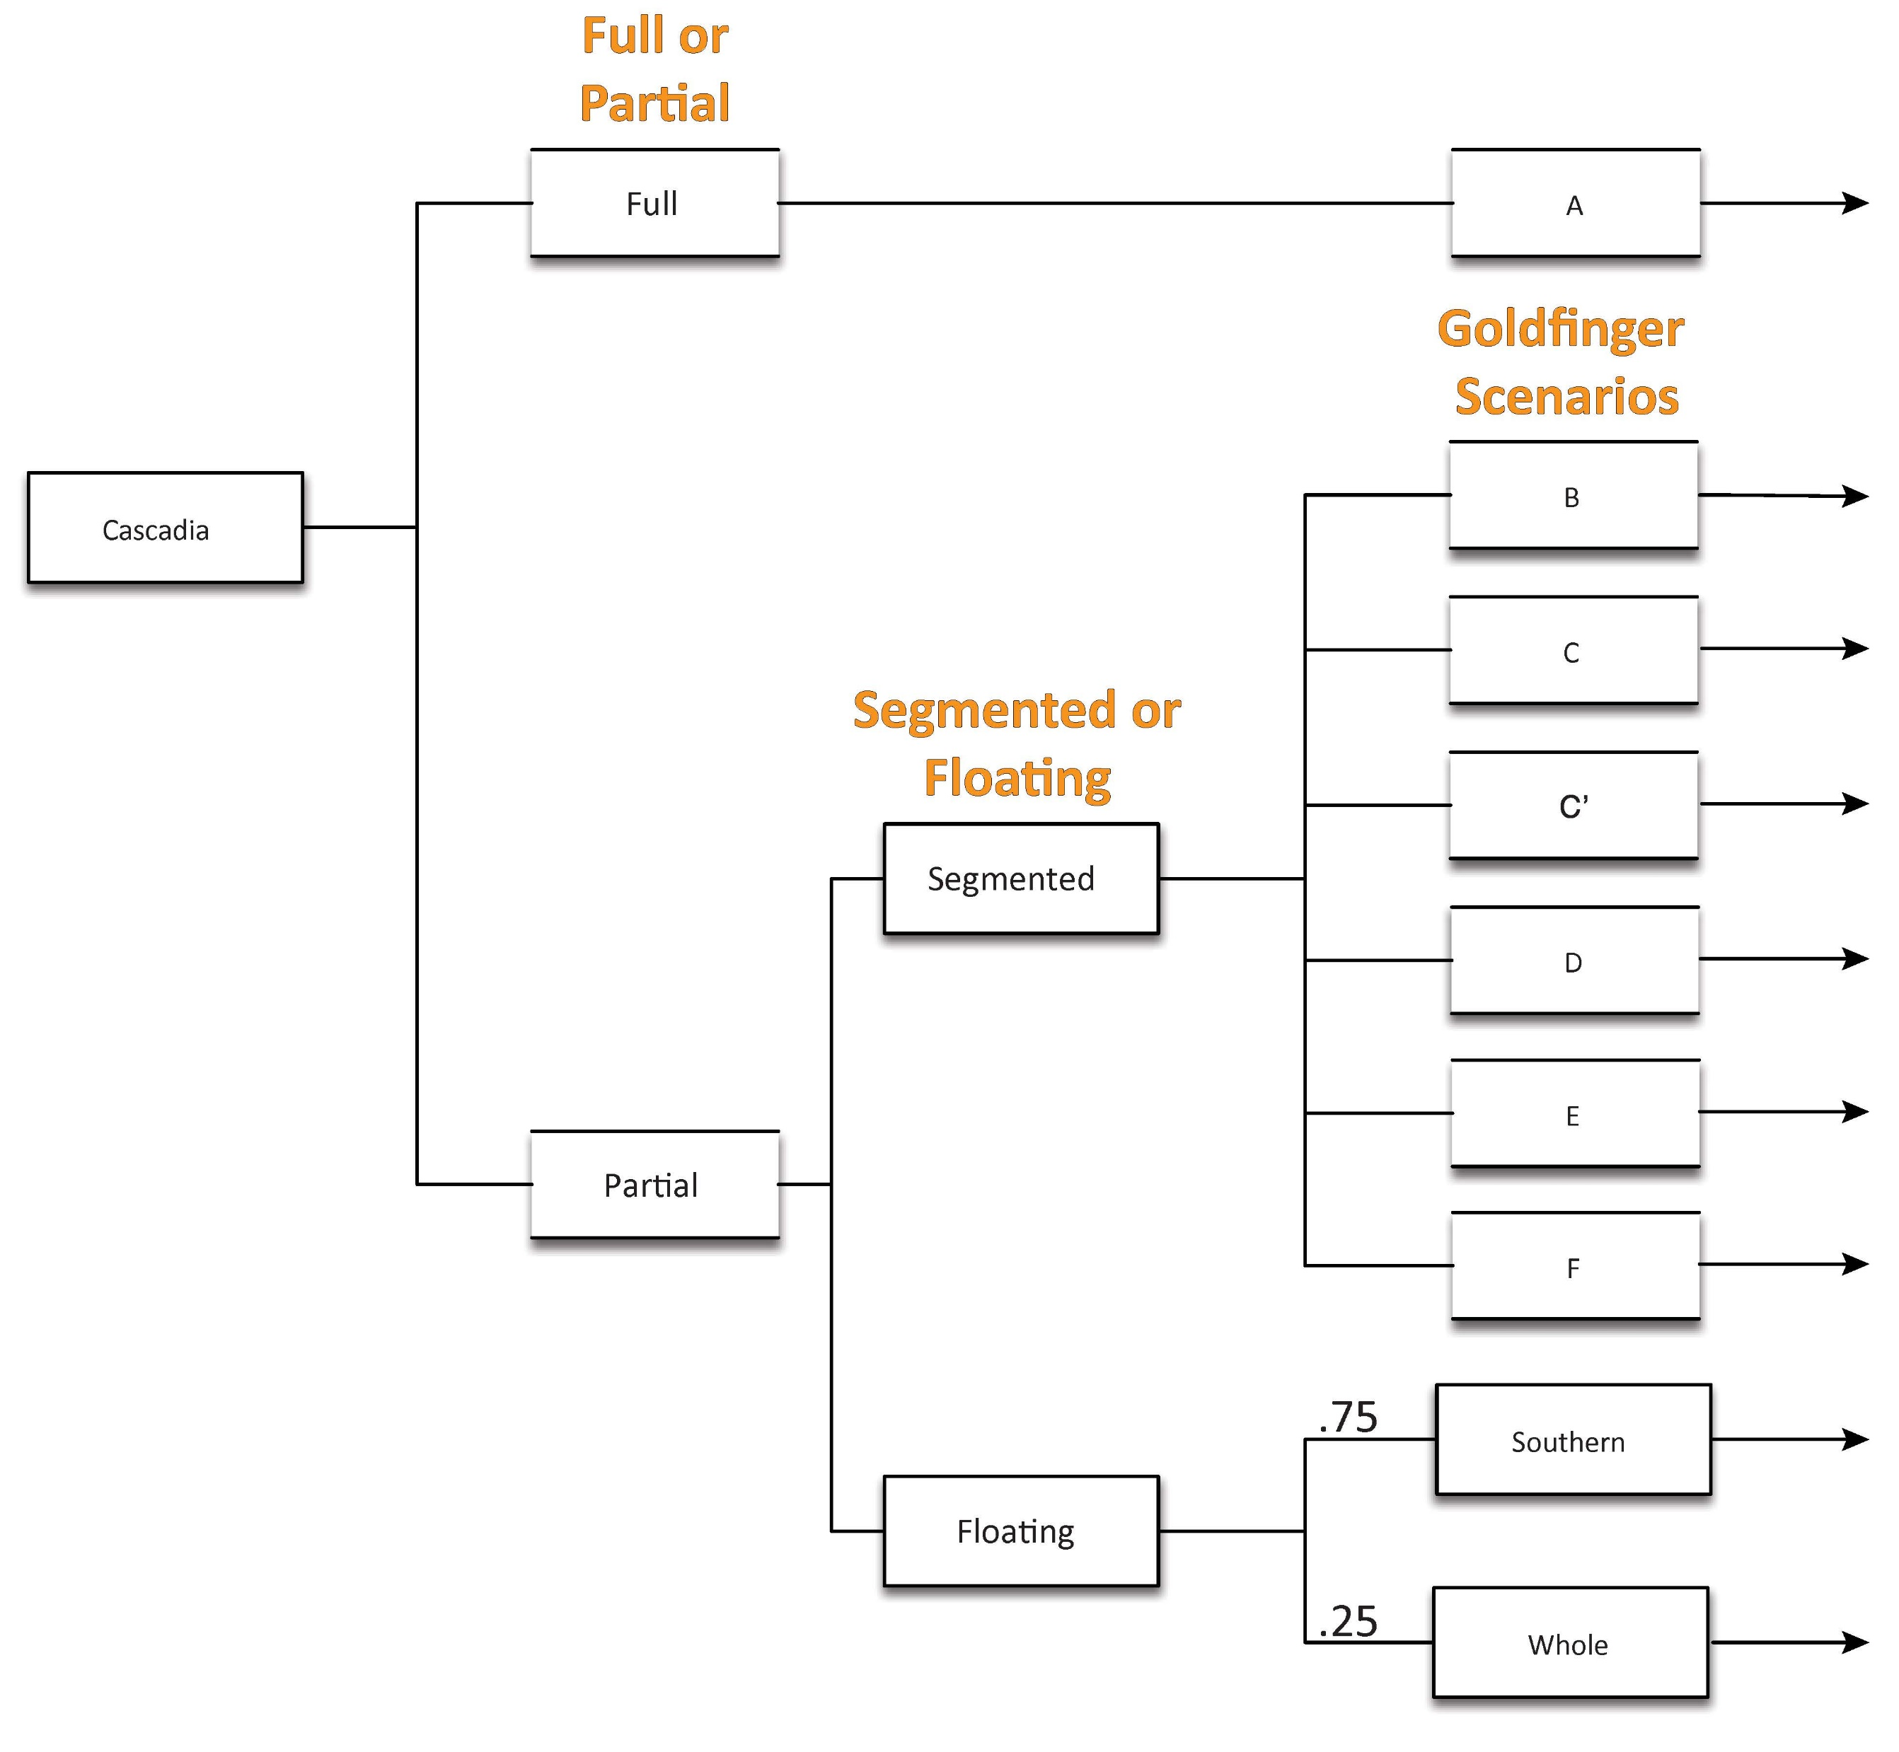
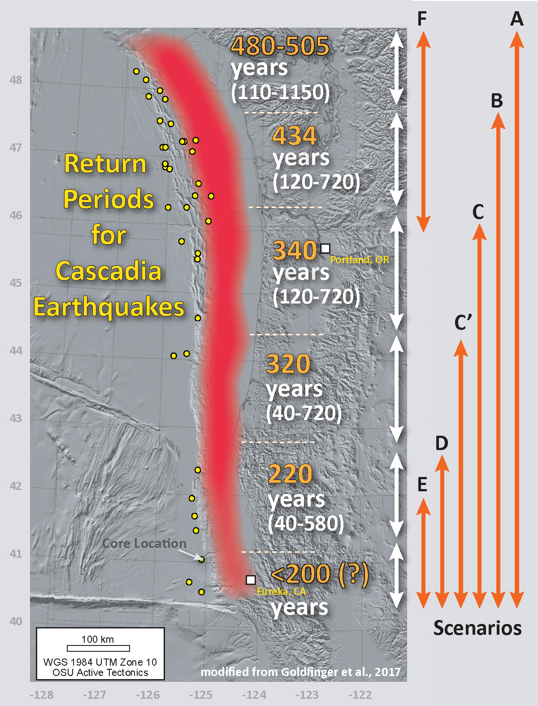
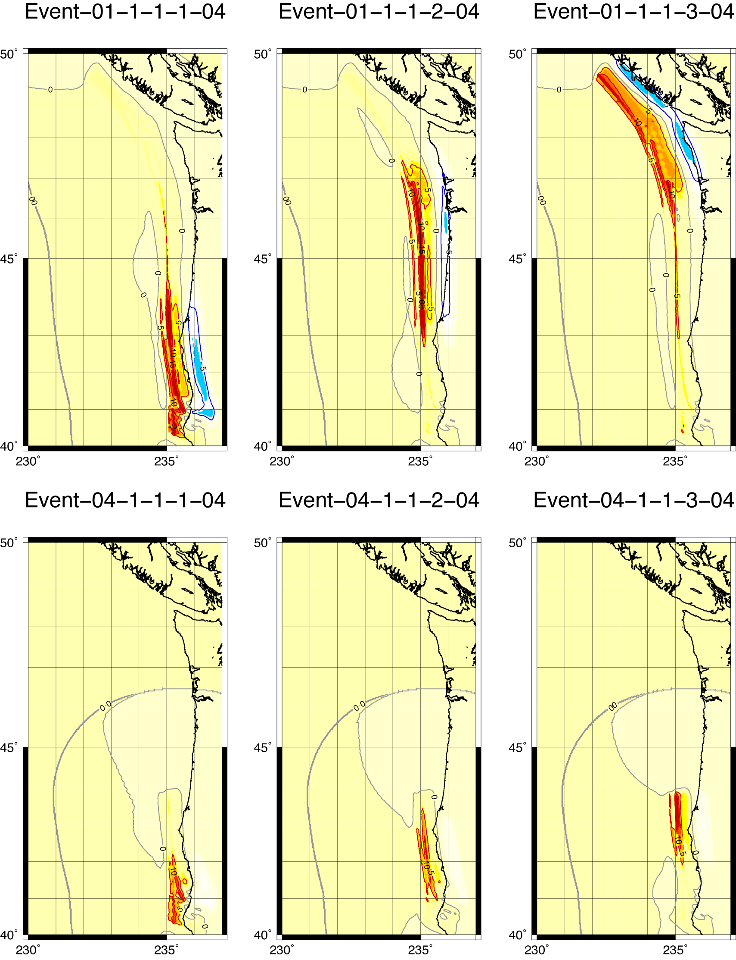
Goldfinger 2012, 2017
The full rupture branch presumes a margin-wide earthquake (e.g., A from Goldfinger et al., 2012, 2017).
The partial rupture branch represents earthquakes that do not span the entire margin.
The 1st splay breaks scenarios into full and partial ruptures.
The two partial branches are segmented and floating:
based on the Goldfinger et al. (2012, 2017) paleoseismic scenarios
based on floating ruptures
Draft Logic Tree
Thio, 2020
Notes:
Here is the beginning of the draft logic tree for Cascadia. Let’s take a look at the 1st 2 branches, the full margin earthquake and the partial margin earthquake.
The full rupture branch presumes a margin-wide earthquake. The partial rupture branch represents earthquakes that do not span the entire margin.
The partial margin branch then splays into two branches: segmented and floating:
Segmented is based on the Goldfinger et al. (2012, 2017) paleoseismic scenarios (upper right plot, updated just 2 weeks ago) and the other is based on floating ruptures (lower right plot).

Slide 8
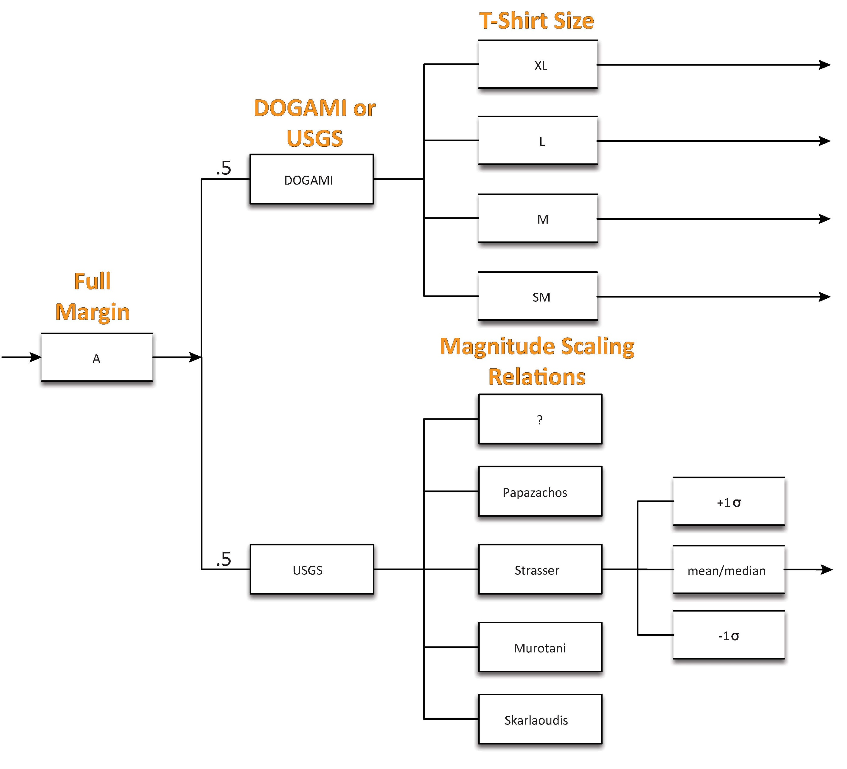
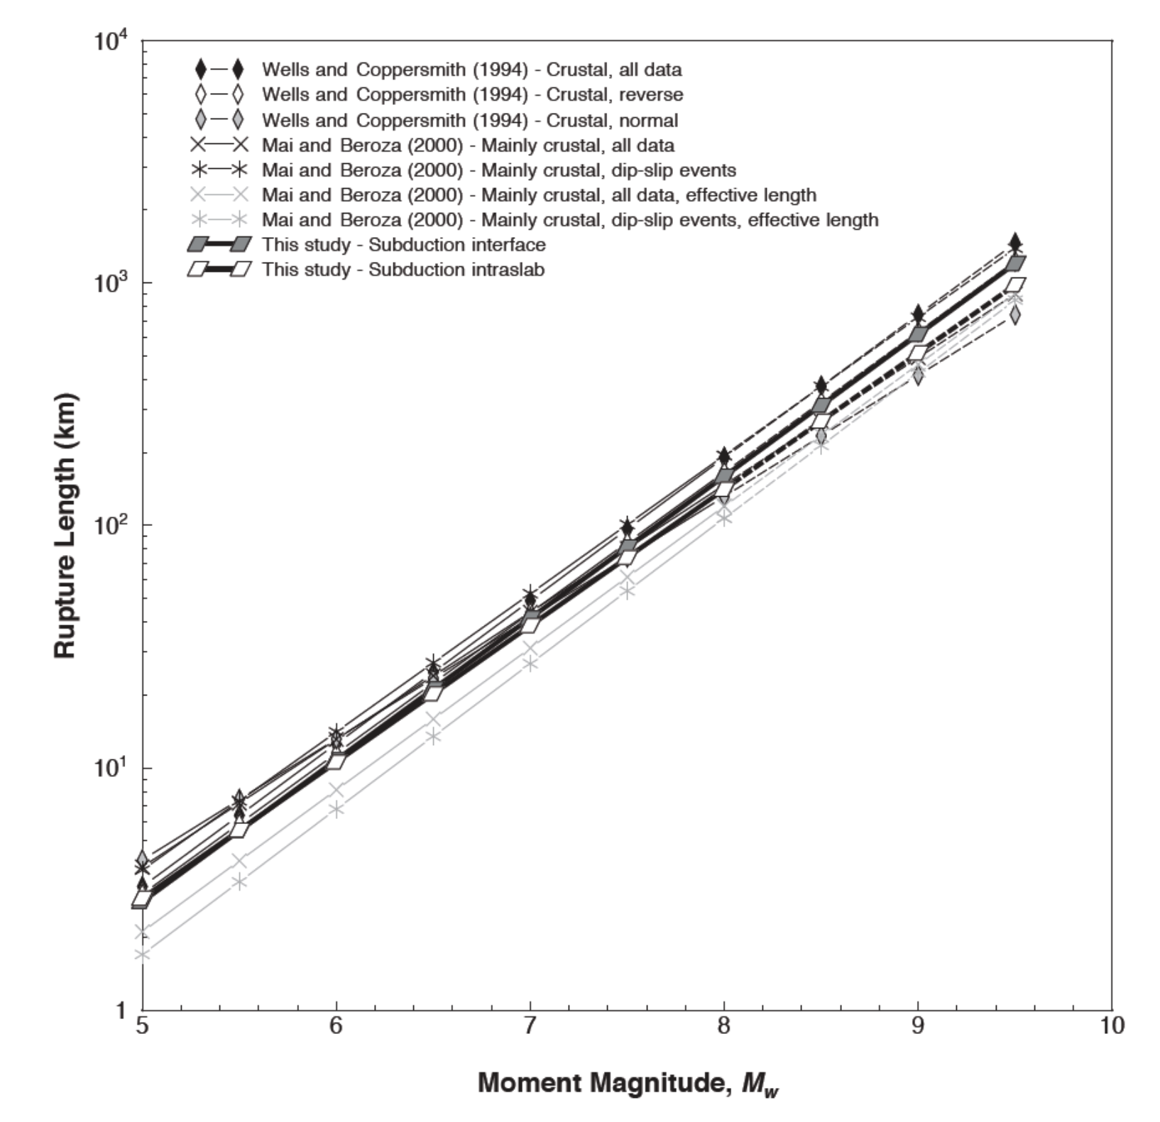
0.025
0.025
0.16
The Full Margin splay breaks scenarios into DOGAMI and USGS branches.
0.53
0.26
Witter et al., 2013
Rupture Size
t-shirt size (DOGAMI)
magnitude scaling relations (USGS)
Draft Logic Tree
Rupture Length vs. M_{W}
Strasser et al., 2010
Notes:
The Full Margin branch splays into DOGAMI and USGS branches. Both branches simply use different methods to determine a magnitude distribution for tsunami sources along a given subduction zone.
For the magnitude distribution in the USGS branch we use a suite of global magnitude scaling relations (empirical relations between the spatial extent of an earthquake and the magnitude of that earthquake). Most participants in the Cascadia workshop agreed that global scaling relations are not appropriate for Cascadia, ergo the emphasis to include an alternate branch.

Slide 9
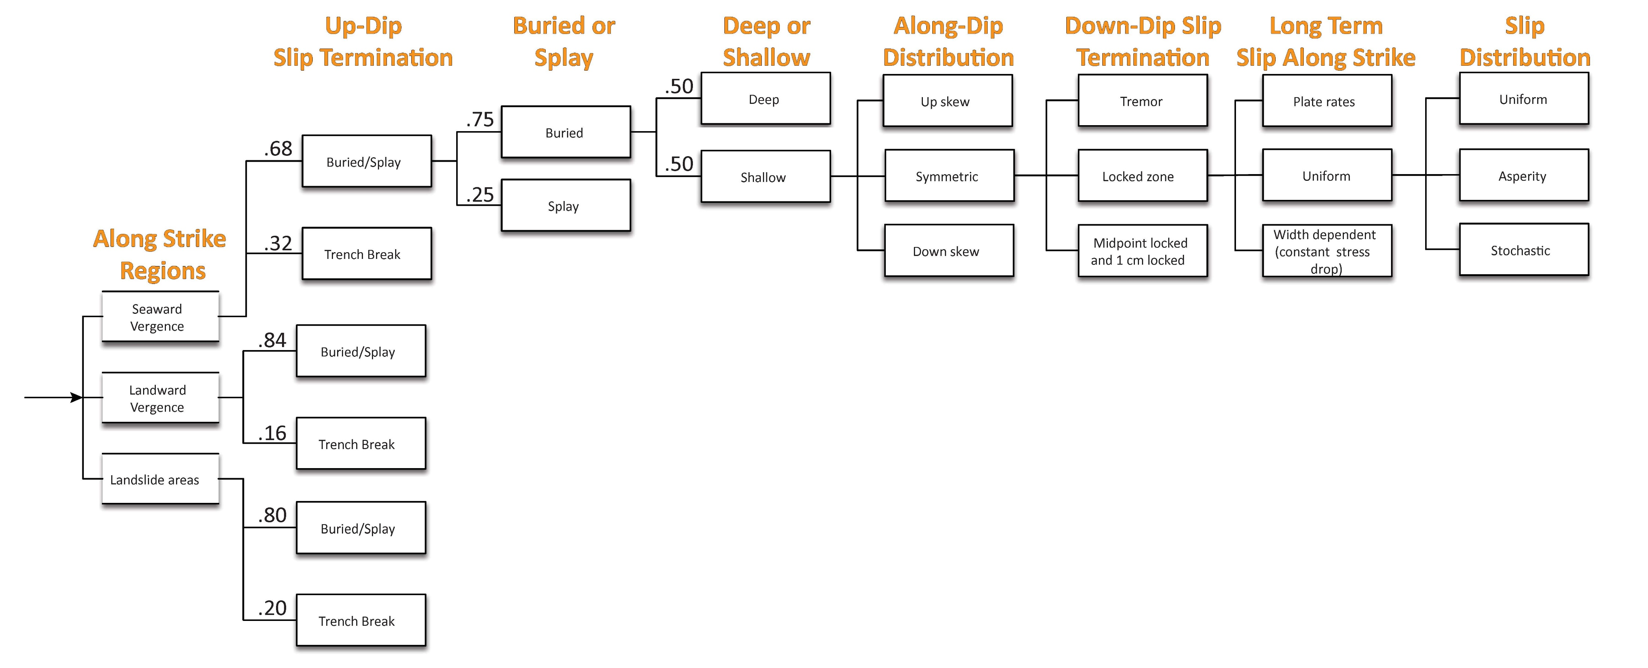
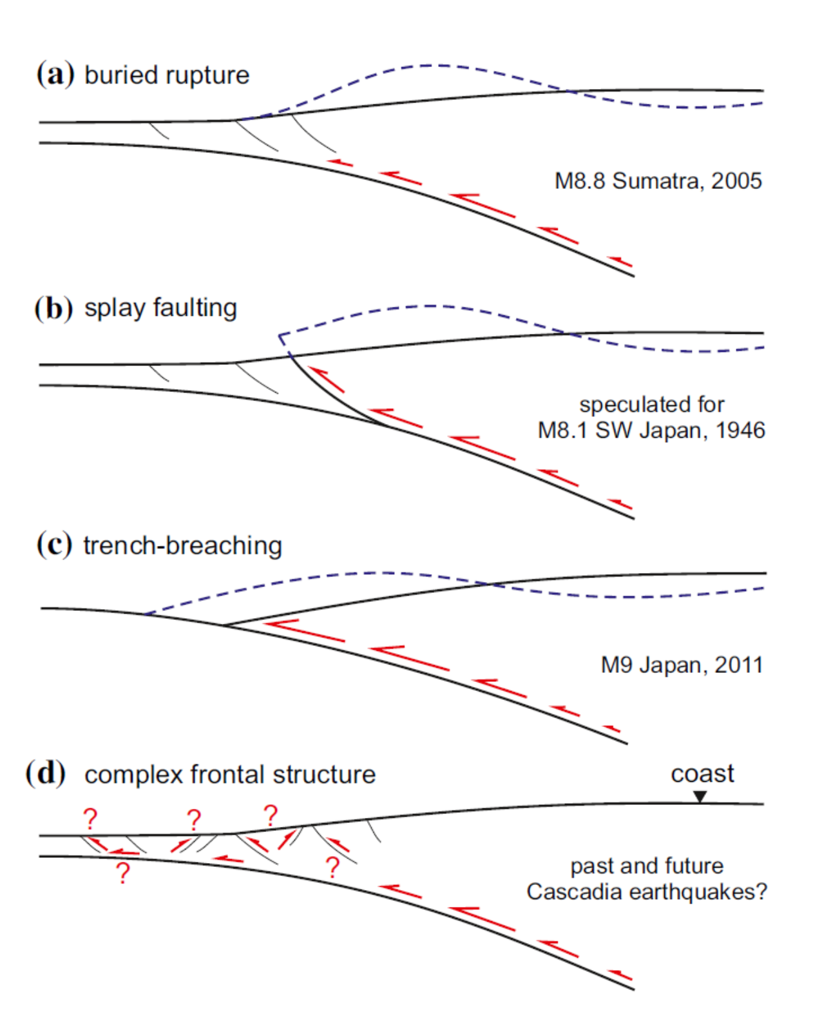
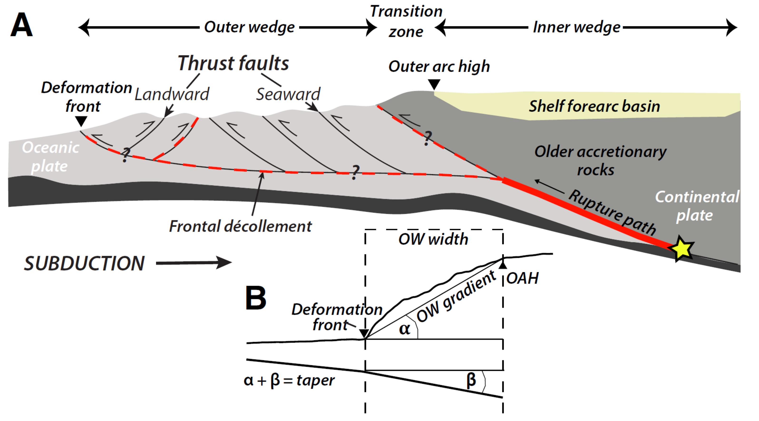
Draft Logic Tree
Fault geometry can influence both slip and tsunami source models. Trench breaking slip can generate larger tsunami.
Watt and Brothers, 2021
Illustrations shows hypothetical slip scenarios (and seafloor uplift) for a range of fault geometry.
Gao et al., 2018
Notes:
The remaining Cascadia branches deal with different aspects of fault geometry. We won’t discuss these in detail here.
These figures do show the variation in fault geometry and how that might affect tsunami size.
Some of the margins considered by this working group lack these details that we have for Cascadia. So, each margin will likely have slightly different versions of the logic tree branches.

Slide 10
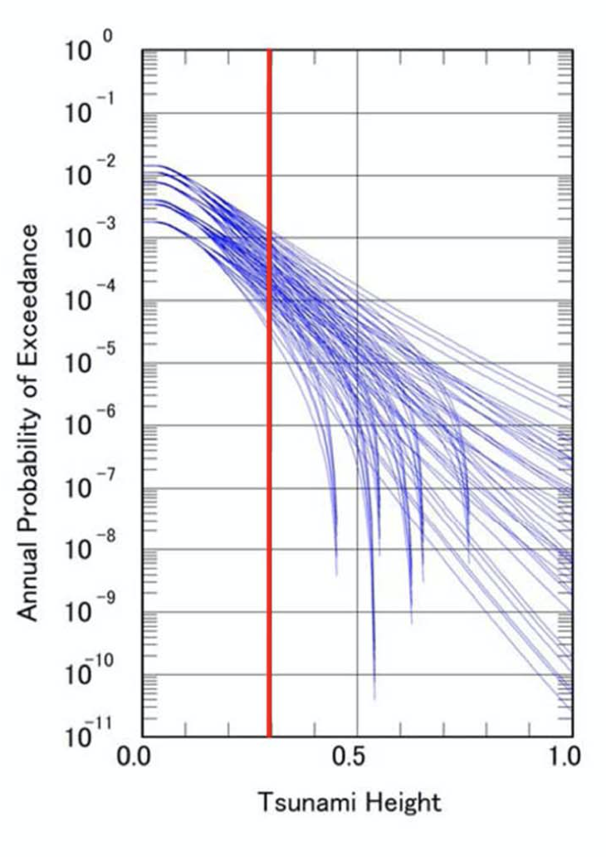
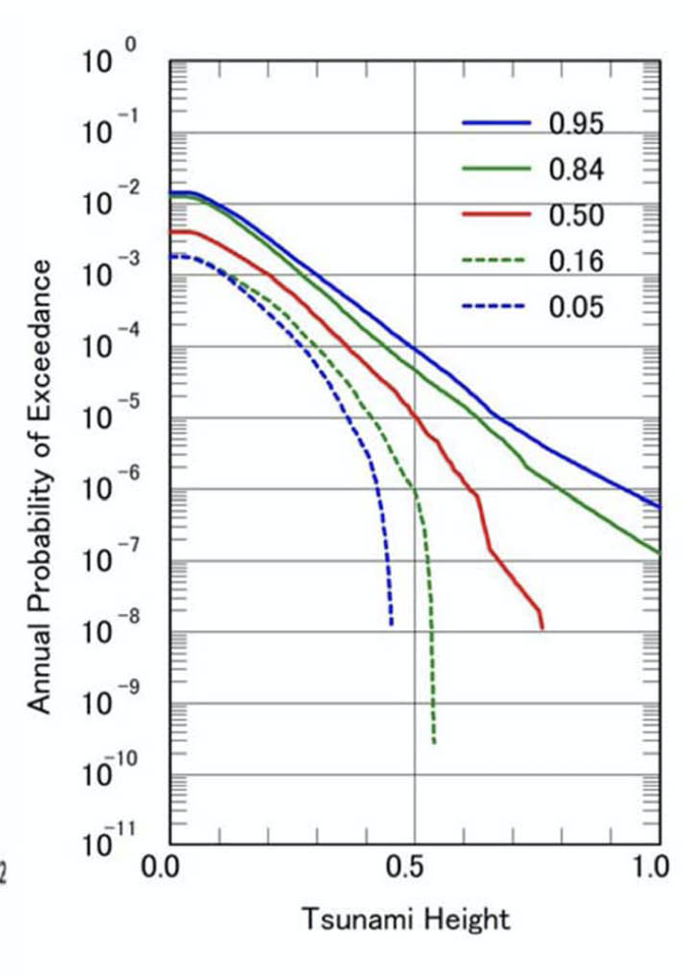
Logic tree results and how to prepare tsunami hazard curves:
Logic tree weights are used to constrain slip and tsunami source modeling.
These tsunami models result in a suite of offshore tsunami heights, representing the percent likelihood (chance) for tsunami sizes for given annual probability of exceedance.
Using this entire suite of model results, we can calculate quantiles that bracket a range of probabilities.
From these data we can calculate the tsunami size for tsunami with return periods (such as the “975-year tsunami”).
Tsunami Model Results
Each line represents an actualization of a suite of logic tree scenario tsunami models, a percent chance (likelihood) for tsunami size with an annual probability of occurrence.
Tsunami Model Quantiles
Each line represents a bracketed summary of the data plotted on the left. E.g., the 0.05 and 0.95 lines bracket 90% of the scenario tsunami plotted on the left.
From Hong Kie Thio presentation
From Hong Kie Thio presentation
Notes:
These logic tree weights are used to constrain fault slip and tsunami source modeling.
The outputs from these tsunami models result in a suite of offshore tsunami heights, representing the chance for tsunami sizes of a given annual probability of exceedance.
In the plot on the left, each line represents an actualization of a suite of logic tree scenario tsunami models, a percent chance (likelihood) for tsunami size with an annual probability of occurrence.
Using this entire suite of model results, we can calculate quantiles that bracket a range of probabilities. From these data we can calculate the tsunami size for tsunami with a specified return period (like the 975-year tsunami).
In the plot on the right, each line represents a bracketed summary of the data plotted on the left. E.g., the 0.05- and 0.95-lines bracket 90% of the scenario tsunami plotted on the left.

Slide 11
Discussion Summary
Emile Okal presented a general discussion about subduction earthquakes and tsunamigenesis. Okal noted important examples of tsunami earthquakes, irregular fault fragmentation, and other sources such as outer rise earthquakes.
Shannon Graham presented a circum-Pacific evaluation of plate motions and megathrust fault coupling ratios.
Kirstie Haynie presented an overview of the USGS Slab model subduction zone geometries, the methods used to prepare these models, and how these models are being updated in the future.
Marco Pagani and Kendra Johnson presented the Global Earthquake Model (GEM), discussed the components of their model, the methods used to prepare their model, and their approach to make further improvements in the future.
Gareth Davies presented a summary of the 2018 Australian PTHA and made suggestions about what to do for people who are preparing PTHA models.
Brian Atwater discussed methods used to conduct paleotsunami investigations and how to apply those methods in the field.
James Goff discussed a Pacific paleotsunami database and provided some transdisciplinary examples of collaboration (e.g., archeologists, anthropologists).
Matias Carvajal began the series of talks about specific margins by discussing an overview of the seismotectonic setting in the subduction zone along the west coast of South America. Carvajal showed several examples of how to subdivide the margin into segments, both large and small.
Notes:
I list the different participants and a brief summary of what they presented during the meeting.

Slide 12
Discussion Summary (continued)
Emile Okal discussed the subduction zones along the Peru, Ecuador, and Central America margins.
Bill Fry and William Power discussed the subduction zones along the Tonga, Kermadec, Vanuatu, Solomon, New Britain, Manus, and Kilinailau margins.
Yuichiro Tanioka discussed the paleotsunami, earthquake slip models, and fault coupling along Japanese subduction zones including the Kuril, Japan, Nankai, Ryukyu, and Izu-Bonin margins.
Harold Tobin discussed the evidence for splay faults along subduction zones focusing on the Nankai margin.
Bre MacInnes discussed the modern tsunami and paleotsunami evidence for the Kuril-Kamchatka subduction zone.
Serge Lallemand discussed the relevant elements that could control tsunamigenesis in the Marianas and Philippines subduction zones, including an overview of the utility of the Submap database. Lallemand was particularly helpful because he prepared maps that formed the basis of our discussion about segment boundaries.
Shannon Graham discussed the Mexico subduction zone. We requested Graham to do this in the last minute and we very much appreciated her willingness to do this for the group.

Slide 13
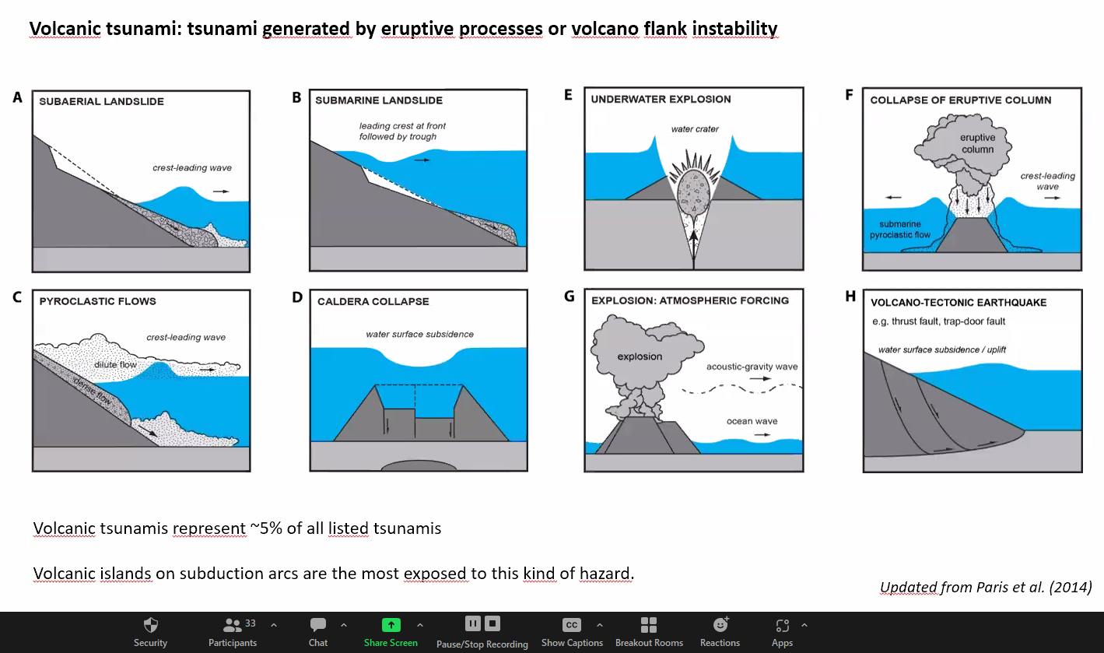
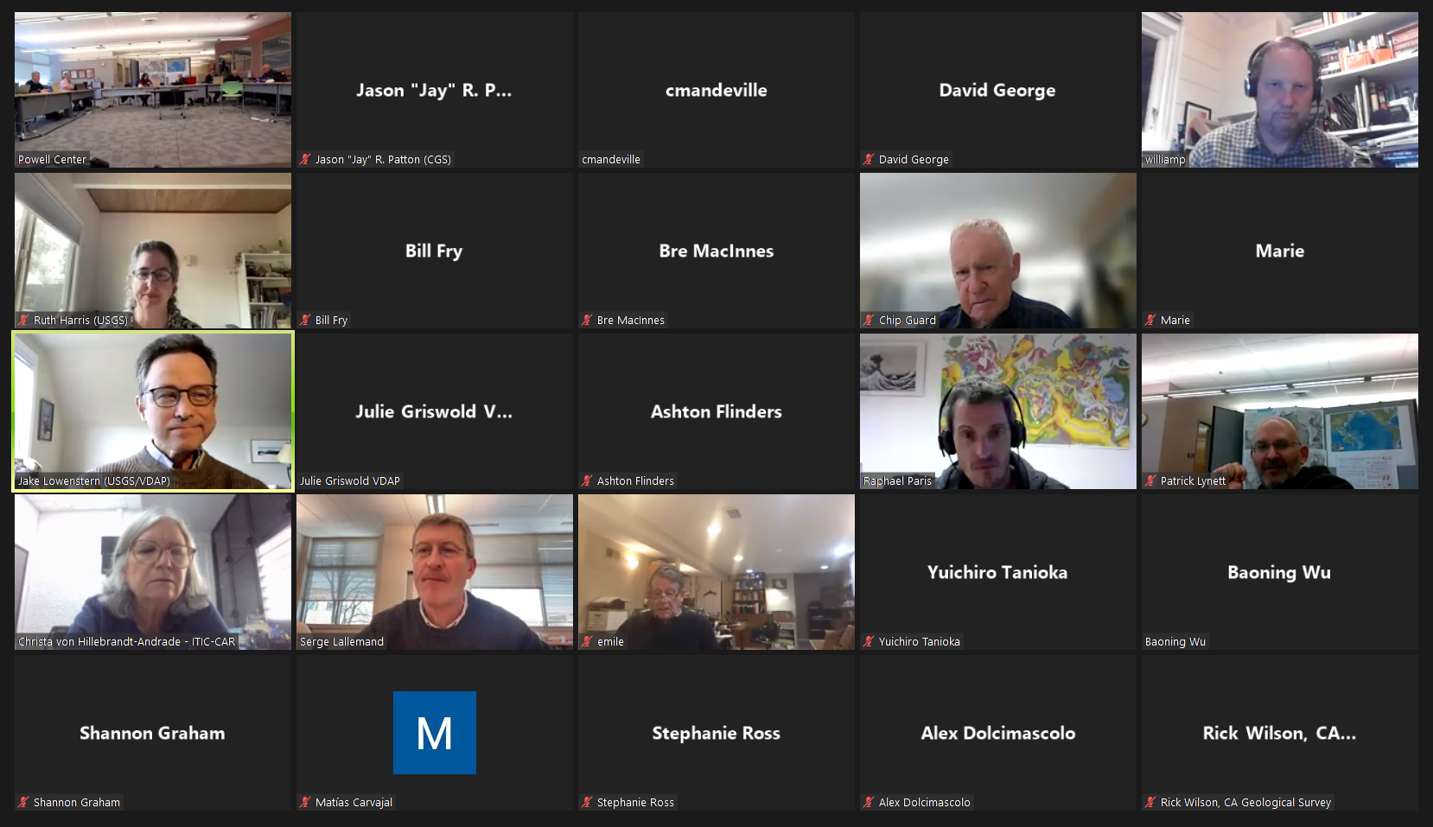
Discussion Summary (continued)
Raphael Paris led a discussion to discuss volcanic tsunami sources. While not a focus of this meeting, this inspired the participants to schedule a [possible] additional Powell Center meeting to address volcano tsunami sources.
Here is map of potential tsunamigenic volcanoes
Notes:
We also had a two-hour session, led by Raphael Paris, to discuss volcanic sources for tsunami. We hope to hold a follow up Powell Center meeting devoted largely to volcanic tsunami sources.

Slide 14
Pat Lynett and Hong Kie Thio led the participants through the process to discuss the segmentation for each margin, a key part of the logic tree.
Thio suggested some potential logic tree branches:
Segmentation vs floating ruptures
Slip-based vs observational recurrence
Slip rates
Coupling coefficients
Downdip slip termination
Magnitude scaling
Recurrence times
Slab interface geometry
Type of slip distribution
Notes:
After we reviewed each margin, we started working on the logic tree. Hong Kie and Pat led us through this effort.
Thio suggested some branches to consider.

Slide 15
Fault Segmentation PTHA treats segmentation in a particular way, which may be different from academic debates about fault segmentation.
Many people who study the structures and paleoseismic histories of subduction zones consider a segment boundary to act as a barrier that earthquake ruptures do not extend through. People are on both sides of this debate (that segment boundaries arrest rupture vs. not arresting rupture) and there are examples of both (e.g., the Investigator fracture zone offshore of Sumatra appears to act as a segment boundary through several earthquake cycles while the 2007 M 8.1 Solomon Isles earthquake slipped through the proposed segment boundary in that location). A limiting factor is that the observational history of earthquakes is short compared to the length of earthquake cycles and supercycles (so it is possible that, over tens of thousands of years, there will be at least one earthquake that slips past any given proposed segment boundary).
However, for PTHA, we are using segment boundaries in a slightly different manner. We are using segment boundaries to help us explore earthquake magnitude distribution and we have logic tree branches that are based on single- versus multi-segment ruptures. So, we suggested that people consider segment boundaries to sometimes act as a barrier to slip and sometimes to not act as a barrier to slip. We addressed the concerns about this (whether boundaries act as a barrier) by voting on the persistence of each barrier, using percent weight. We voted on each segment boundary, applying a weight that represents the chance the segment boundary might act as a rupture barrier.
Notes:
PTHA treats segmentation in a particular way, which may be different from academic debates about fault segmentation.
Many people who study the structures and paleoseismic histories of subduction zones consider a segment boundary to act as a barrier that earthquake ruptures do not extend through. However, for PTHA, we are using segment boundaries in a slightly different manner. We are using segment boundaries to help us explore earthquake magnitude distribution and we have logic tree branches that are based on single- versus multi-segment ruptures. So, we suggested that people consider segment boundaries to sometimes act as a barrier to slip and sometimes to not act as a barrier to slip. We addressed the concerns about this (whether boundaries act as a barrier) by voting on the persistence of each barrier, using percent weight. We voted on each segment boundary, applying a weight that represents the chance the segment boundary might act as a rupture barrier.

Slide 16
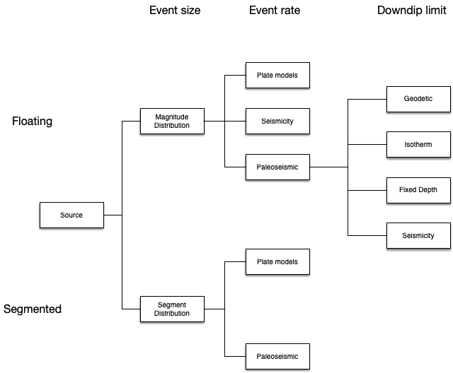
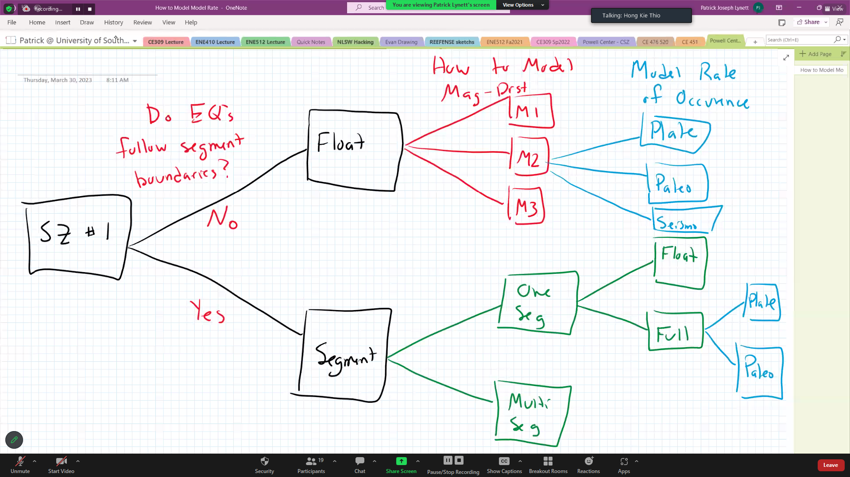
Pat Lynett and Hong Kie Thio led the participants through the process to discuss the segmentation for each margin, a key part of the logic tree. First, we looked at a proposed draft (on left) and then we decided what the tree should look like for this project.
Lynett used his magic pen to help the participants determine the best configuration for tree branches
Hypothetical Logic Tree Shape proposed by Thio
Example scaling relations used for Cascadia
Notes:
Thio showed how some of these branches may appear in an hypothetical logic tree. Here we see that the earthquake size is first controlled by either magnitude frequency relations or with segment distributions.
Then the event rate can be calculated using plate rate models, seismicity models (e.g., Guttenburg-Richter), or paleoseismic data.
The third proposed branch addresses slip distribution with a down-dip termination constraint.
I include a screenshot from the Cascadia logic tree showing some of the existing magnitude scaling relations.
On the right we see how Lynett used his magic pen to lead the participants through a conversation about the logic tree configuration.

Slide 17
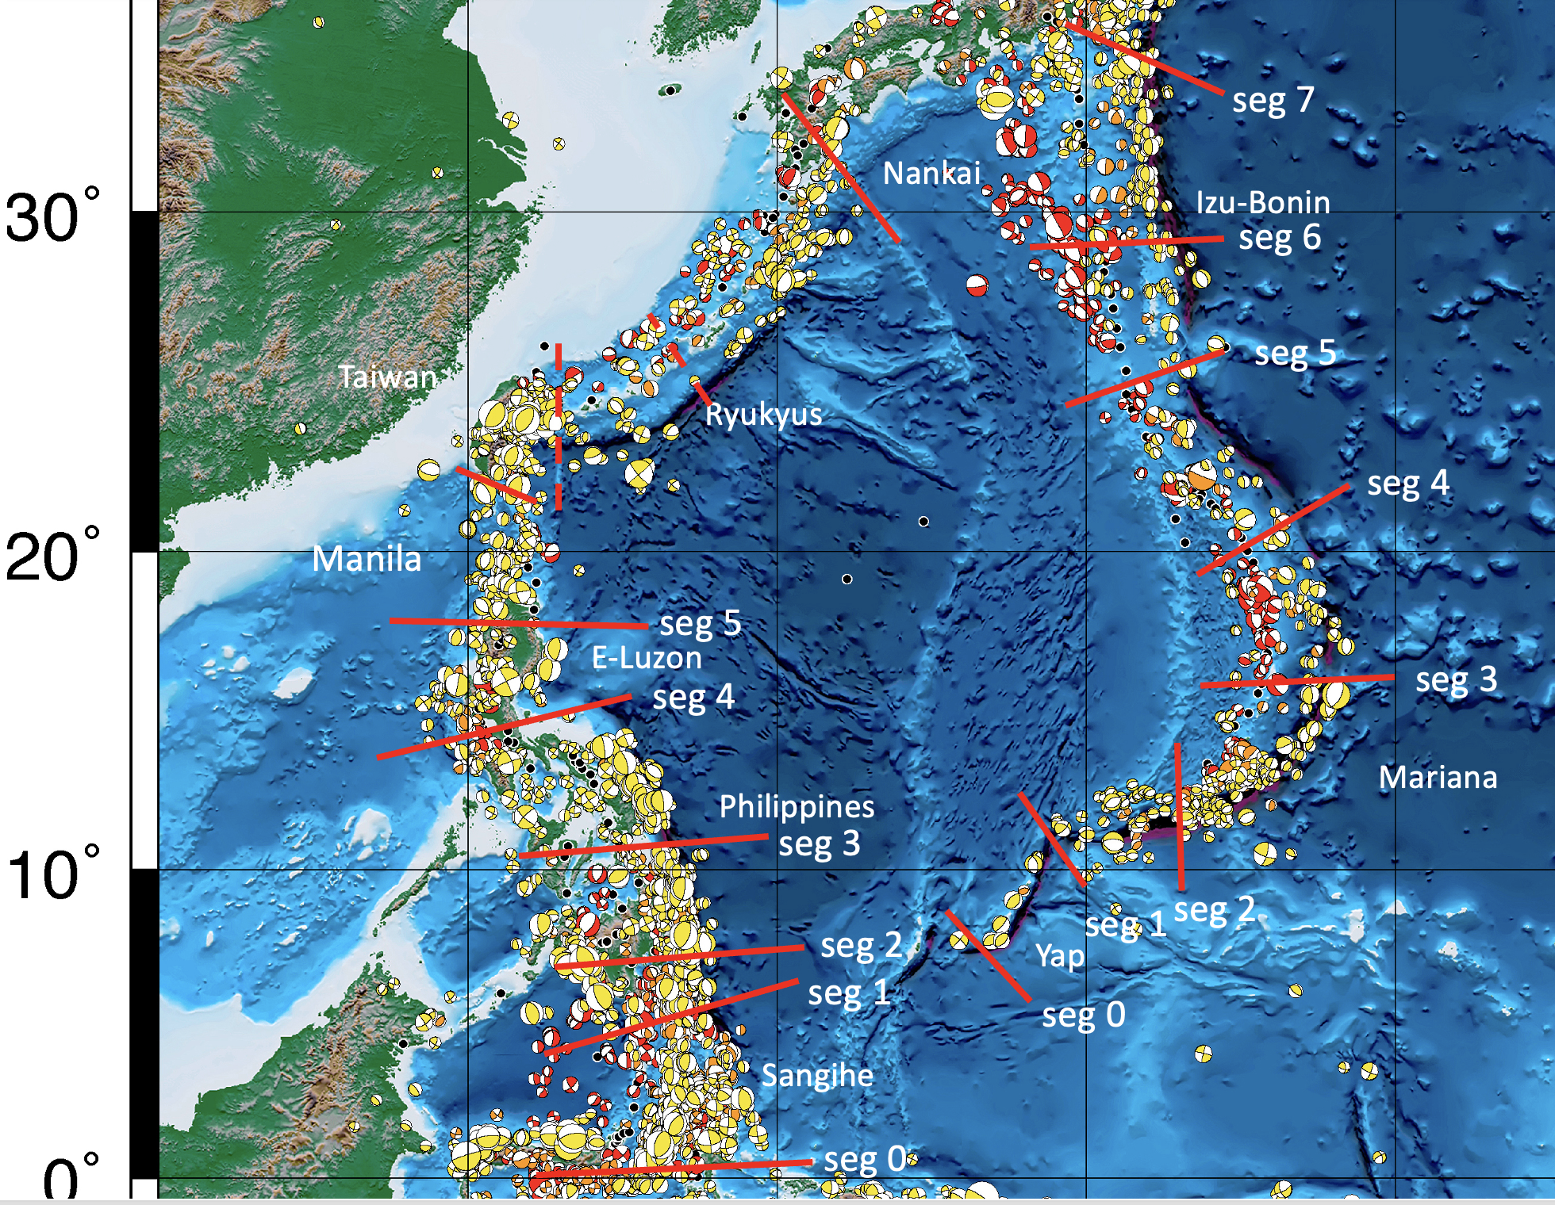
Pat Lynett and Hong Kie Thio led the participants through the process to discuss the segmentation for each margin, a key part of the logic tree.
Serge Lallemand used maps in a digital presentation to help us decide where to place segment boundaries.
Participants consensed on the location of segment boundaries, then voted on the strength of each boundary to arrest rupture spanning the boundary.
The example on the right shows some of these segment boundaries.
Notes:
For the remainder of the meeting we focused on using the participants to locate segment boundaries.
First we all agreed about the location of these boundaries. Then Lynett used an online poll for participants to vote on logic tree branch weights. E.g., floating vs. segmented; the number of possible segments that could rupture coincidentally; and finally, the strength of each segment boundary to act as a barrier to earthquake fault slip.
Here is one of the maps that we used.
We held a follow up meeting to discuss margins that we did not get to during the weeklong meeting.

Slide 18
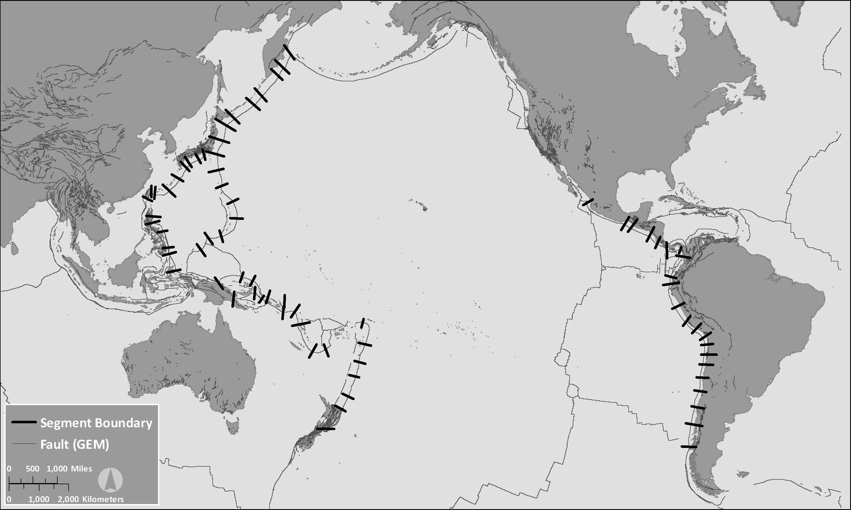
This is a map that shows the segment boundaries that the participants agreed to include in the logic tree.
Notes:
This is a map that shows the segment boundaries that the participants agreed to include in the logic tree.
We did not discuss segments for the Middle America trench but are in the process of doing this. I present the draft segment boundaries here.

Slide 19
U.S. Geological Survey Tsunami Sources Powell Center Working Group:
Cascadia Probabilistic Tsunami Hazard Assessment Meeting Summary
Thank You!
Are there
any questions?
giphy.com/gifs/starwars-3ornk03njkdi5mNKJG
National Tsunami Hazard Mitigation Program
Winter Meeting 2023

Slide 22
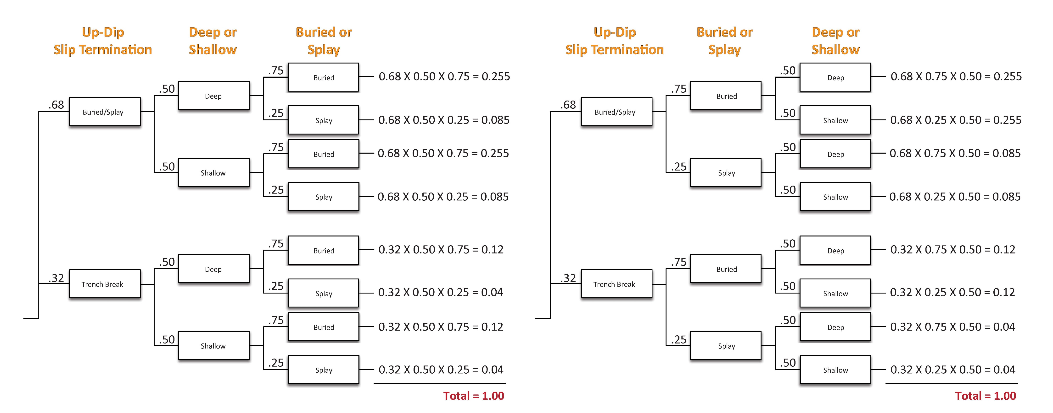
PTHA and Logic Trees
In the logic tree, the order of the branches does not matter.
Example on the left has the deep/shallow branch before buried/splay branch. The example on the right has the buried/splay branch before the deep/shallow branch. Note how the probabilities for each option sum to 1.00.
Notes:
In the logic tree, the order of the branches does not matter. Though, conceptually, it sometimes helps us to place them in a particular order.
Example on the left has the deep/shallow branch before buried/splay branch. The example on the right has the buried/splay branch before the deep/shallow branch. Note how the probabilities for each option sum to 1.00.

Slide 23
