Slide 1
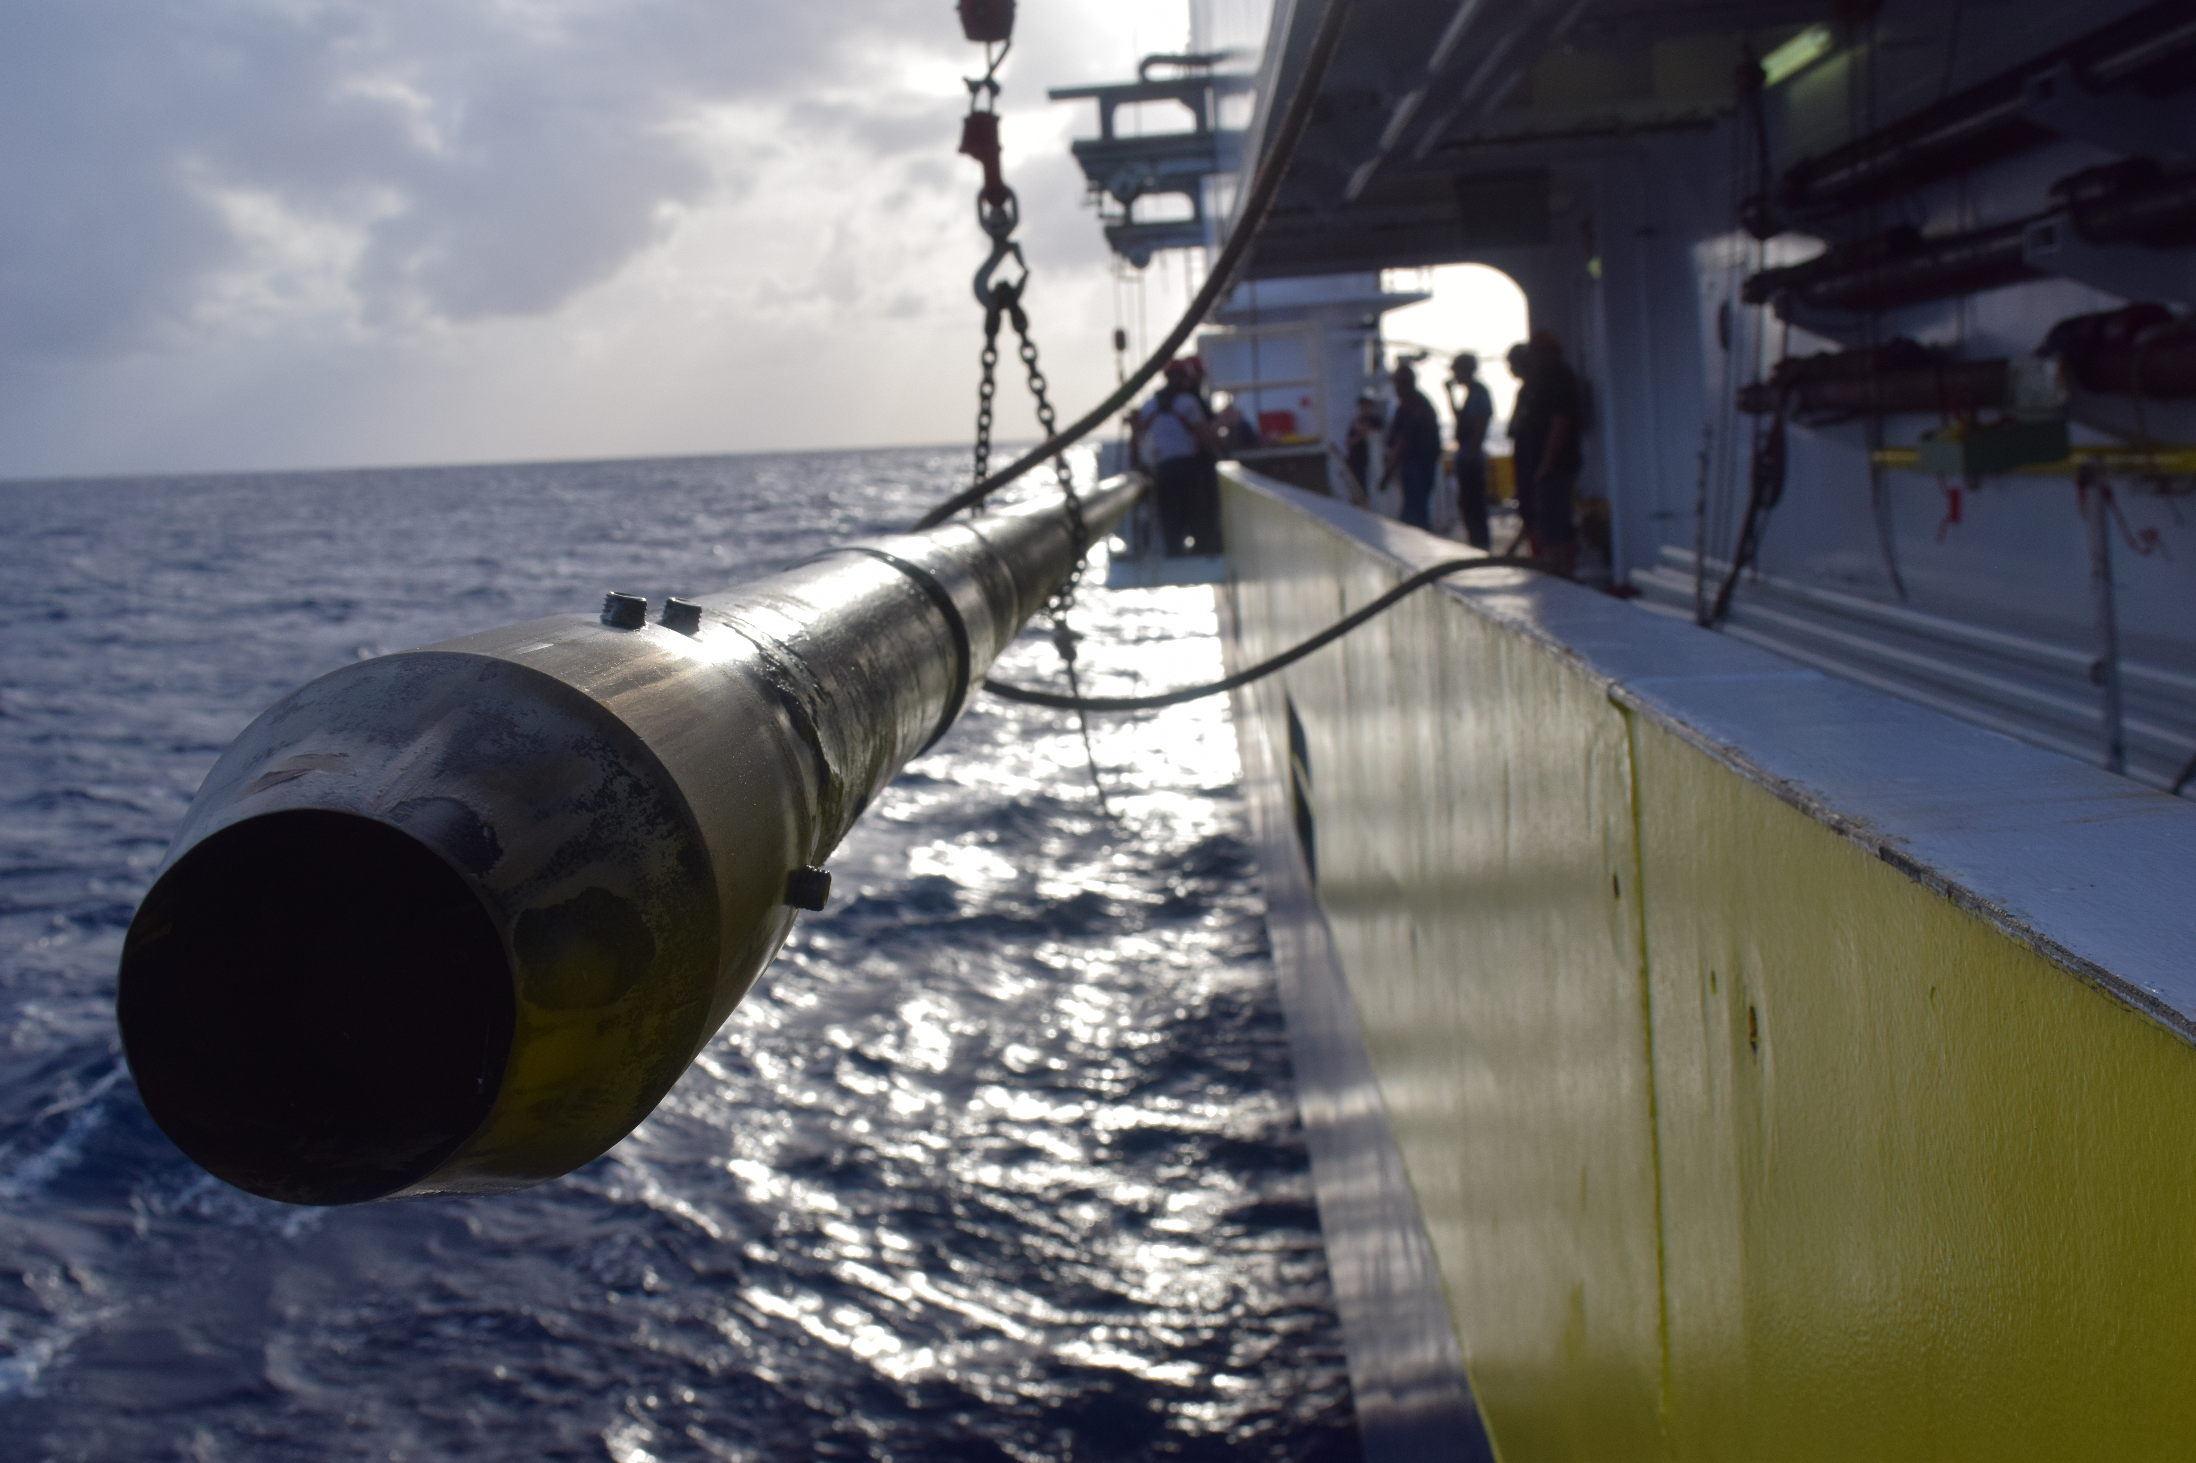







  Sedimentary Evidence for the 2016 November M 7.8 Kaikōura Earthquake and Possible Sedimentary Evidence for Paleoearthquakes along the Hikurangi Subduction Zone
Philip M. Barnes¹
Alan Orpin¹
Jamie Howarth^{2,5}
Jason R. Patton³
Geoffroy Lamarche^{1,4}
Jenni Hopkins⁵
and Ship-board Science Party
Susanne Woelz, John Mitchell, Peter Gerring, Will Quinn (NIWA)
Monique McKoewn, Aratrika Ganguly, Simon Banks (Auckland University)
Sam Davidson (University of Canterbury)
National Institute of Water & Atmospheric Research, Wellington, New Zealand (NIWA)
GNS Science, Lower Hutt, New Zealand.
Humboldt State University, Dept. of Geology, California, USA
School of Environment, University of Auckland, New Zealand
Victoria University of Wellington.

Slide 2
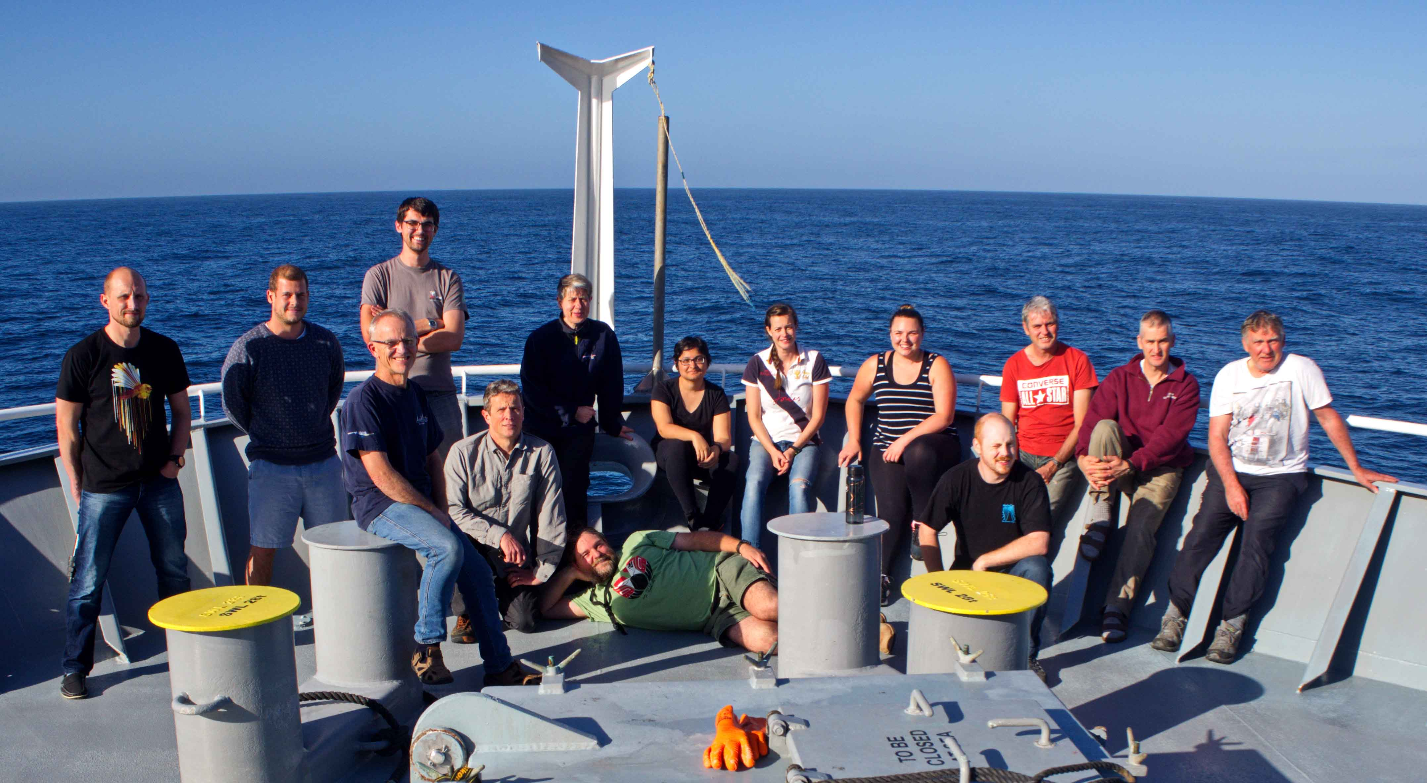
Tangaroa voyage TAN1613 was funded by MBIE Endeavour fund and a NIWA Core Programme
TAN1613 Science Crew

Slide 3
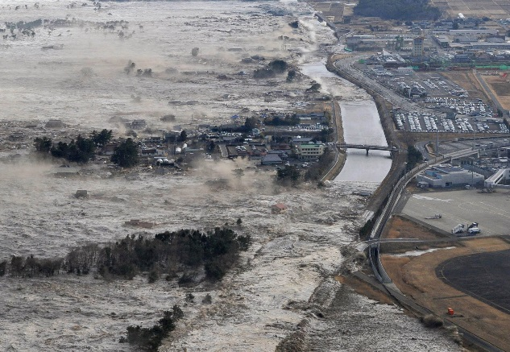
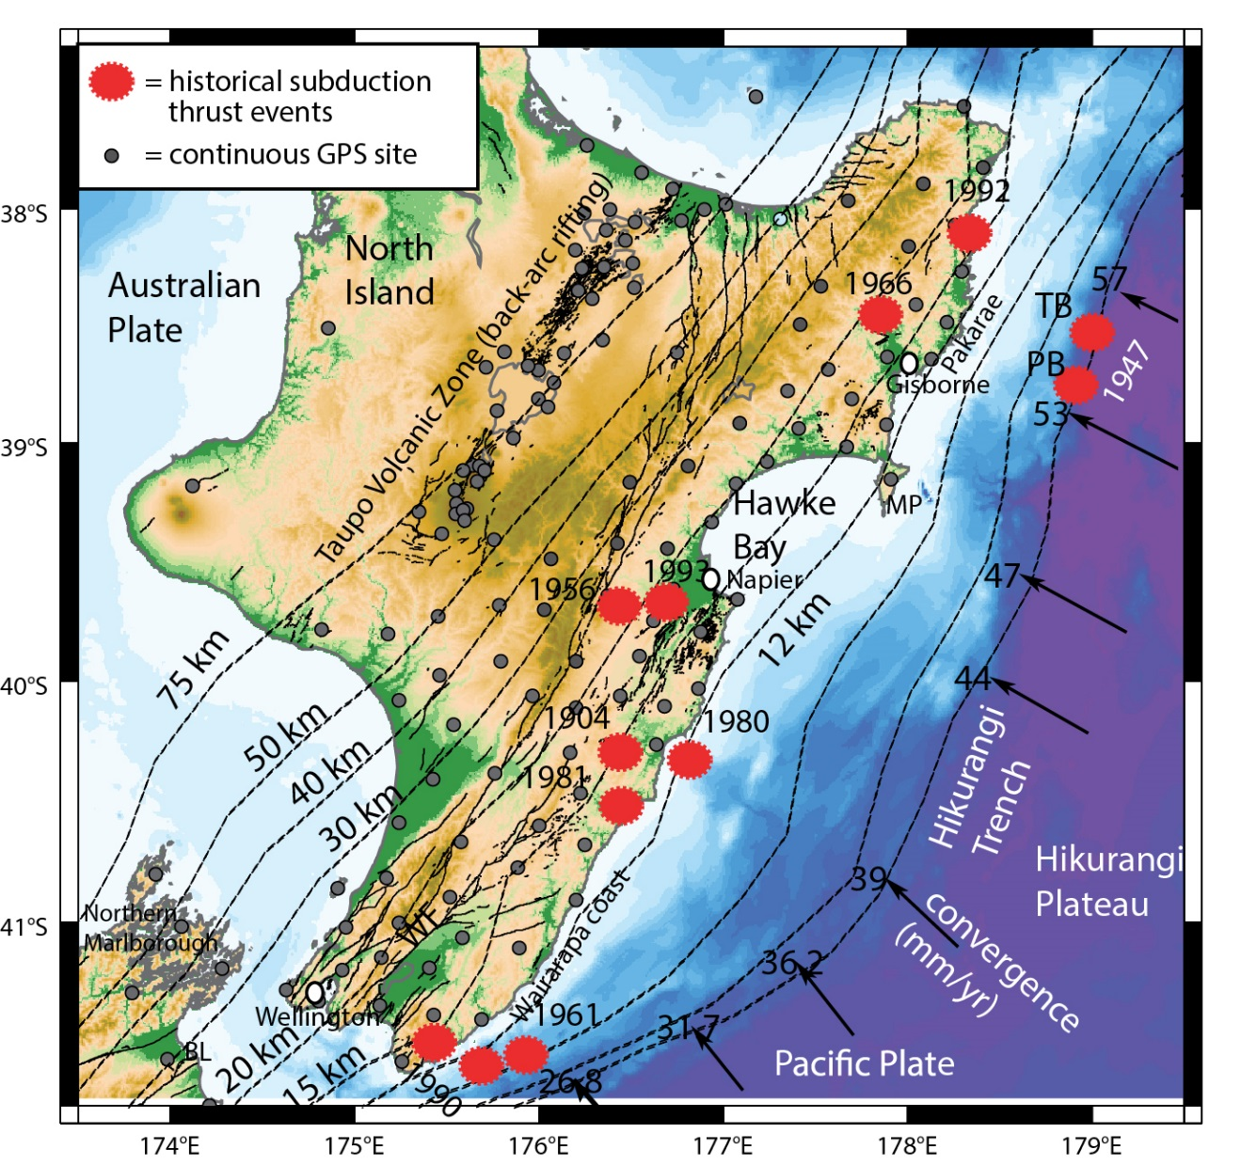
2011 Japan: Mw 9.0
http://www.japantimes.co.jp/life/2014/03/08/lifestyle/still-hunting-shadows-three-years-after-311/#.VEn7IvldVUM
The Hikurangi Subduction Margin
No historic Great Earthquakes on the Hikurangi Megathrust
Potentially New Zealand’s largest source of earthquake and tsunami hazard and risk
Australian
Plate

Slide 4
Existing paleoseismic records are derived from:
  uplifted coastal terraces
  subsided lagoons
  marine paleoseismology for Northern Hikurangi
Clark et al 2015, Wallace et al. 2015

Slide 5
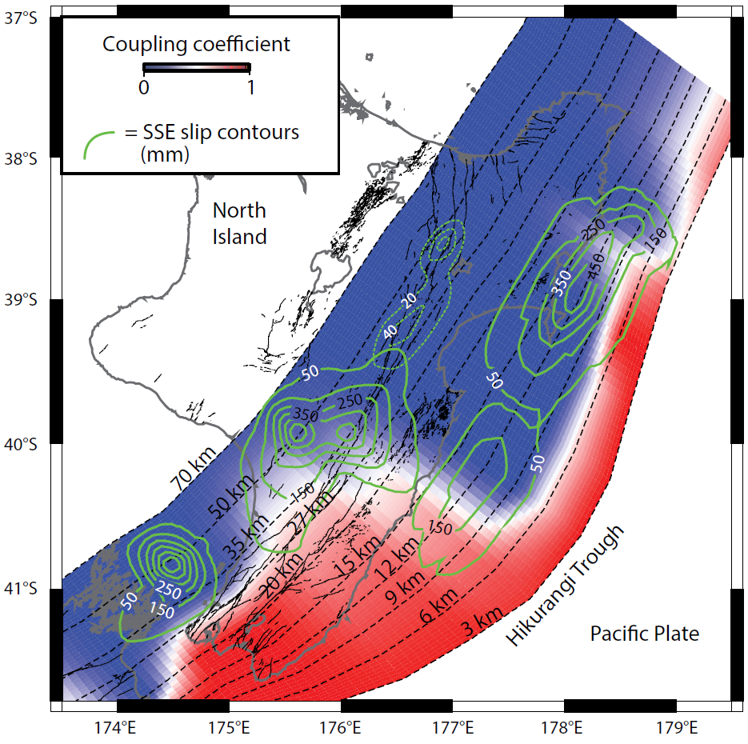
Coupling Ratio and Slow Slip Earthquakes
These may reveal something about the potential spatial variability for Great Earthquakes (M > 8.0).
Wallace et al., 2014

Slide 6
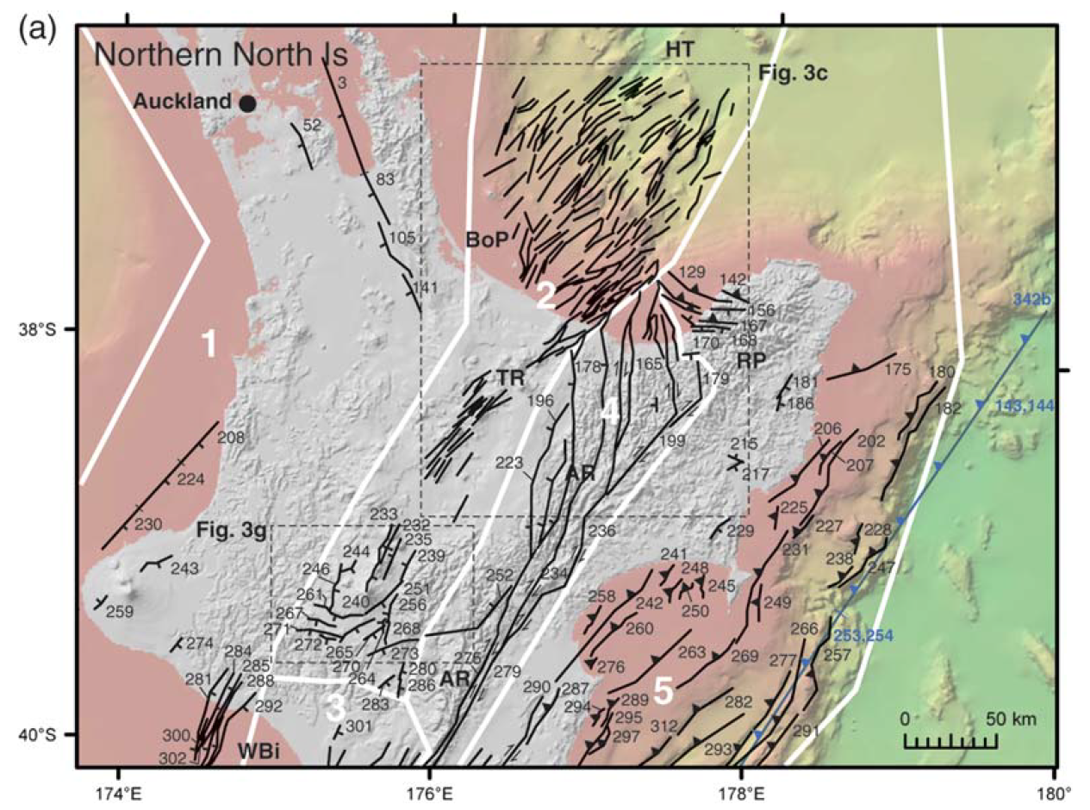
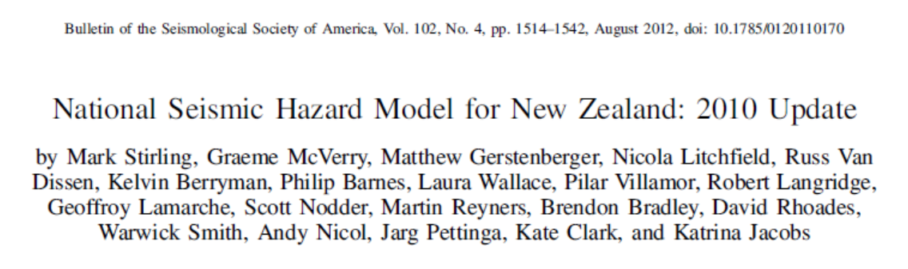
Complicated Fault Systems
There are multiple sources for strong ground shaking.

Slide 7
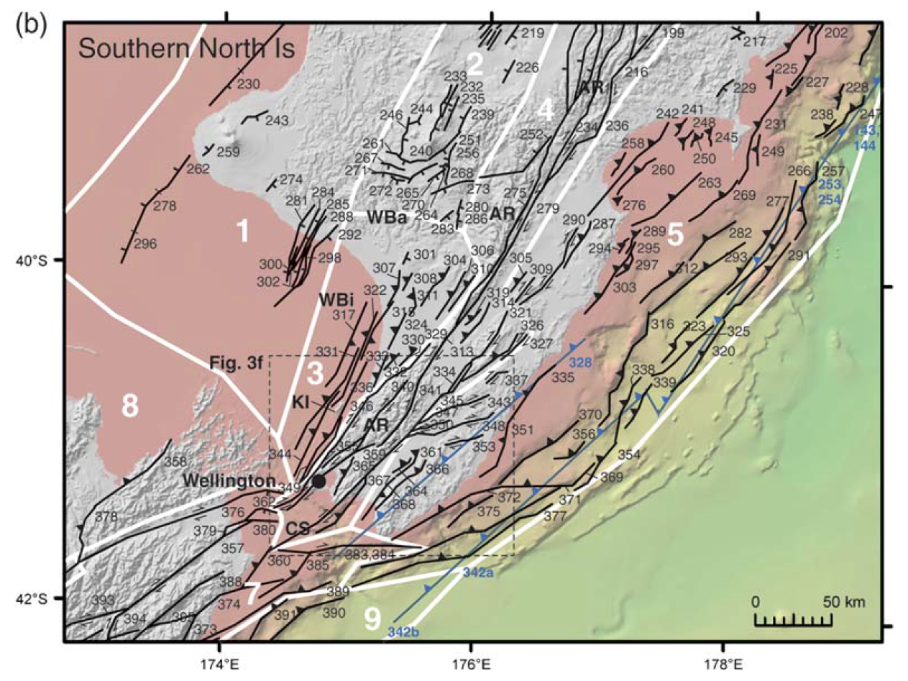
Complicated Fault Systems

Slide 8
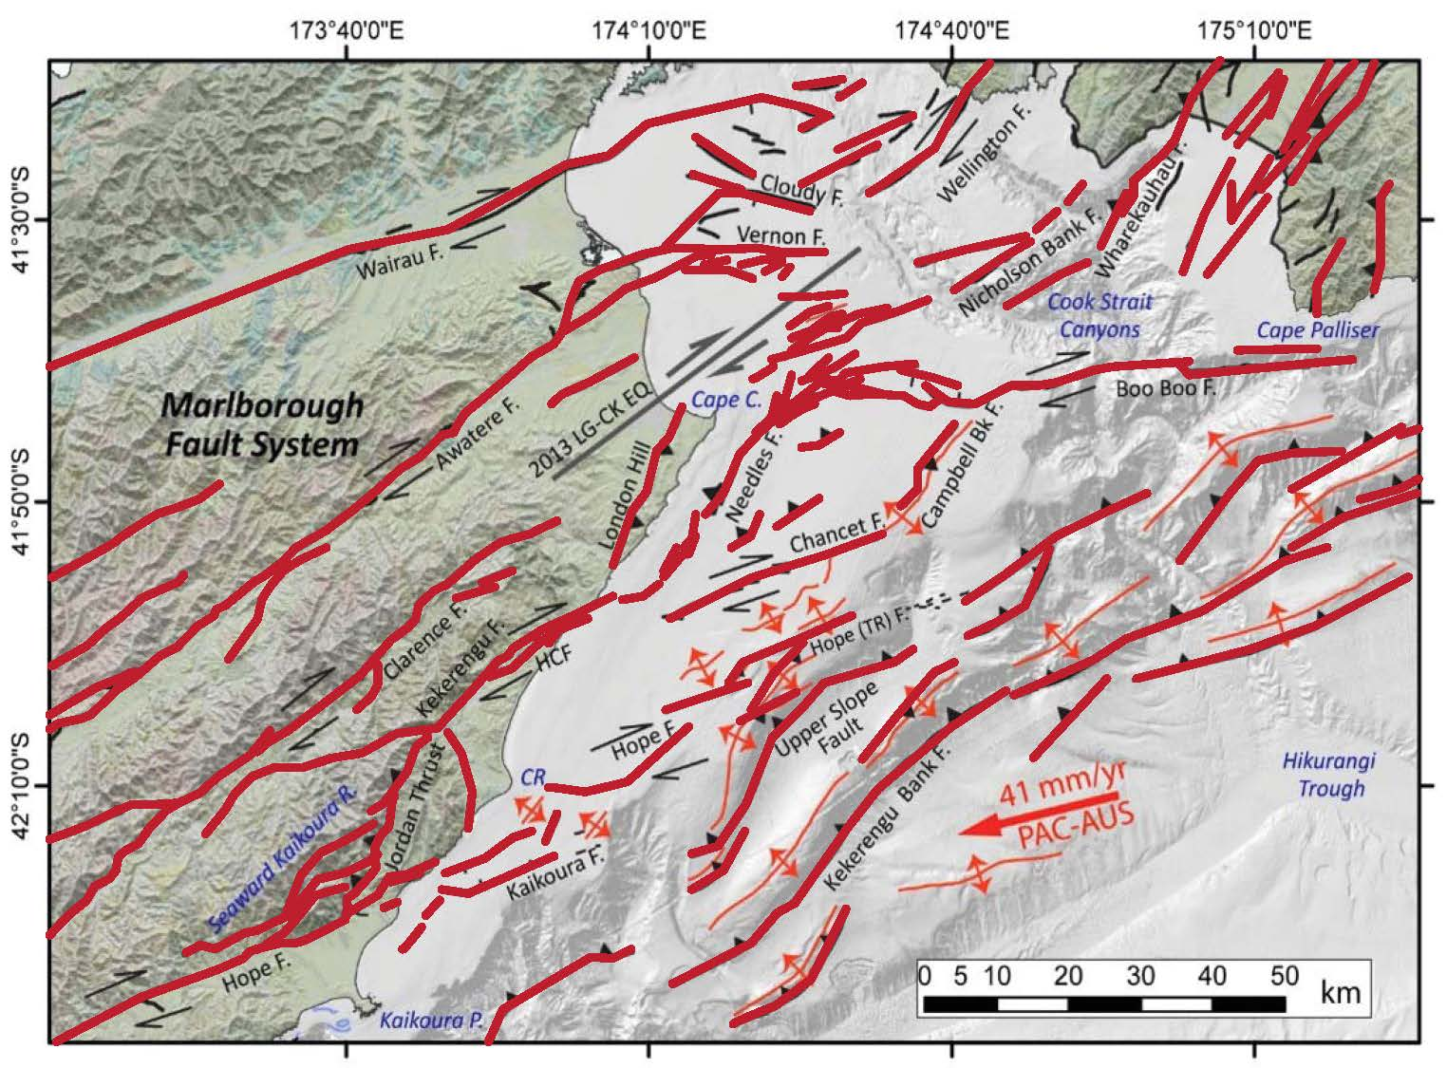
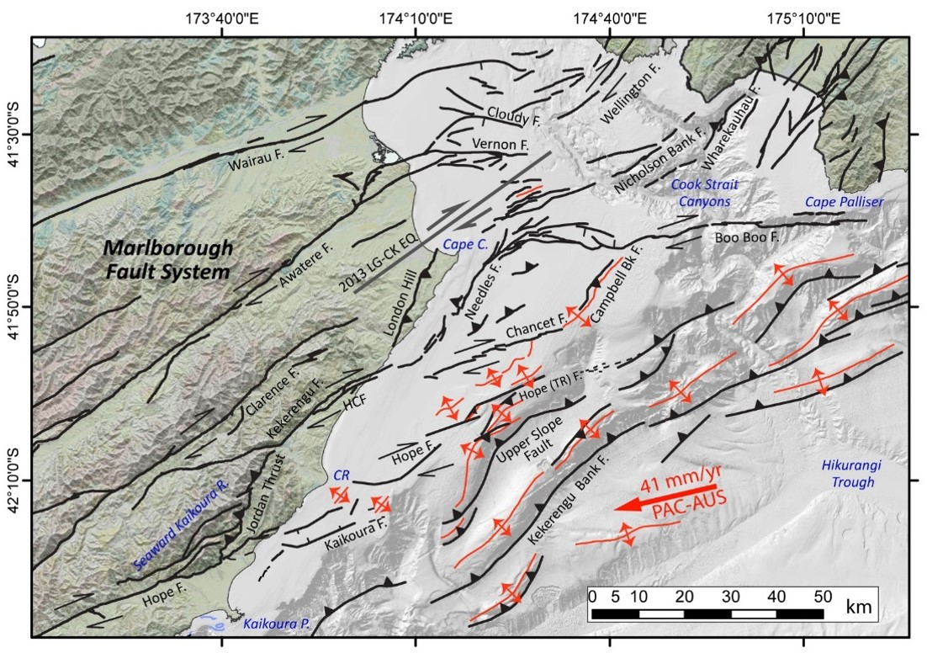

Complicated Fault Systems

Slide 9
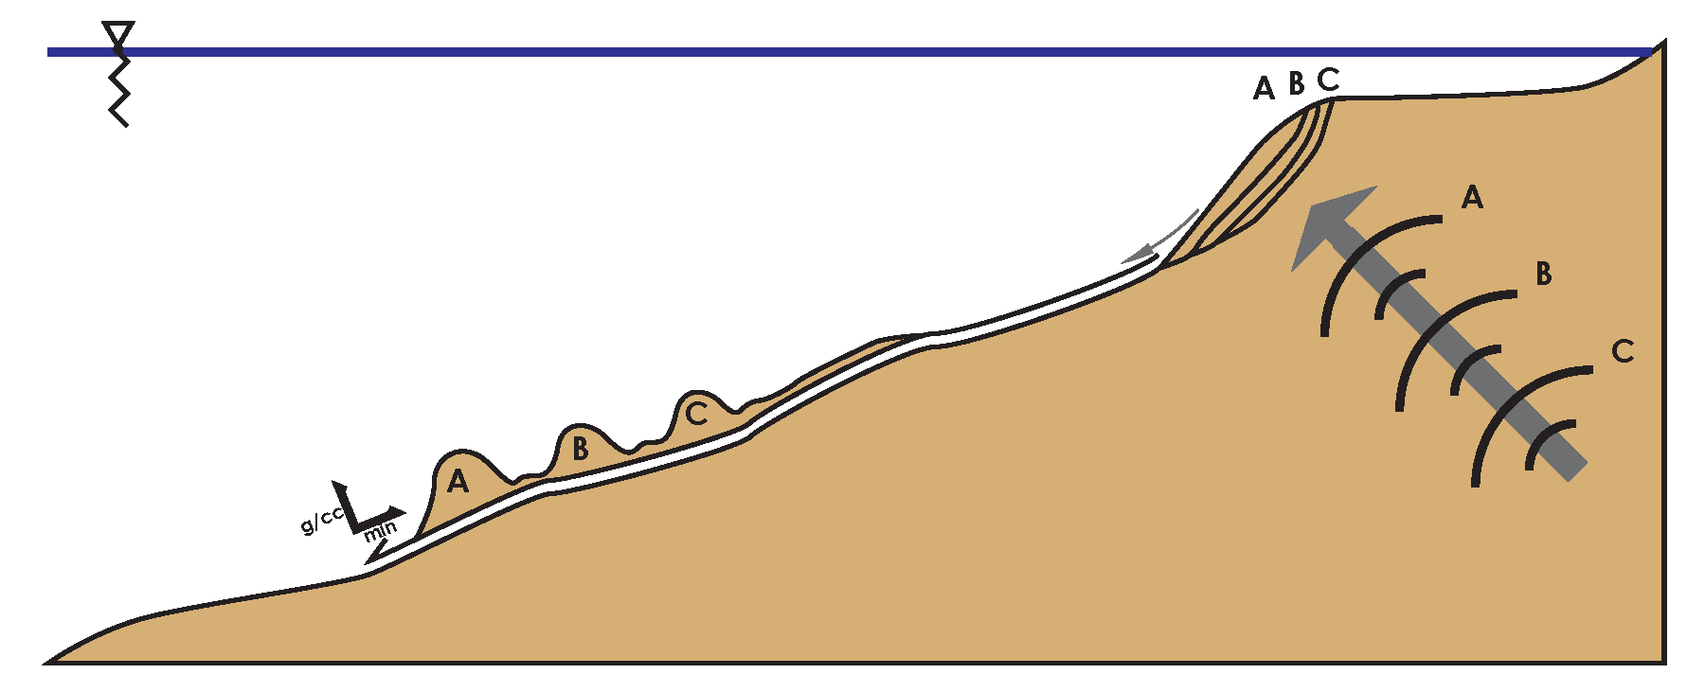
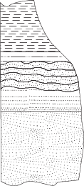
Earthquakes, ground motions, landslides, turbidity currents, and turbidites:
Seismic Forcing of Slope Stability
  Earthquake creates Ground Motions
  Ground Motions trigger Landslides
  Landslides transform into Turbidity Currents
  Turbidity Currents leave deposits called Turbidites
Submarine Landslides
Turbidite
Turbidity Current
Ground Motion
Earthquake
Notes:
9

Slide 10
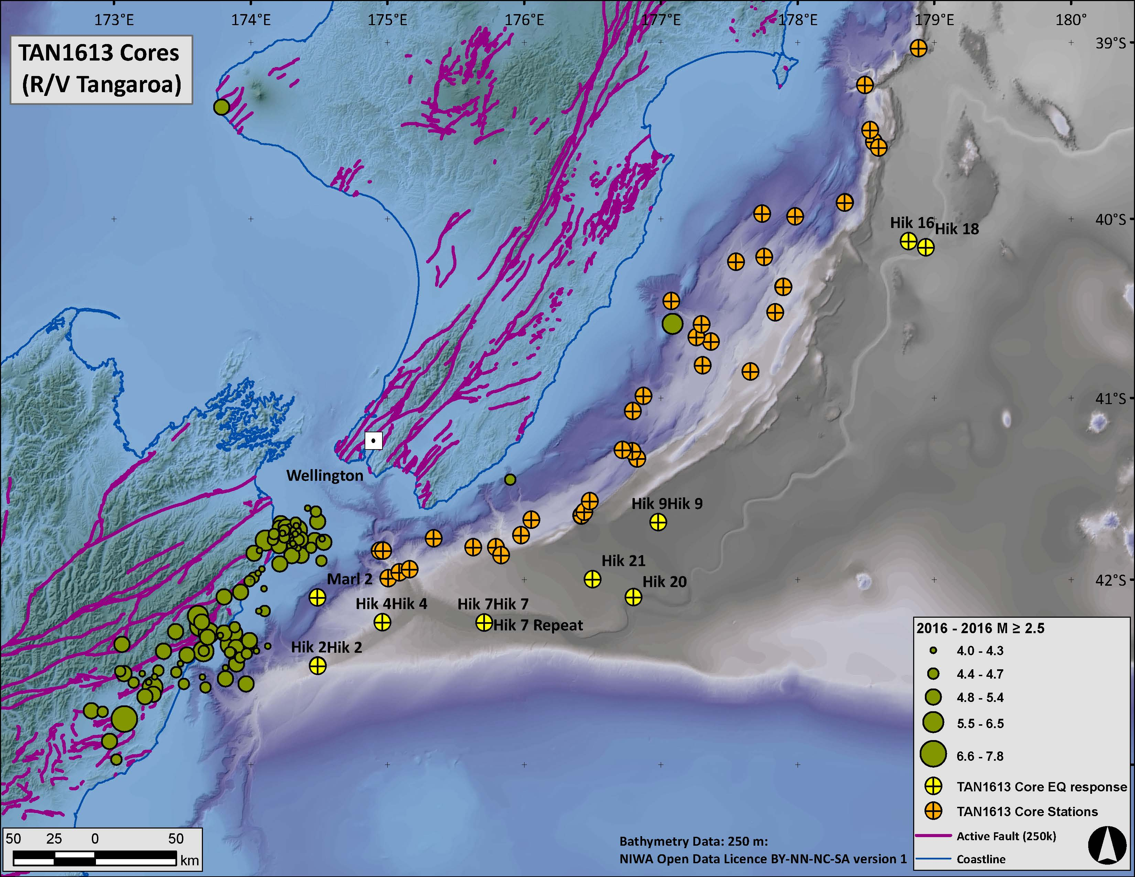
We collected:
61 sediment cores up to ~5.5 m long from sites on the continental margin between the Kaikōura coast and Poverty Bay.
We used two types of corers
  Piston corer
  Multi-corer
The longer cores probably span the last 5000-7000 years

Slide 11
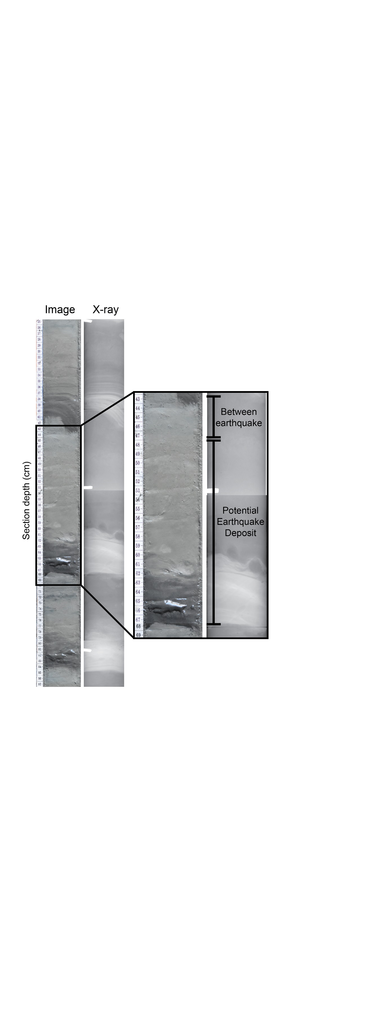
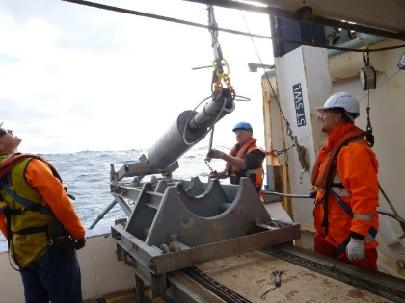
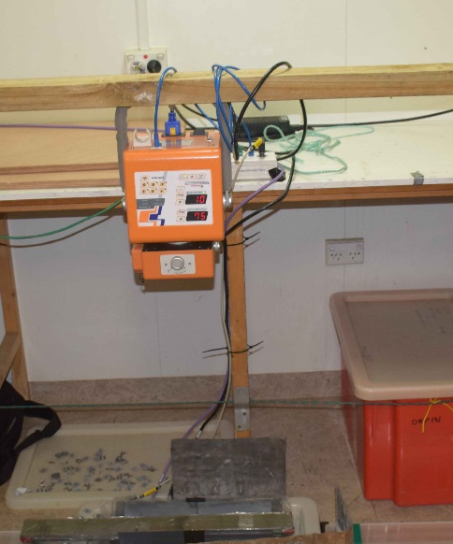
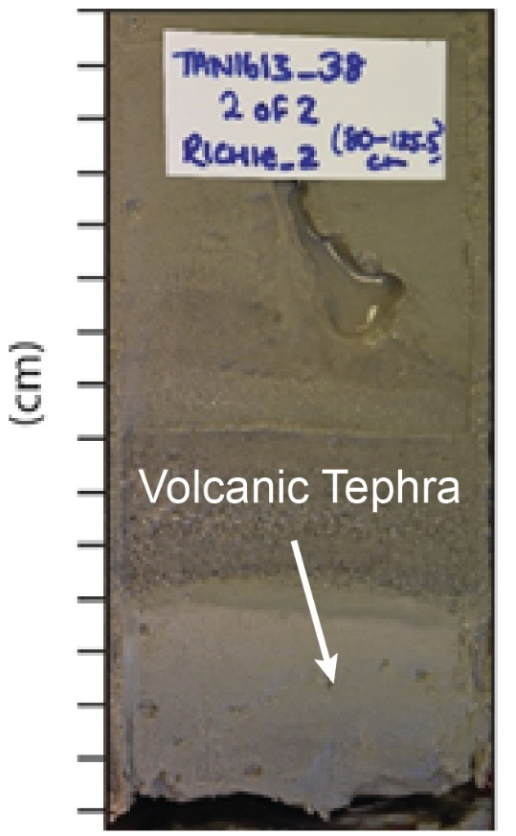
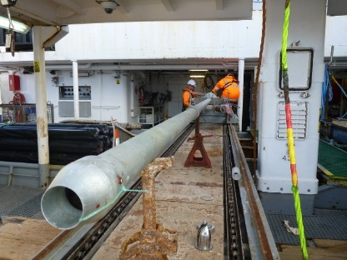
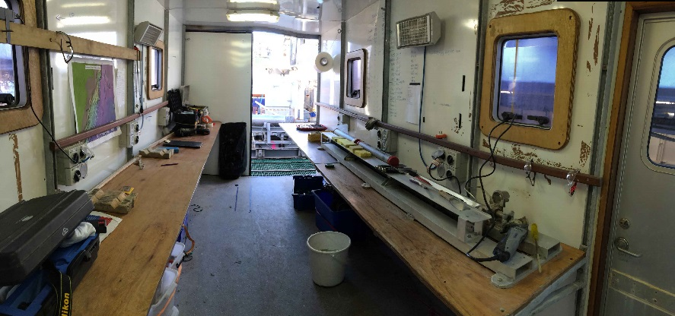
Piston Corer
X-ray radiography of cores
Repeated turbidite layers
Volcanic Ash
From North Is.
Portable laboratory

Slide 12
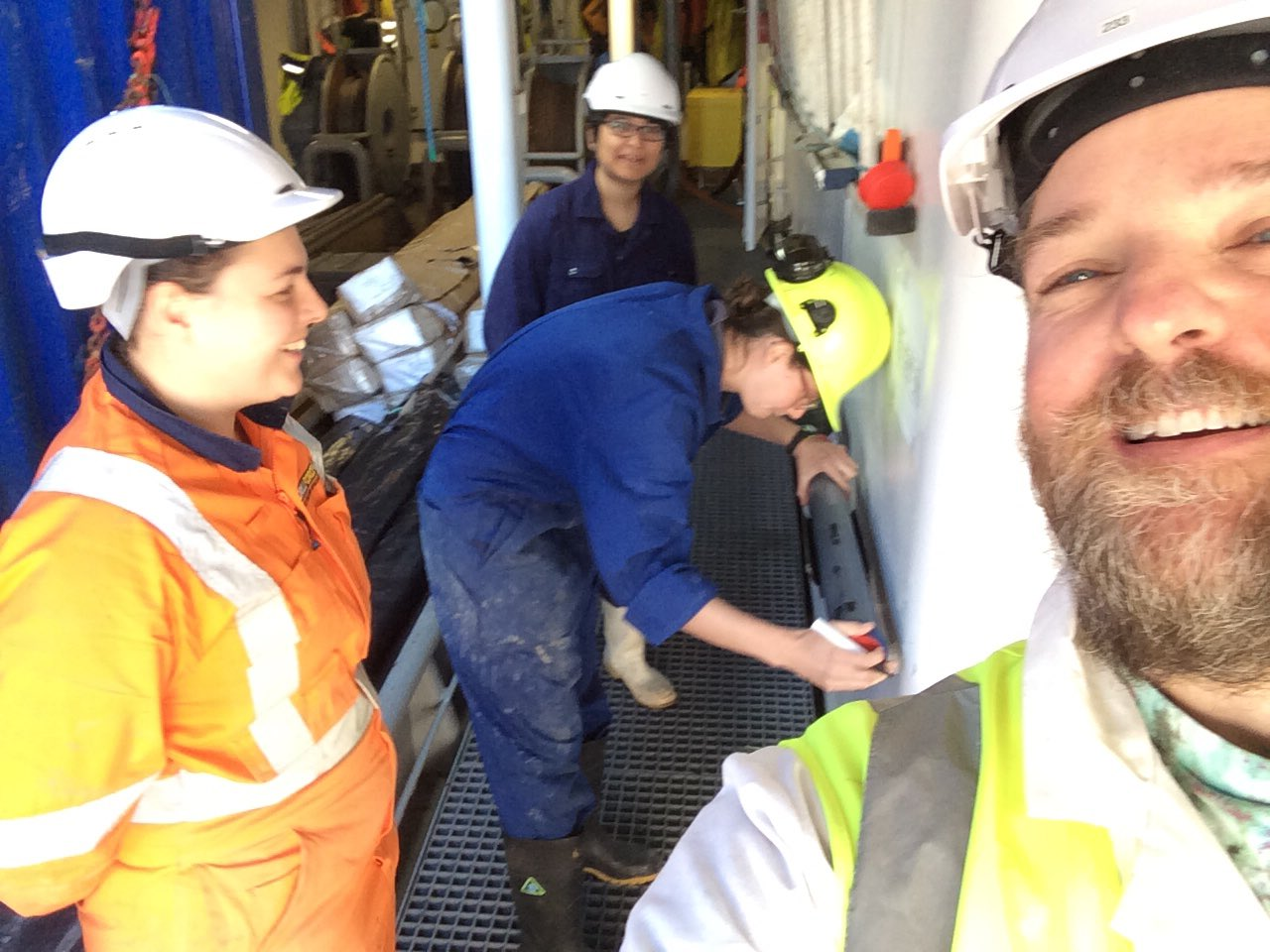
Aratrika Ganguly
Cutting the last core!
Jason R. Patton
Monique McKoewn
Jenni Hopkins

Slide 13
Some Preliminary Results:
The cores contain layers of gravel, sand, mud, and volcanic ash.
Many layers are “turbidites”, rapidly transported and deposited (within hours and days) from turbidity currents resulting from landslides.
Some cores contain up to 25 individual turbidites: Excellent paleoseismic records are likely.
Volcanic ash, recording past eruptions from North Island volcanic centres.
Post-voyage analysis will involve detailed laboratory analysis and radionuclide age control.

Slide 14
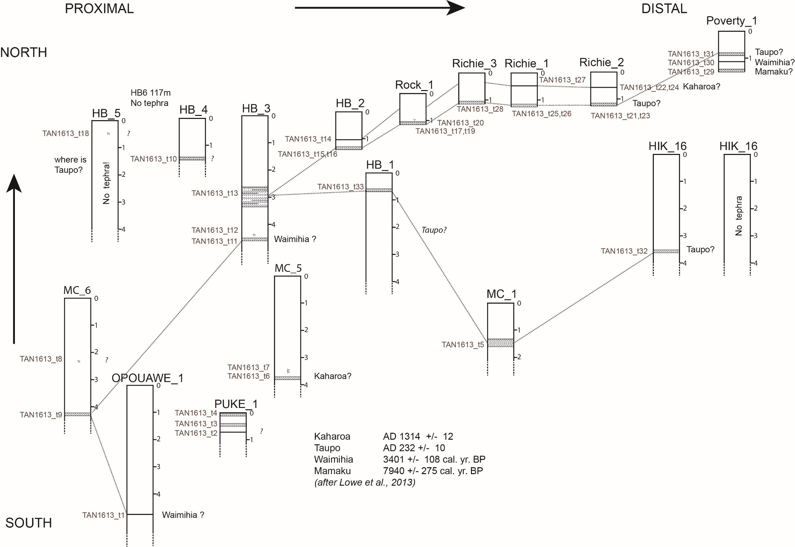
Tephrostratigraphy
Prelim Interpretation:
Dr. Jenni Hopkins
*

Slide 15
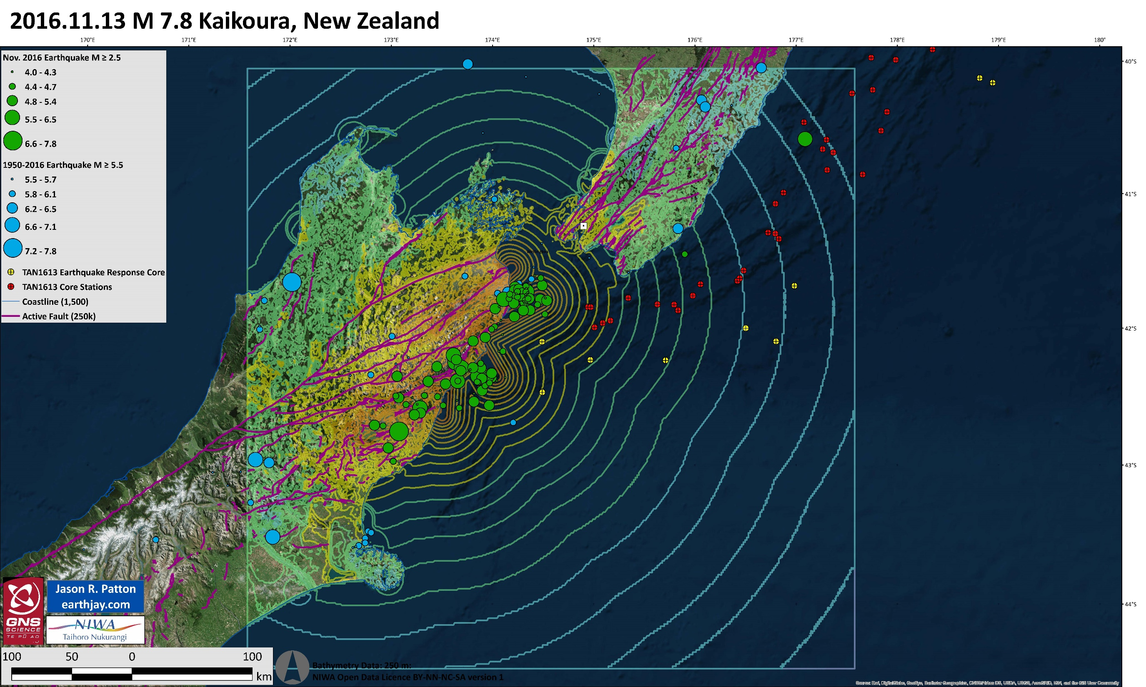
“While you were gone…”

Slide 16
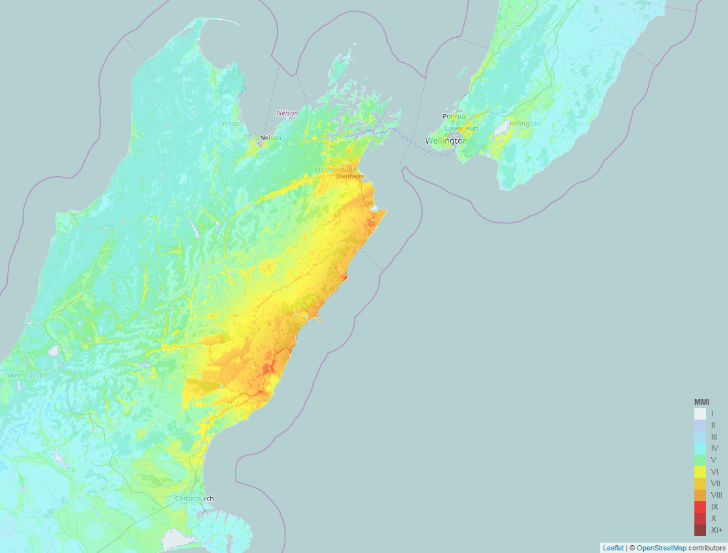
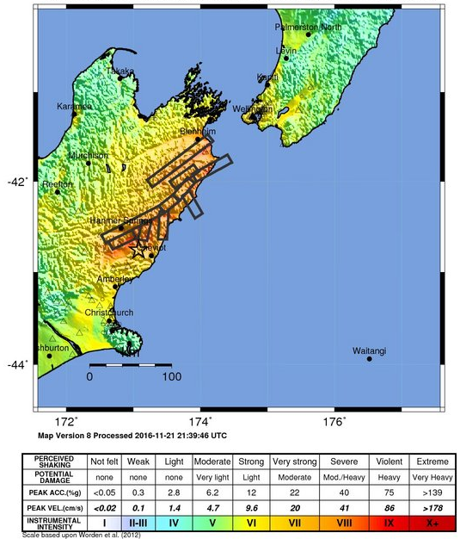
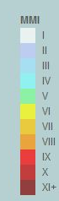
Strong Ground Shaking During Earthquake
USGS
Shakemap
New Zealand Geonet Shakemap

Slide 17
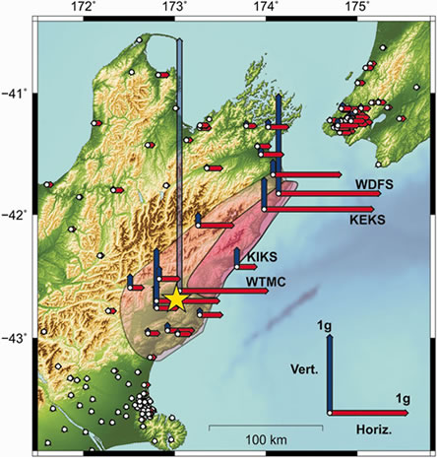

PGA recorded in horizontal and vertical directions recorded by GeoNet strong motion instruments.
Up to 100,000 landslides mapped in pink regions.

Slide 18
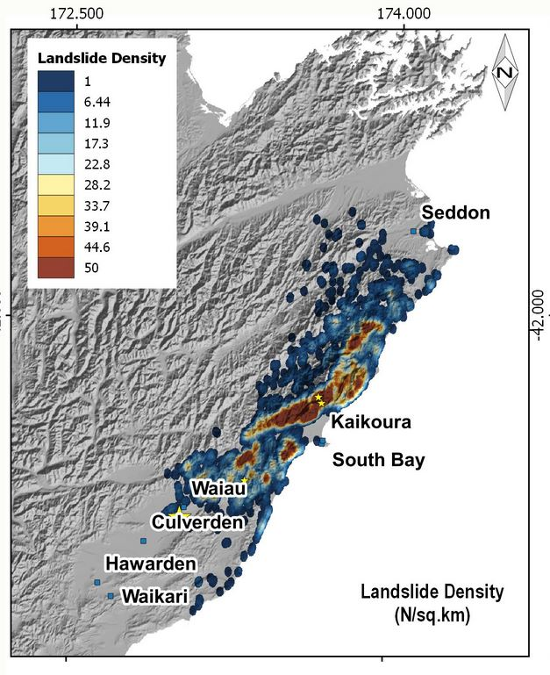
Landslide Density Map
Given the large number of landslides on land and that submarine landslides occur in materials often more susceptible to failure, maybe there were some submarine landslides.
Valkaniotis Sotiris of the Earthquake Geology Research Group and the Aristotle University of Thessaloniki
*

Slide 19
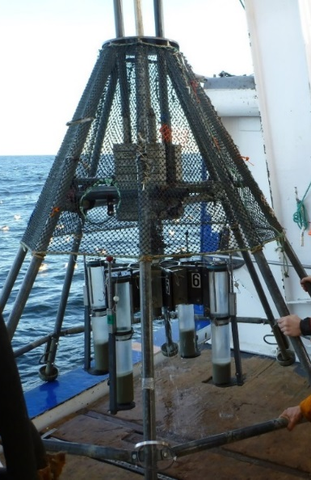
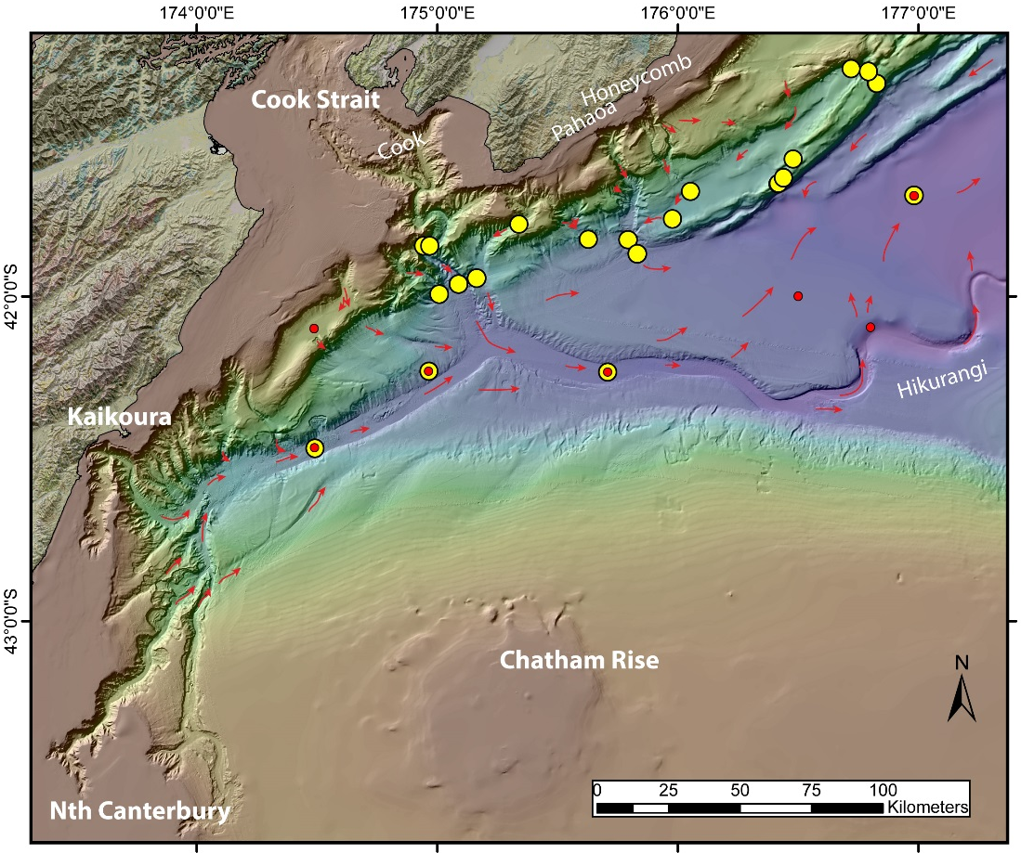
Marine geoscience response to the Nov. 14th Mw 7.8 Kaikōura earthquake
1. Was a new turbidite emplaced in the Hikurangi Trough following the November 14th Mw 7.8 Kaikōura Earthquake?
* The earthquake presented a very rare opportunity with which to calibrate paleoseismic data!
Multicorer:
4 short cores at once.

Slide 20
Orange Symbols:
Cores collected as part of our paleoseismic Investigation
Yellow Symbols:
Cores targeted to find evidence of M 7.8 earthquake

Slide 21
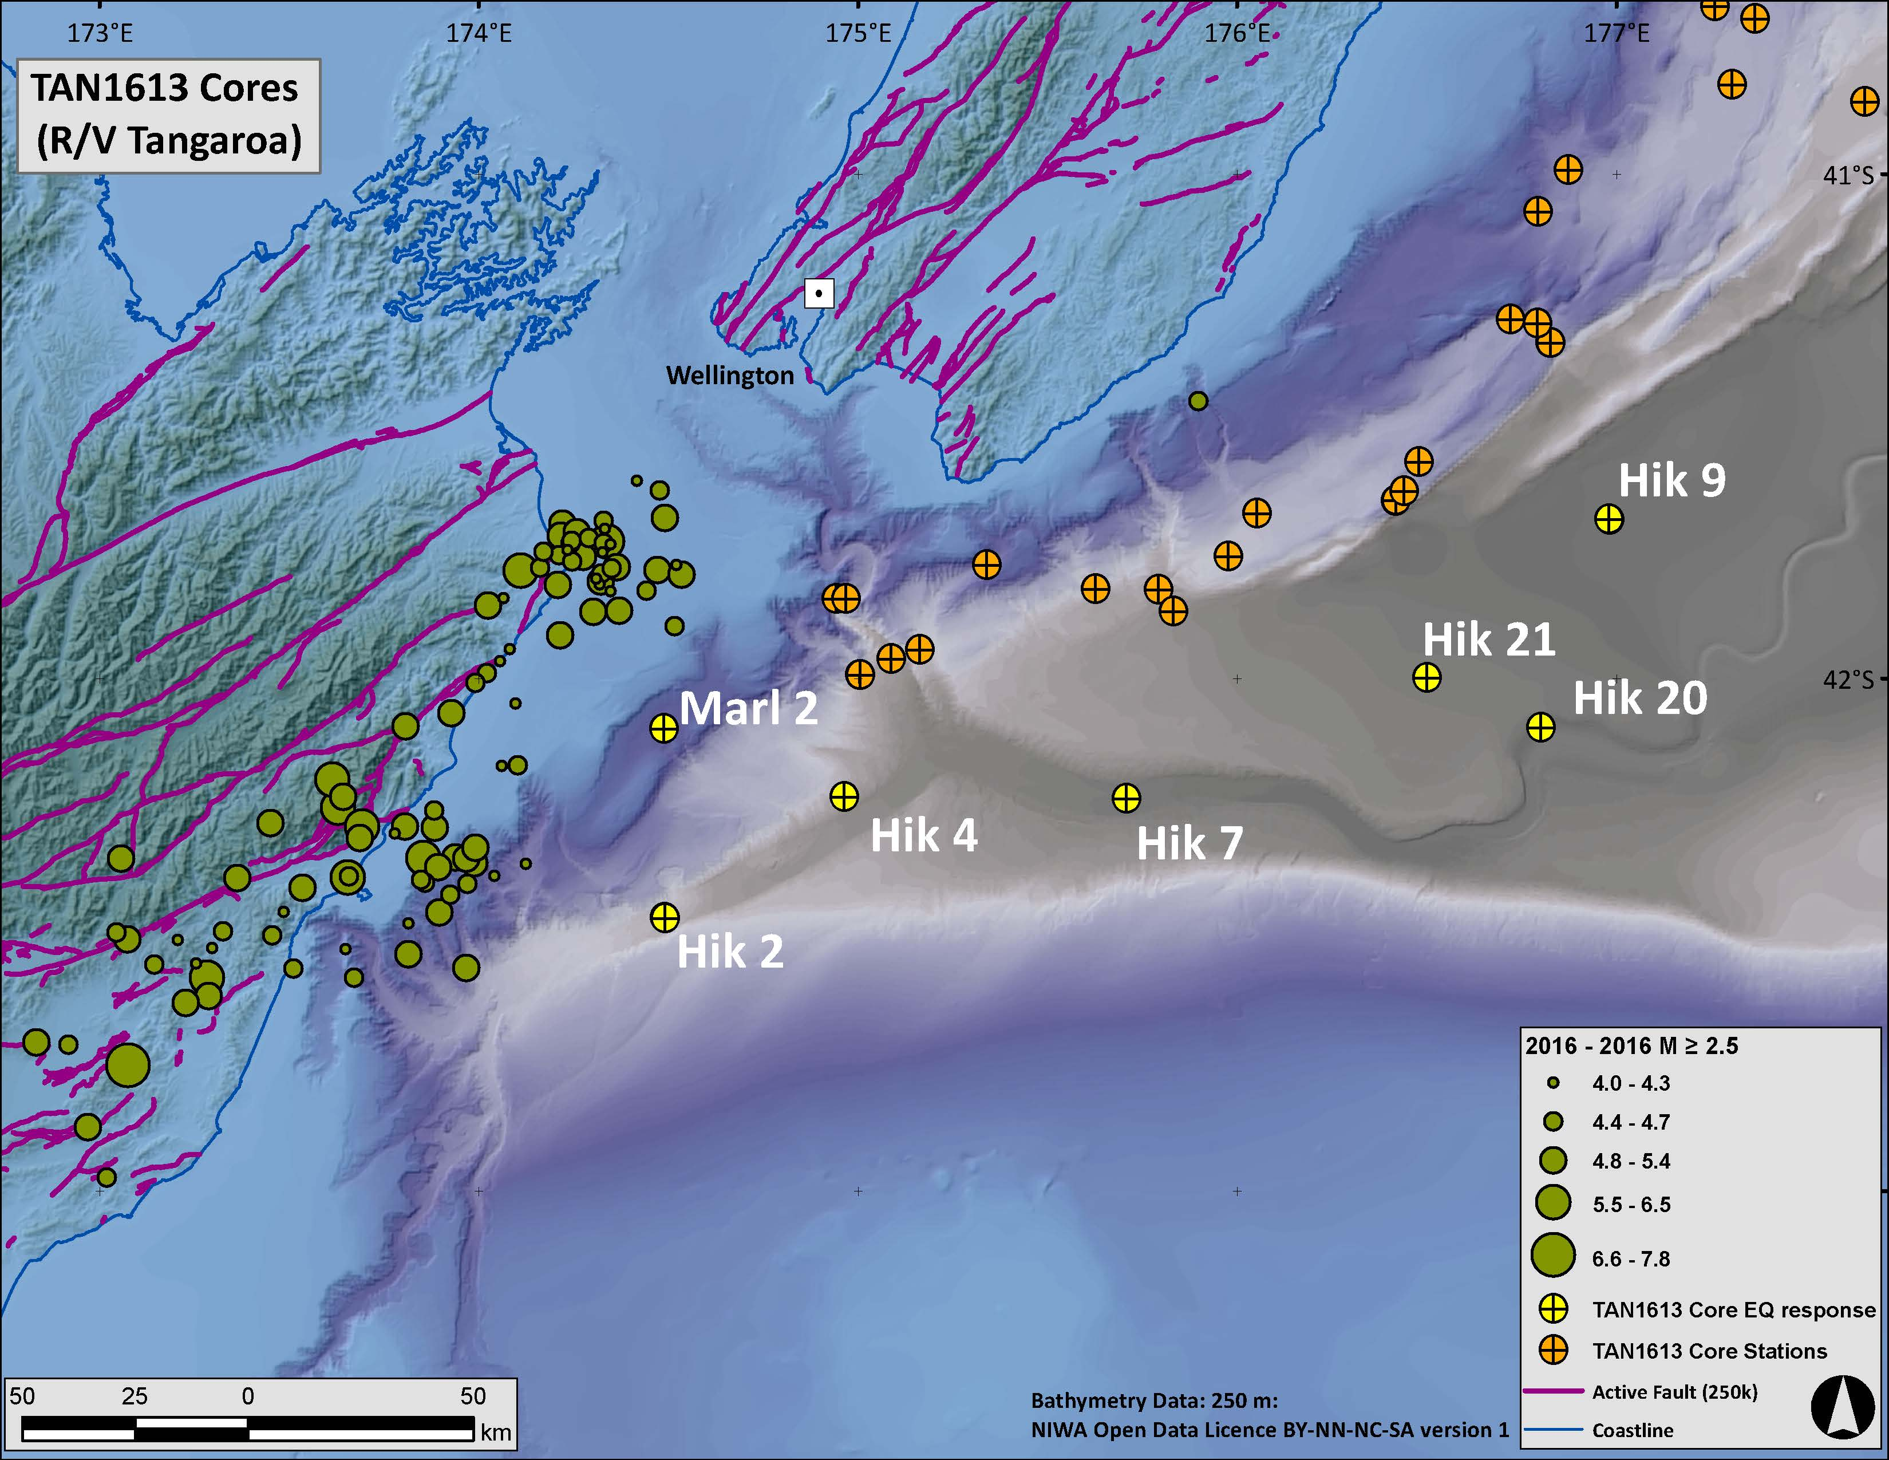
Core Locations Chosen Based Upon:
turbidity current pathway analyses (MOVE software)
seafloor type analyses (e.g. backscatter data)
ability to test for alternate triggering hypotheses (geomorphic setting)

Slide 22
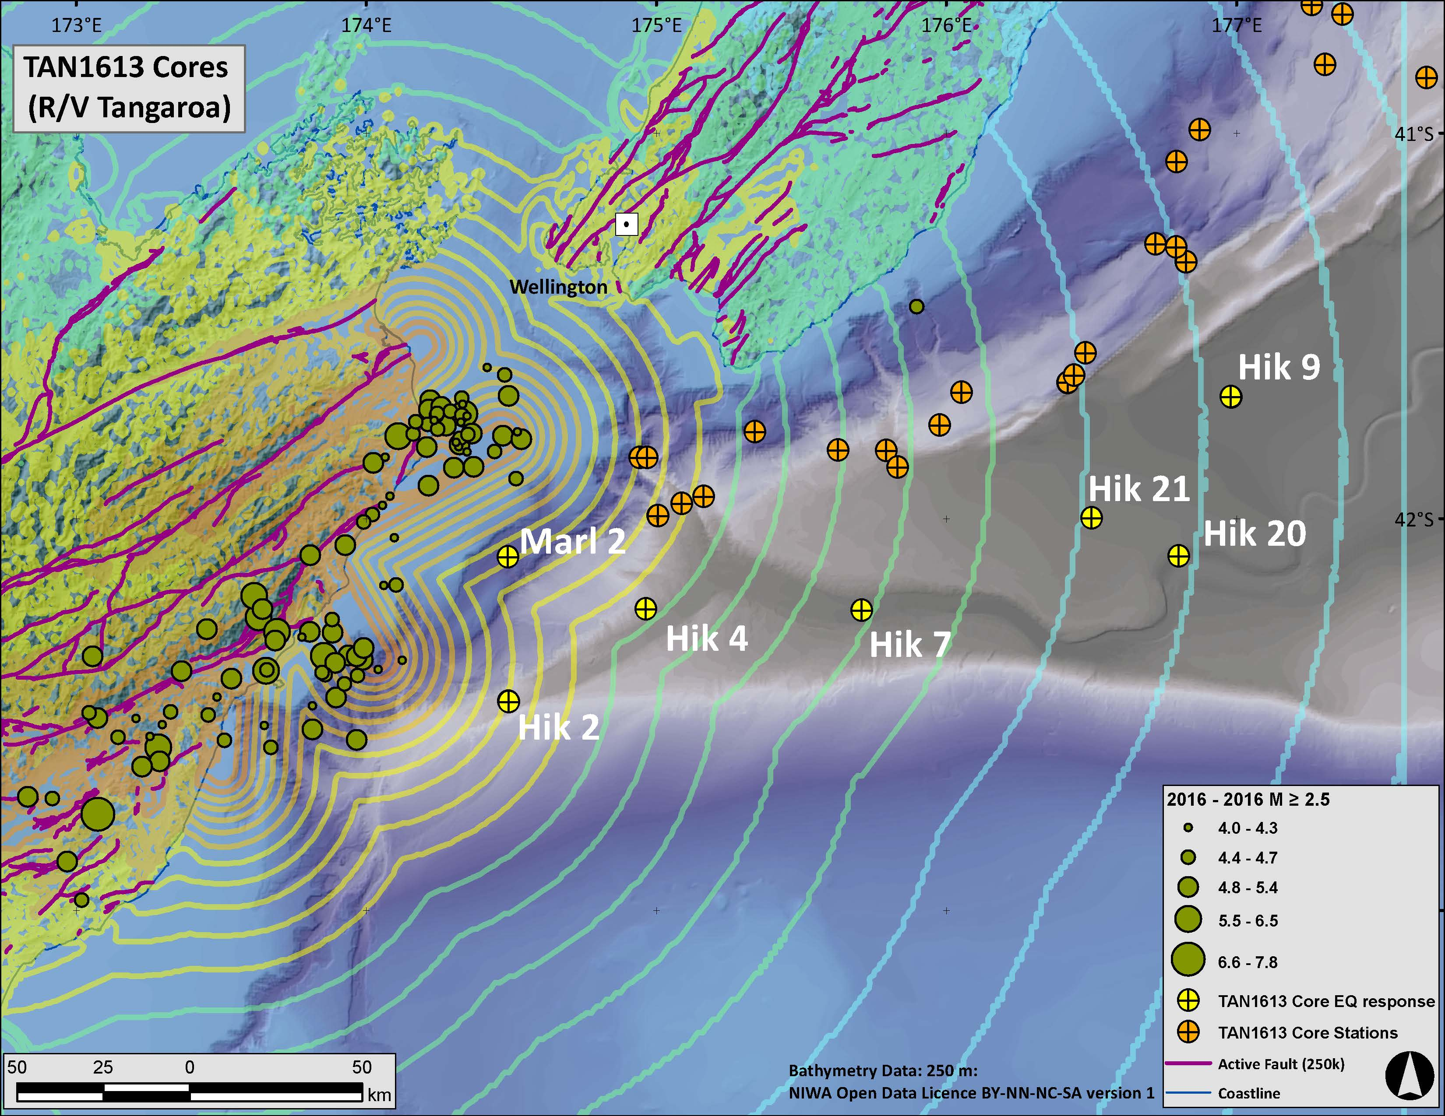
Possibility of strong ground shaking in source areas
USGS Shakemap
MMI contours
*

Slide 23
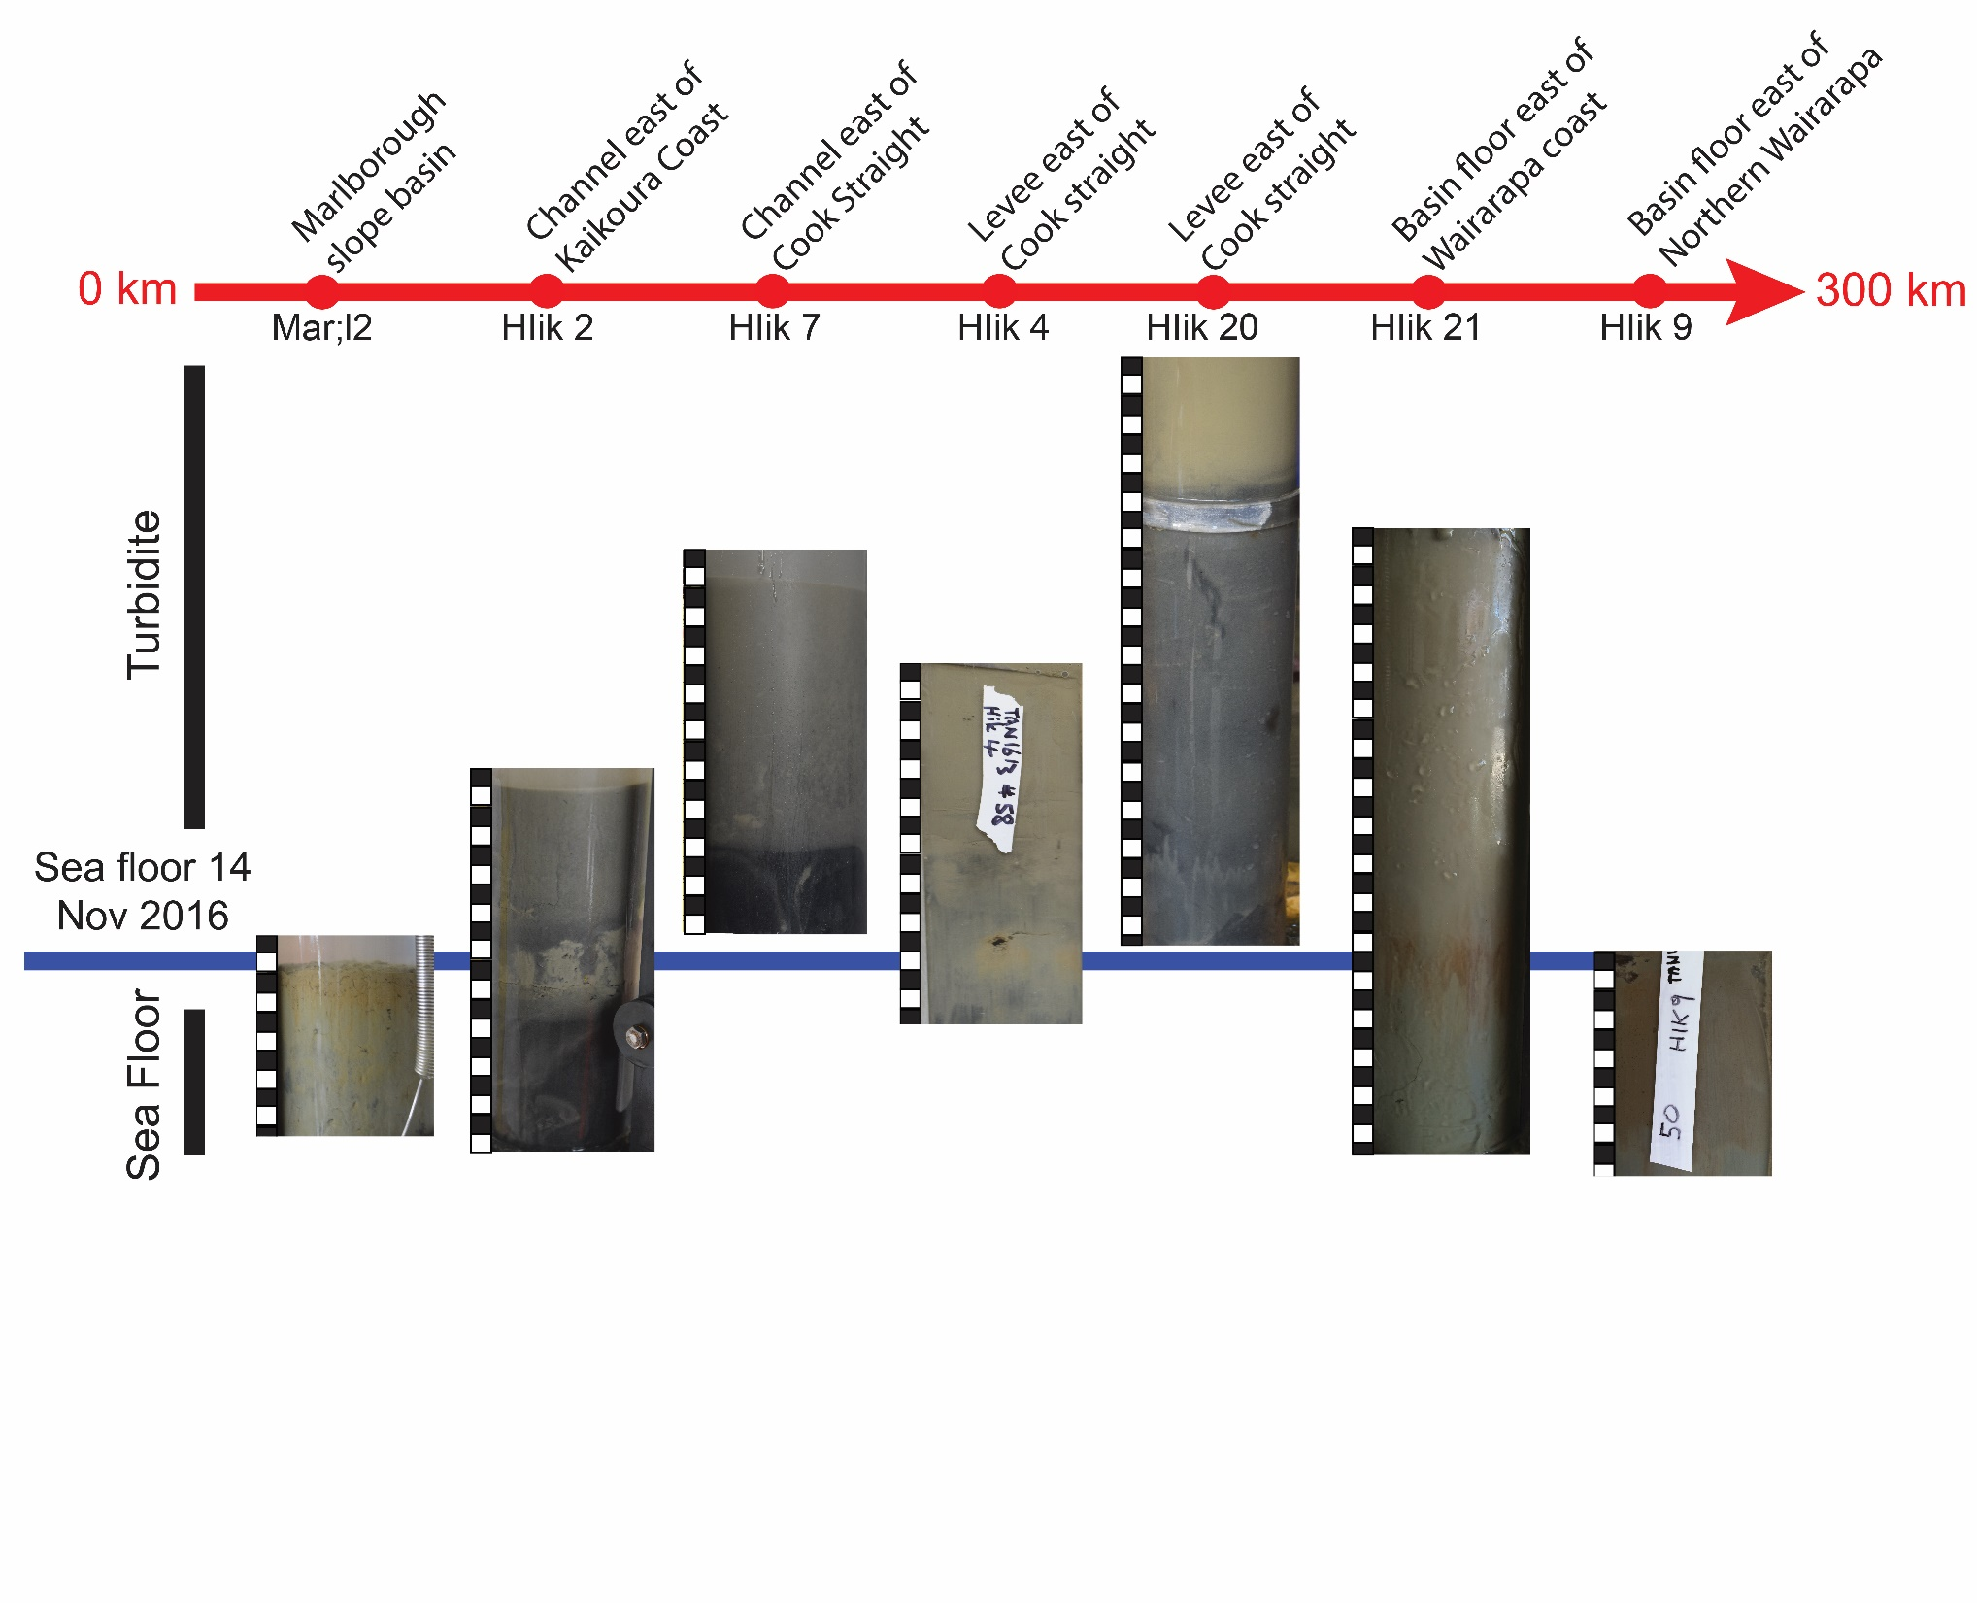

M 7.8 Seismoturbidite?
Absence and Presence

Slide 24

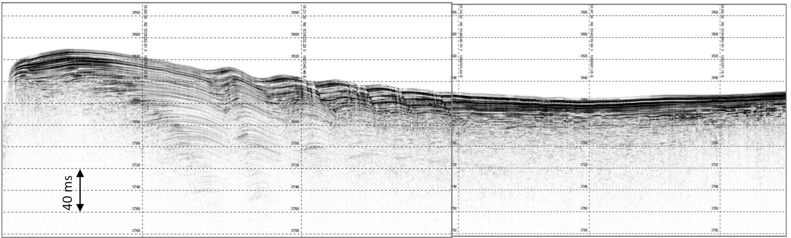
TOPAS Sub-Bottom Data
Transit: Hik 20 to Hik 21
Turbidites!

Slide 25
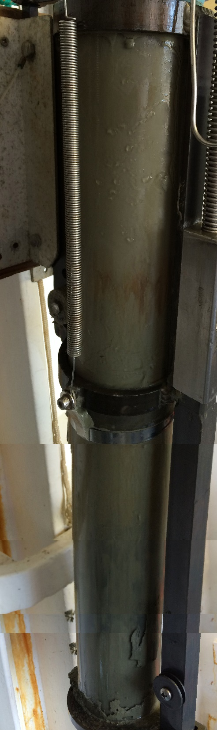
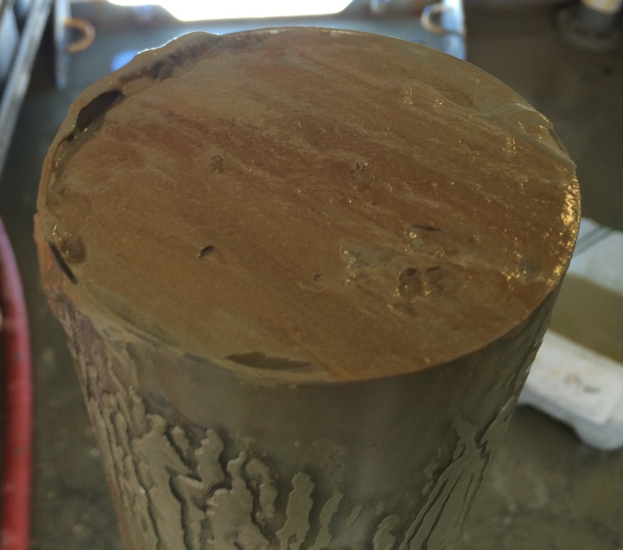
TAN1613-53
(Hik 21)
Core is located on the seafloor above the Hikurangi Channel, which would require the turbidity current to avulse the ~250 m deep channel.
Oxidized sediment underlying turbidite

Slide 26
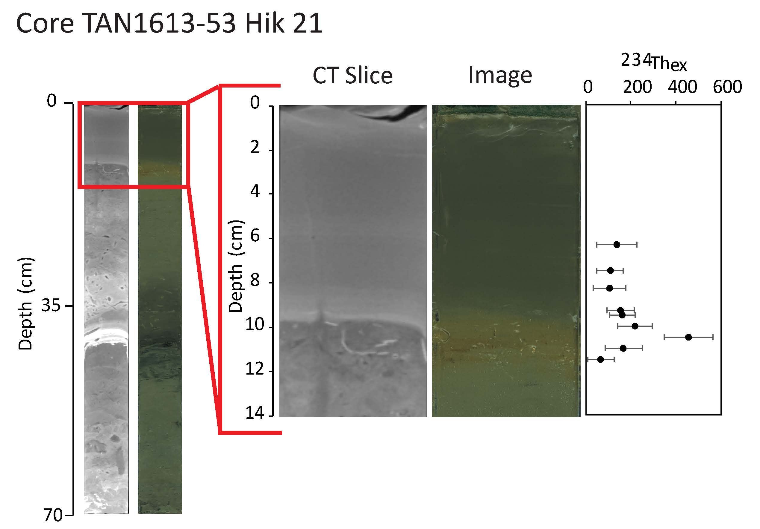
²³⁴Th Half-Life = 24.1 Days
No Bioturbation
Bioturbation
Oxidized
Pre-Earthquake Seafloor
Upward Fining Deposit
Deposited
“Yesterday”

Slide 27
Yellow circles show locations where the co-seismic turbidite has been sampled, scaled to deposit thickness (T). The bottom right inset shows the detailed morphology of the entrenched Hikurangi Channel with some of the co-seismic turbidite sample sites indicated by stars

Slide 28
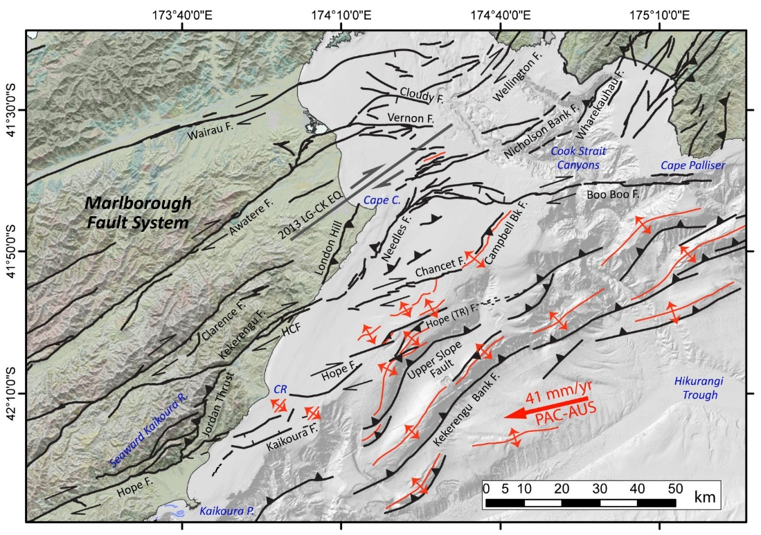
Marine geoscience response to the Nov. 14th Mw 7.8 Kaikōura earthquake
2. Helping to characterise the distribution and location of faults that ruptured during the November 14th Mw 7.8 Kaikōura Earthquake
Community geoscience response data indicates that some on-land faults ruptured with large displacements at the coast line.
On Tangaroa we undertook seafloor mapping and profiling of the Needles and Chancet faults, two major structures offshore of the Kekerengu Fault
Onshore fault breaks in Yellow, provided by GNS Science

Slide 29
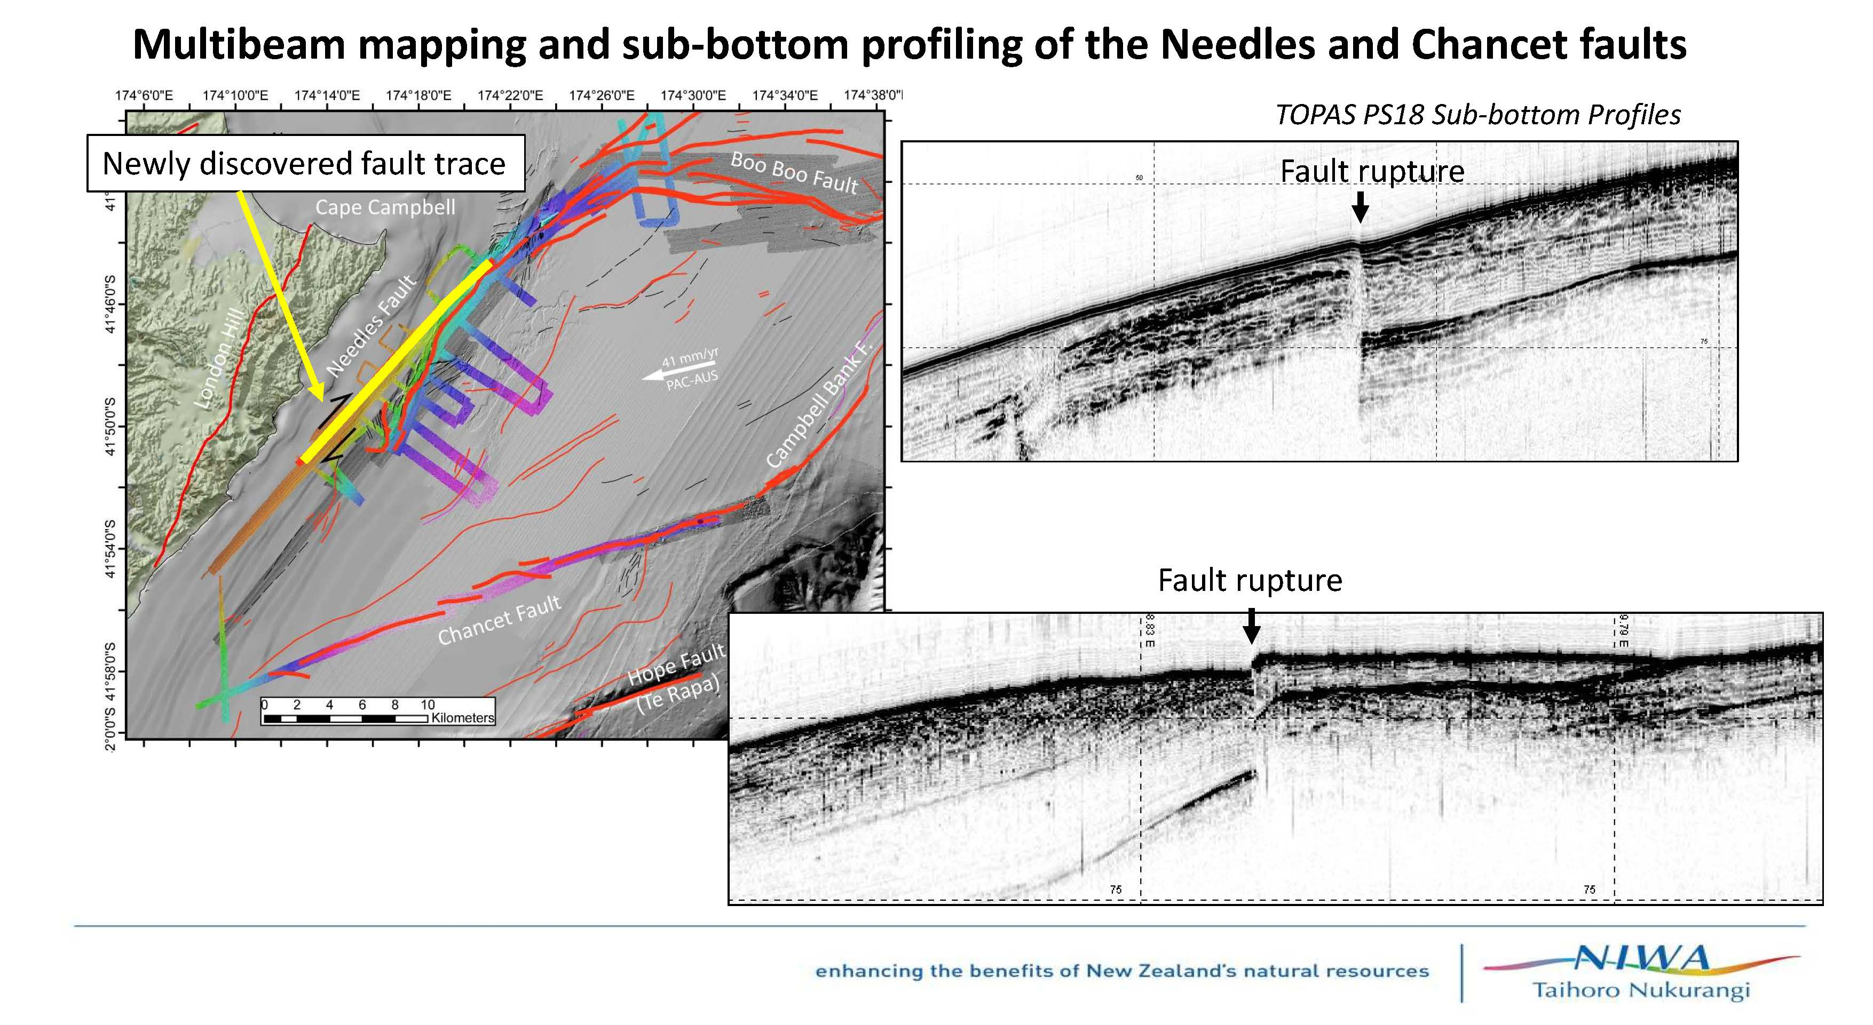
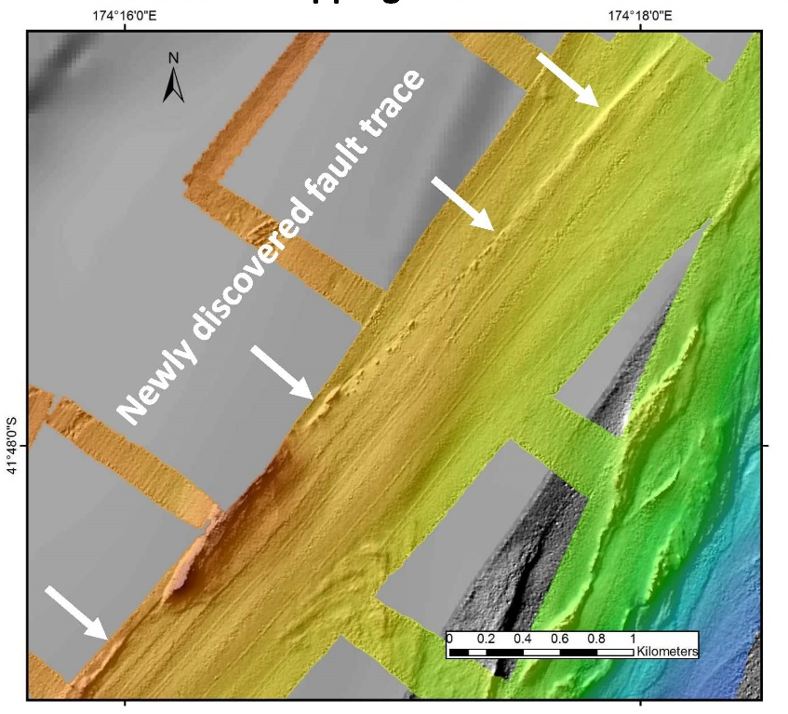
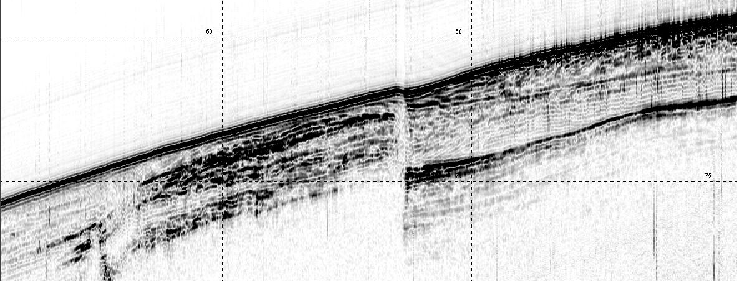
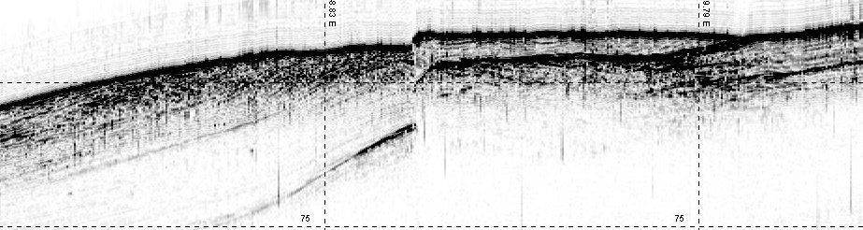
Multibeam mapping and sub-bottom profiling of the Needles and Chancet faults
TOPAS PS18 Sub-bottom Profiles
Fault rupture
Fault rupture

Slide 30
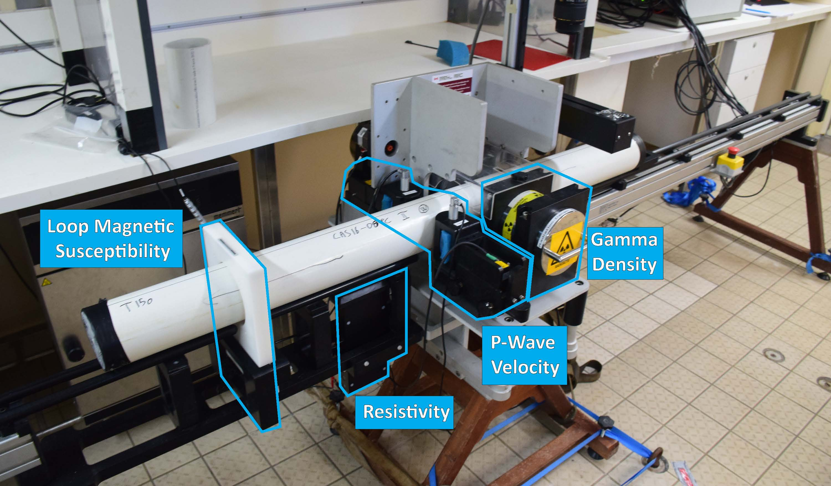
Next Steps:
Sediment Cores:
CT Scanning of cores
Petrophysical Analyses and Correlation
Physical Sedimentology
Radioisotopic Analyses
Additional Complimentary:
Slope Stability Analyses
Ecologic Analyses
Multi Sensor Core Logger
Petrophysics: magnetic susceptibility, gamma density, p-wave velocity, resistivity
Other: imagery (RGB)
*

Slide 31
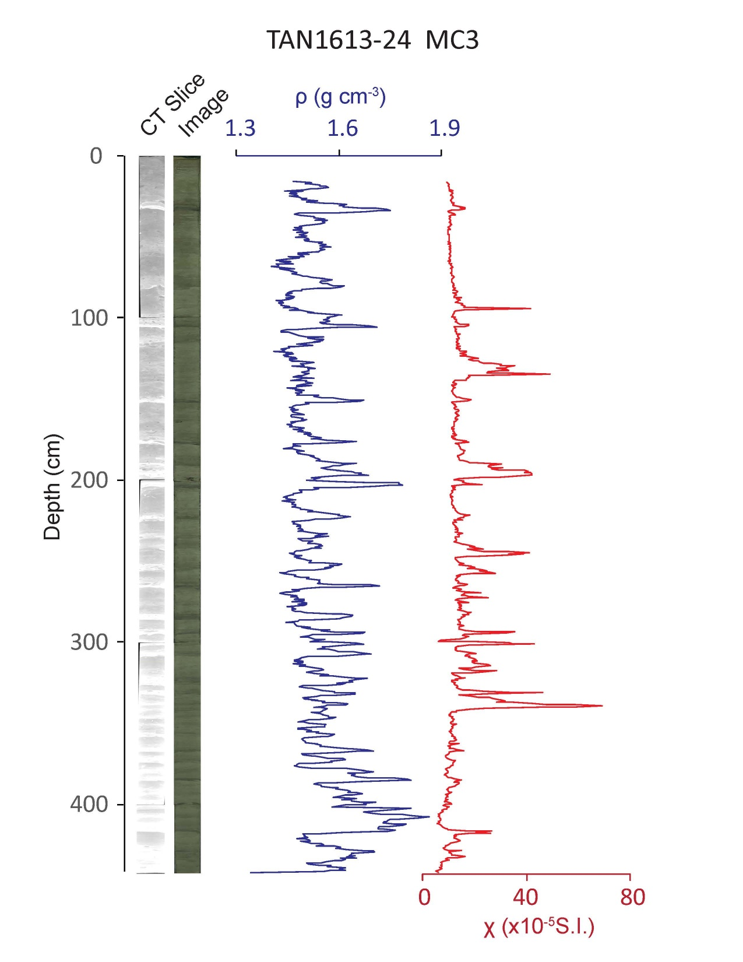
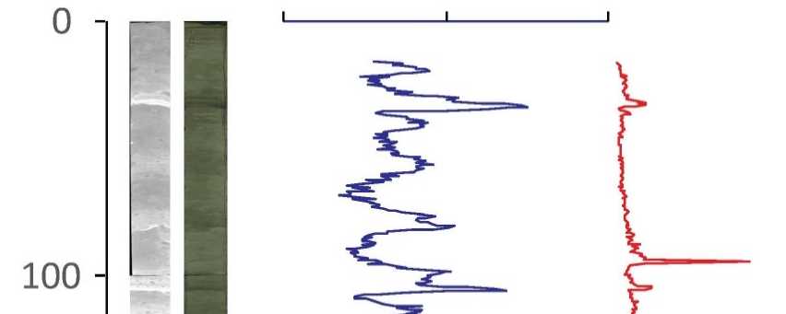
Preliminary Results
Imagery:
CT and RGB
Petrophysics:
γ Density and Magnetic Susceptibility
*

Slide 32
Preliminary results 1 – Coseismic turbidite study
The 14th Nov. Mw 7.8 earthquake generated a widespread turbidity current in the Hikurangi Trough offshore of Marlborough and Wairarapa.
We detected a very recently emplaced turbidite about 10-20 cm thick over a very large region, extending at least 300 km from Kaikōura.
The turbidite was still settling on the seabed from the water column. Final deposition may take many more days.
Our preliminary interpretation has been confirmed with detailed laboratory analysis and dating of the sediment.
The precise location of the submarine landslides that generated the turbidity current has not been fully studied. However, some large landslides have been identified in multibeam surveys conducted by NIWA.
*

Slide 33
Preliminary results 2 – Coseismic rupture of the Needles Fault
New mapping and profiling on the continental shelf by NIWA research vessel Tangaroa confirms that the submarine Needles fault ruptured in the Nov. 14th Mw 7.8 earthquake forming new scarps on the seafloor along the NE Marlborough coast south of Cape Campbell.
This fault is an offshore extension of the Kekerengu Fault, on which earthquake displacements of 5-10 m occurred on land.
The offshore rupture appears to have extended at least 20 km offshore, but data collected in the last 24 hours! - needs analysis to confirm the distribution.
These marine data will help inform understanding of the entire fault network activated during the earthquake.
*

Slide 34
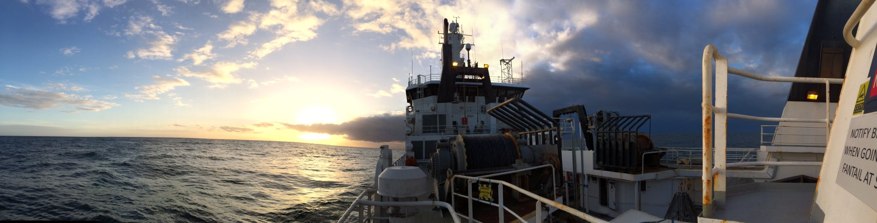
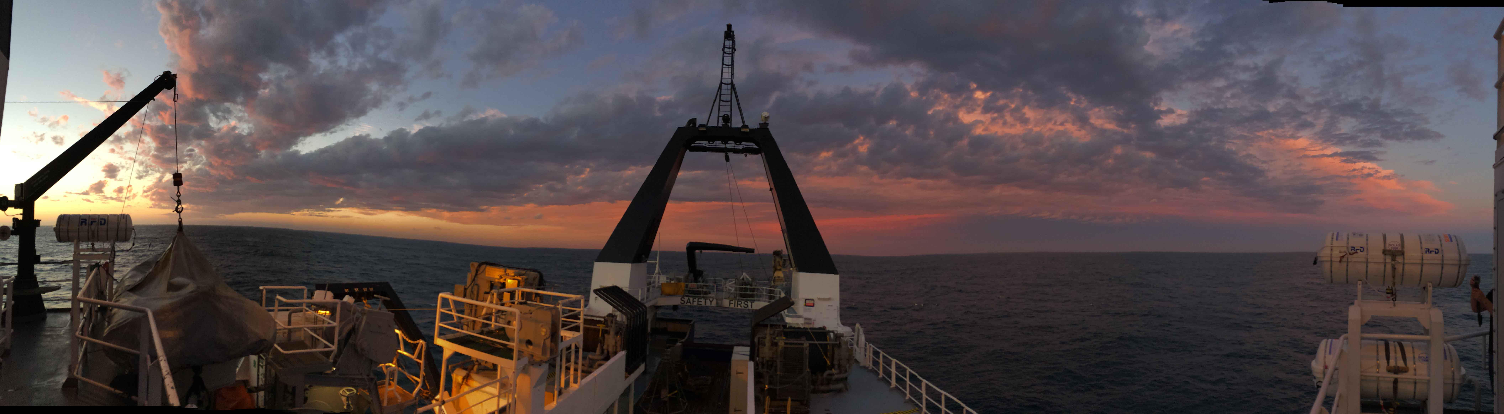
Thanks for your time!

Slide 35
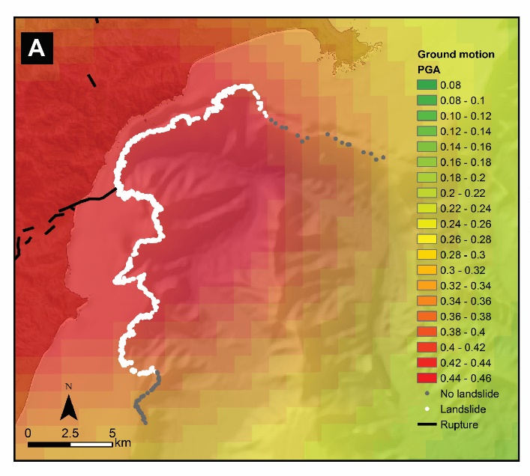
Comparison of ground motion simulation for the Hundalee fault using the GMPE for site class C and the distribution of landsliding on the canyon rim triggered by the Kaikōura earthquake.
Mountjoy et al., submitted
Notes:
Ground motion prediction and recurrence interval estimate for canyon flushing triggered by widespread failure of the Kaikōura Canyon rim. A) Comparison of ground motion simulation for the Hundalee fault using the GMPE for site class C (12) and the distribution of landsliding on the canyon rim triggered by the Kaikōura earthquake. B) Hazard curve derived from the Kaikōura Canyon from the NSHM used to derived recurrence interval estimates for PGA.

Slide 36
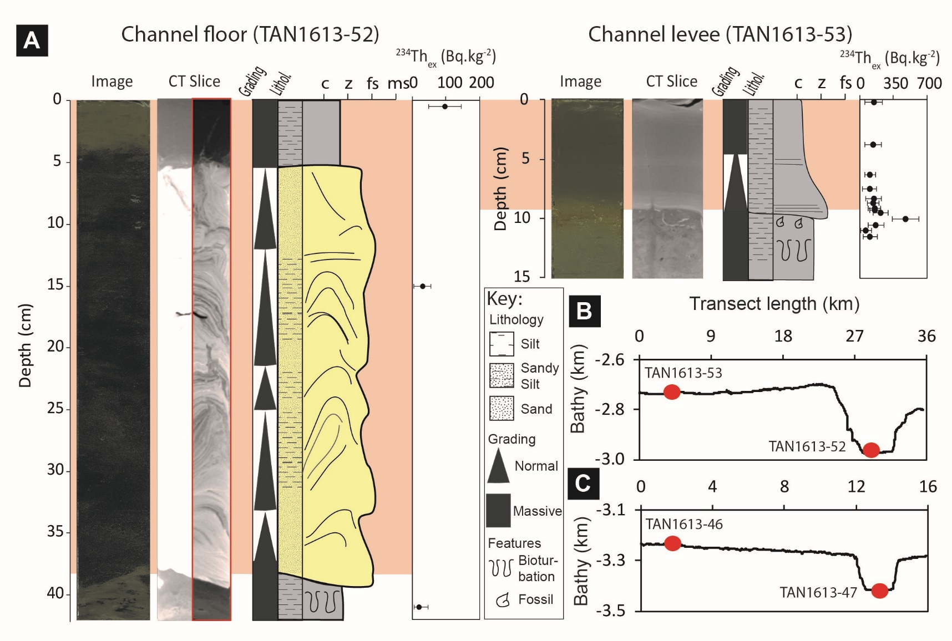

Slide 38
