Slide 1
Induced Seismicity
Last updated: July 2015

Slide 2
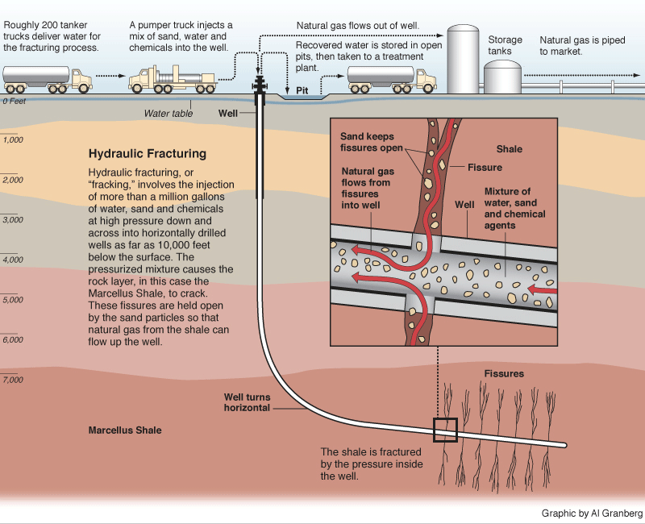
Hydraulic Fracturing
Graphic by Al Granberg

Slide 3
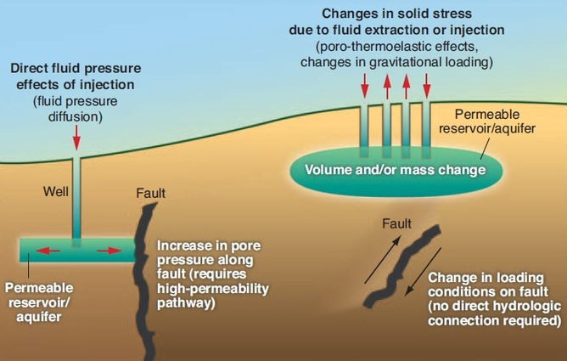
Effects of Injection on Faults
Figure from Ellsworth, Science, 2013

Slide 4
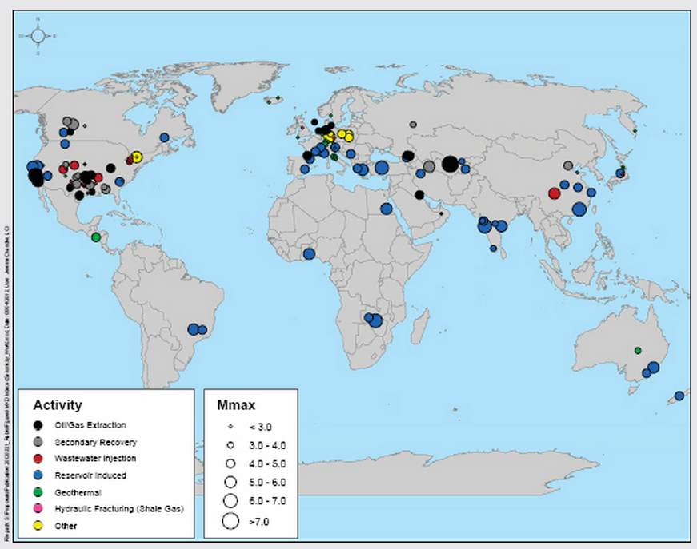
Worldwide Locations of Potentially Induced Seismicity
National Academies of Science, 2012

Slide 5
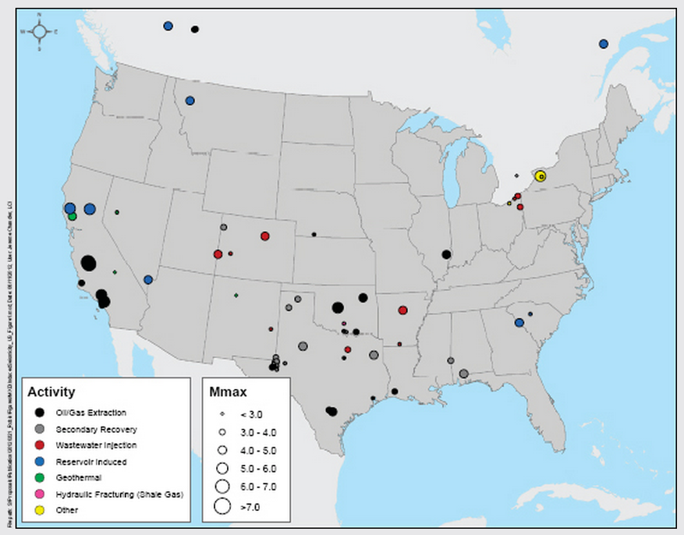
US Locations of Potentially Induced Seismicity
National Academies of Science, 2012

